Slide 1
WEALTHY AND HEALTHY
Nutritious value of fruits and vegetables
By: Duru TARI

Slide 2
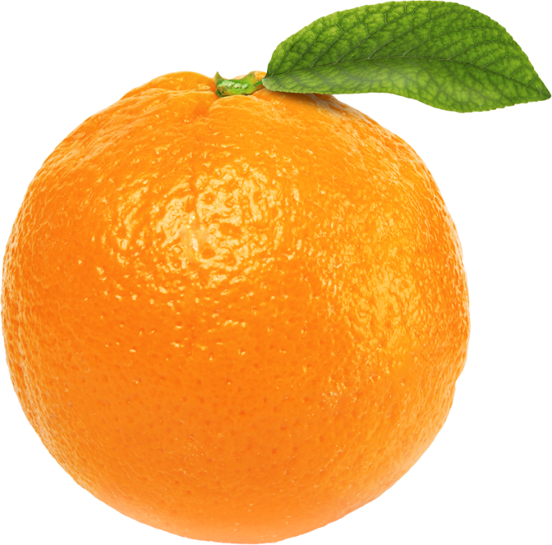
orange
Oranges are a healthy source of fiber, vitamin C, thiamin, folate and antioxidants. Oranges are mainly composed of carbs and water, and contain very low amounts of both protein and fat. They are also low in calories. It is grown in Çukurova, Antalya and Hatay.

Slide 3
apples
Apples are high in fiber, vitamin C and various antioxidants. They are also very filling, considering their low calorie content. It is grown in Amasya, Tokat, Kastamonu, Burdur, Bursa, Isparta, Antalya, Nevsehir and Nigde. Actually apples are my favorite because of they are have only 52 calories and their taste is good.

Slide 4
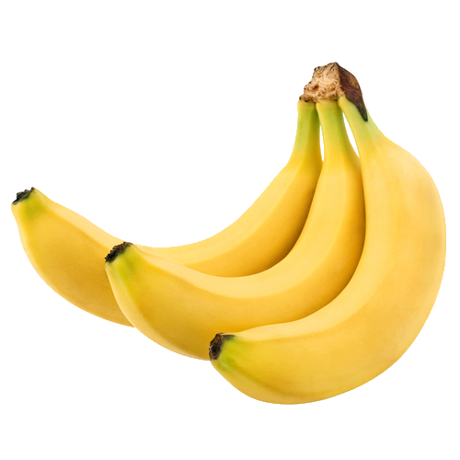
banana
Bananas are a healthy source of fiber, potassium, vitamin B6, vitamin C, and various antioxidants. It is grown in Mediterranean region in Turkey.

Slide 5
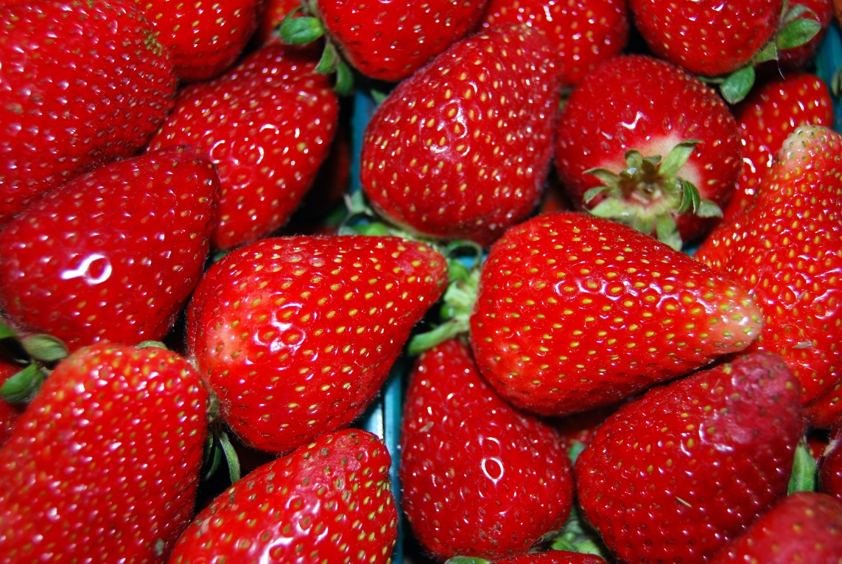
strawberries
They are an excellent source of vitamin C and manganese, and also contain decent amounts of folate (B9) and potassium. It is grown in Mersin,Aydın and Antalya.

Slide 6
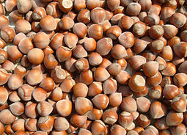
hazelnut
: Hazelnuts provide significant amounts of antioxidants and actually it has B6. It is grown in the North, Blacksea region in Turkey.

Slide 7
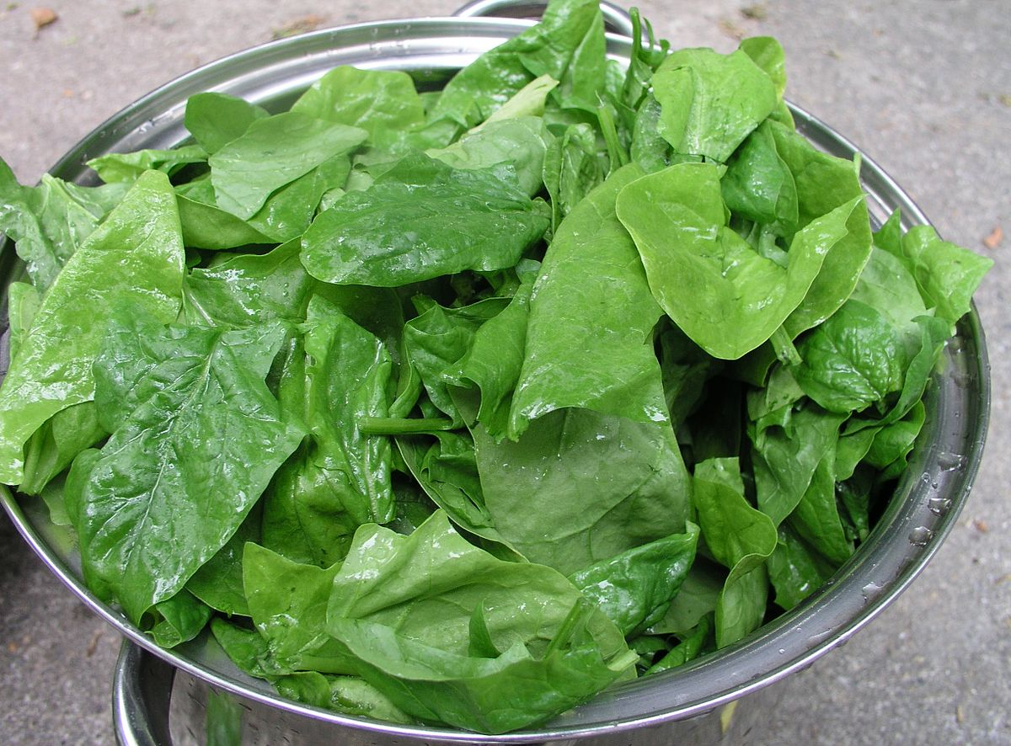
spinach
: Eating spinach is good for your eye health, reduce oxidative stress, help prevent cancer and reduce blood pressure levels. It includes vitamin A,C and K1,folic asit and calcium. It is grown in most of the areas in Turkey.

Slide 8
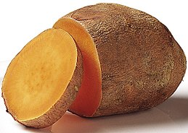
Sweet potato
It is rich in an antioxidant called beta-carotene, which is very effective at raising blood levels of vitamin A. It is my favorite in vegetables. It is sweet and actually i love sweet things. It is grown in Hatay in Turkey.

Slide 9
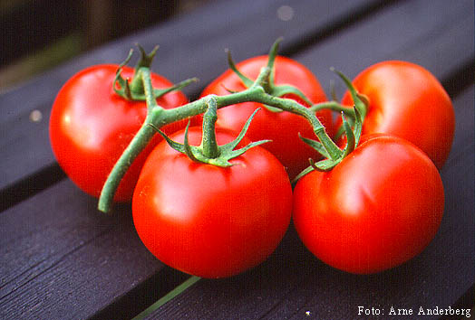
tomatoes
They are also a great source of vitamin C, potassium, folate and vitamin K. It is grown in Antalya, Çanakkale and Mersin.

Slide 10
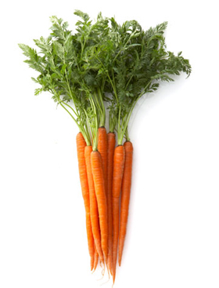
carrot
The traditional orange colored carrots get their bright color from beta-carotene, an antioxidantthat is converted to vitamin A in the body. It is grown in Ankara, Konya, Antalya, Mersin, Hatay, İzmir, Aydın and Manisa

Slide 11
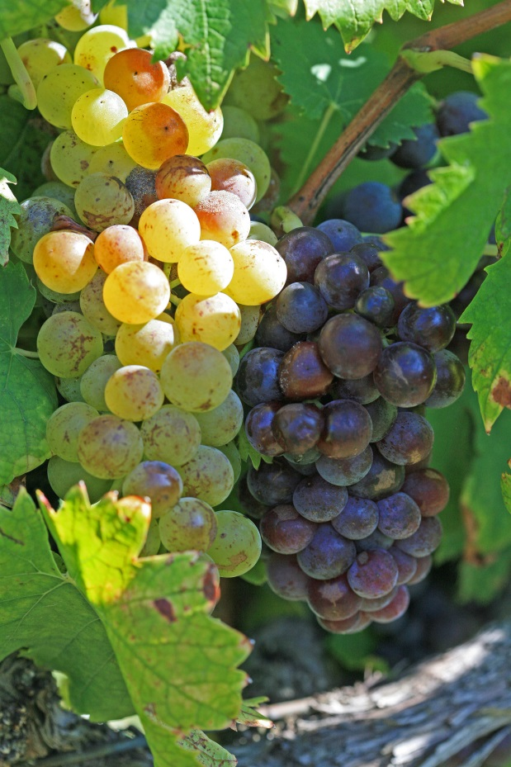
grapes
They are also a good source of vitamin C and it is a powerful antioxidant. It is grown in Erzincan, Manisa, Diyarbakır and Antalya.

