Slide 1
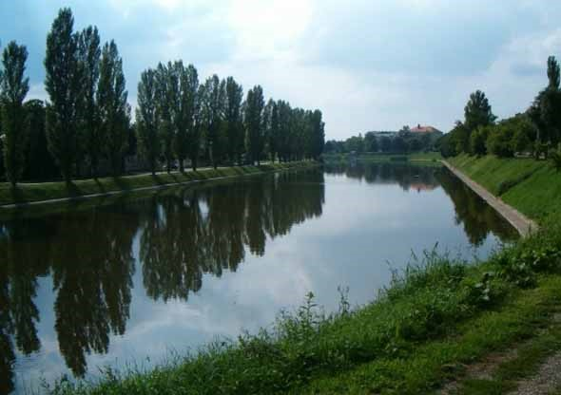
Bosut is river that goes through Vinkovci. We love to say that the river represents us well – it is a bit lazy and slow, sometimes it seems like it does not move at all. Here we love to go fishing or walking up and down the river when days are nice and sunny.
BOSUT
http://www.visitecroatia.com/hr/aktivnosti/priroda/rijeke/

Slide 2
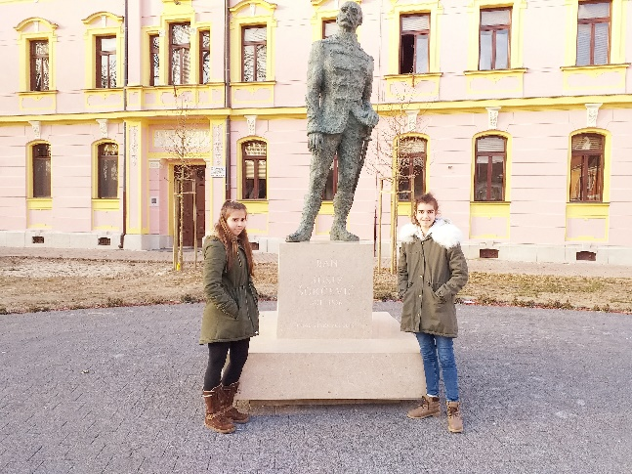
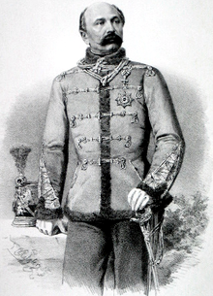
Ban Josip Šokčević statue
He was born on March 7th ,1811 in the town Vinkovci in
Slavonia.
After he finished the military academy he served in Lavov where he was sent to Italian battlefield while there was a war between Italy and Austria.
Later he was promoted and became a major general.
Ten years later ban Josip Jelačić was ill,so Josip Šokčević replaced him
After that in1860th he became a ban.
He died in November 16th,1896.

Slide 3
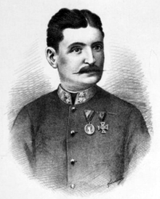
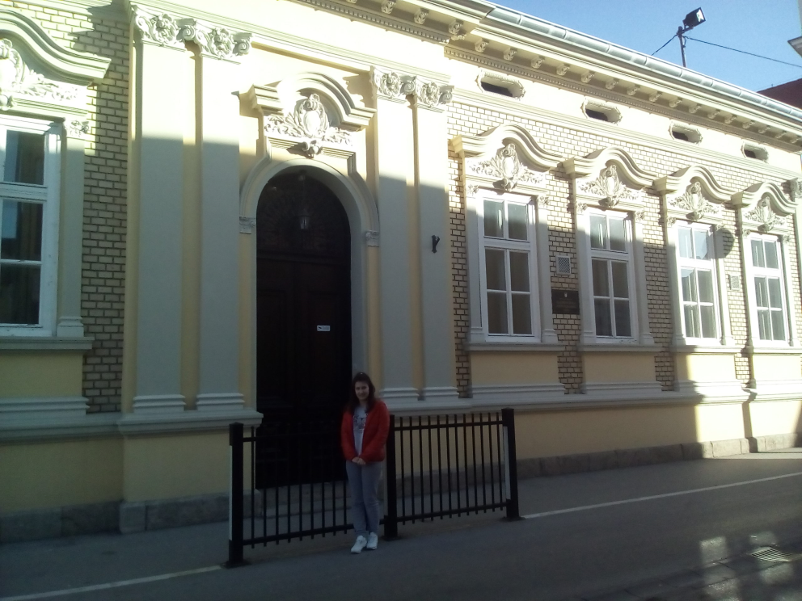
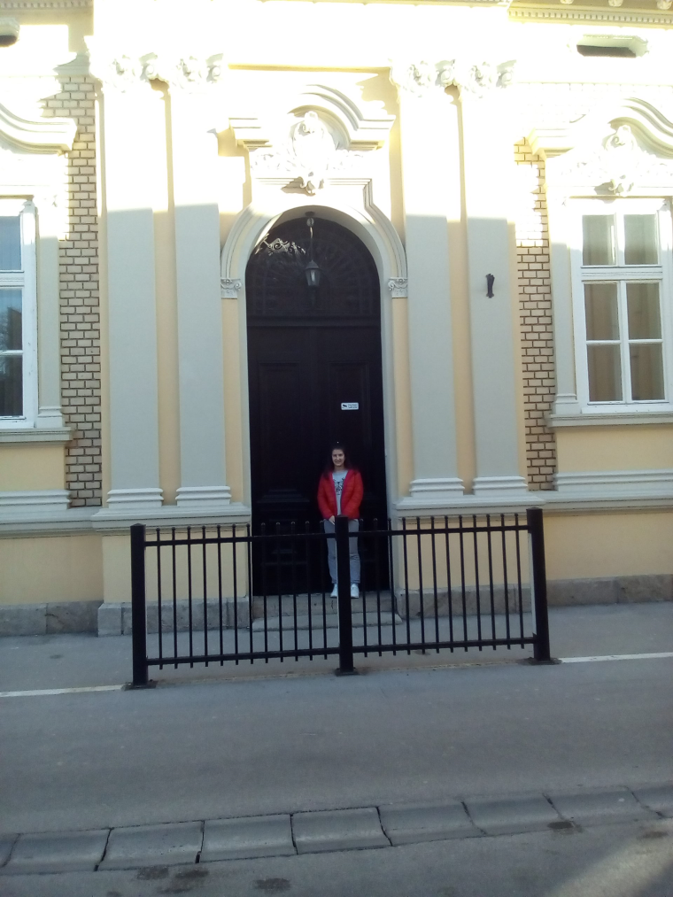
Music school “Josip Runjanin”
It was built in 1953.
Josip Runjanin wrote Croatian anthem.
Many students attend this school along with
the regular one, they learn how to sing and play various
instruments here.

Slide 4
HNK Cibalia-Vinkovci stadium
HNK Cibalia Vinkovci is a football club from Vinkovci, it was founded in 1919.
Cibalia’s stadium was built in 1966. It has 10 000 seats.

Slide 5
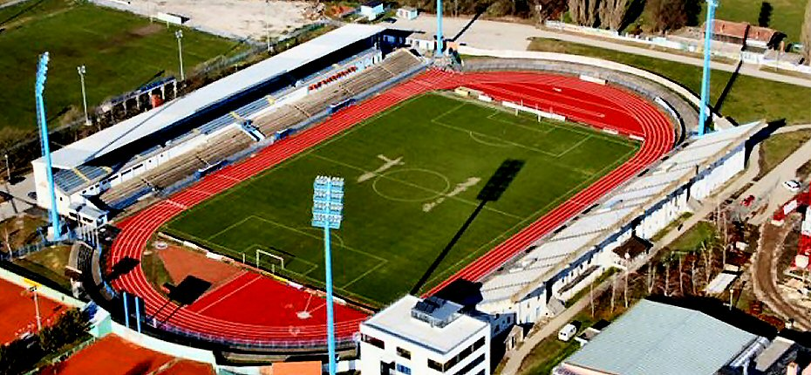
HNK Cibalia Stadium Football club Cibalia is named after the Roman name for Vinkovci. The club was founded in 1919., and the stadium built in 1966.

Slide 6
Lamp - Vinkovci symbol
This lamp is a symbol of Vinkovci, it is entioned in a famous song about our town .
Lamp is placed in central Vinkovci square and on this location concerts, performances and other events ar held.

Slide 7
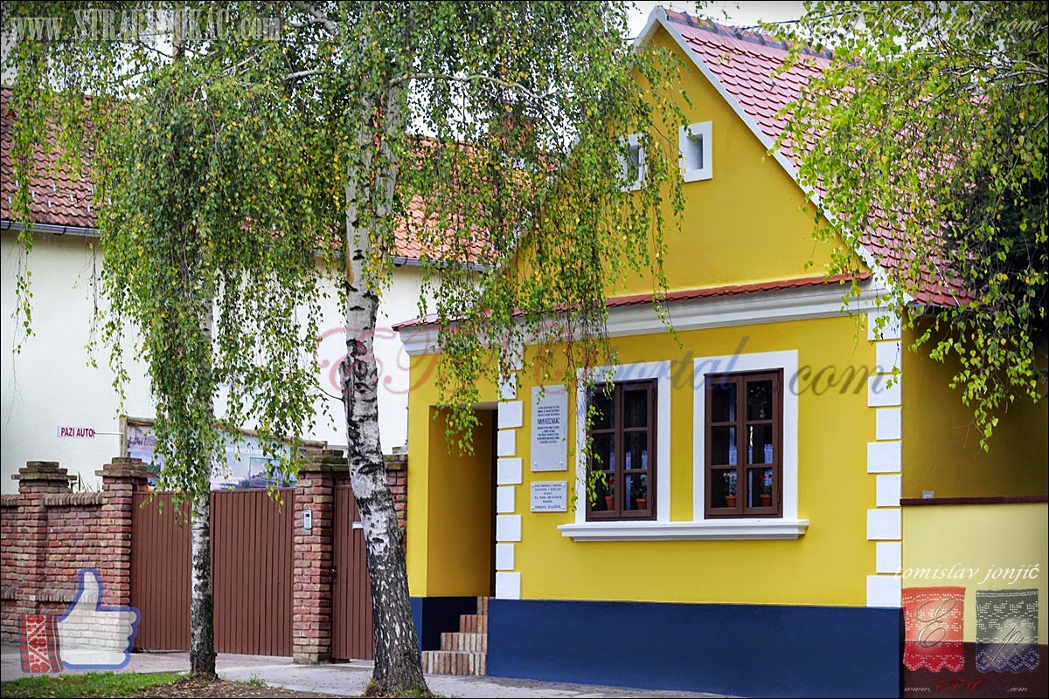
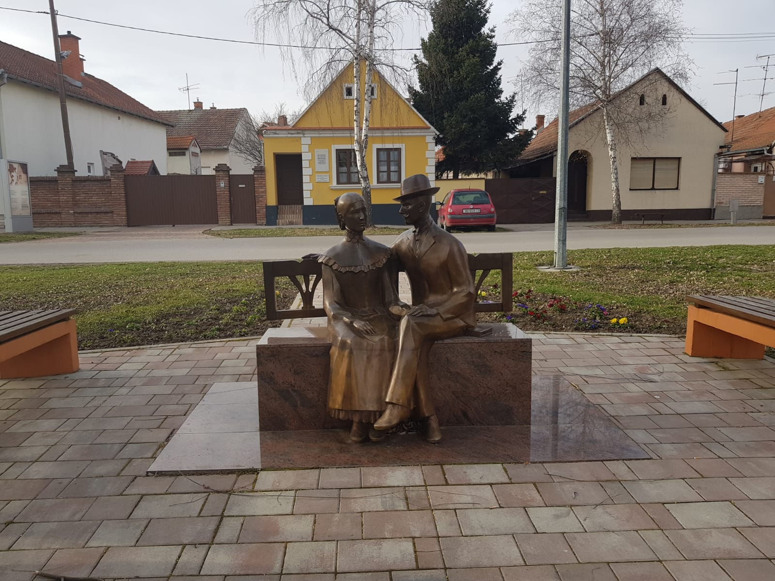
Ivan Kozarac was famous writer from Croatia. He was born in Vinkovci on February 8th 1885. and died on 16th of October 1910. On this picture I am sitting next to Marija and Ivan. Ivan fell in love with Marija but they couldn’t be together because they were in blood relations.
http://www.etnoportal.com/otvorena-rodna-kuca-ivana-kozarca-u-vinkovcima/

Slide 8
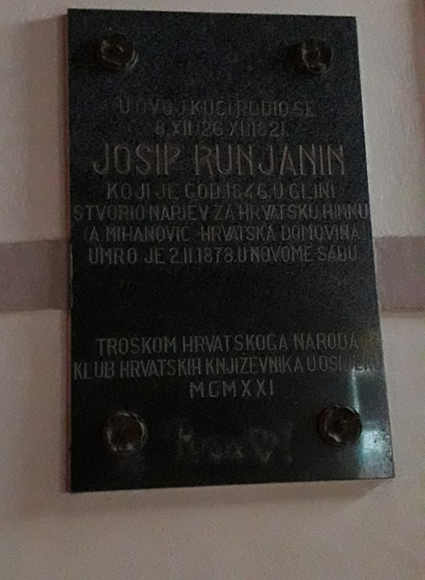
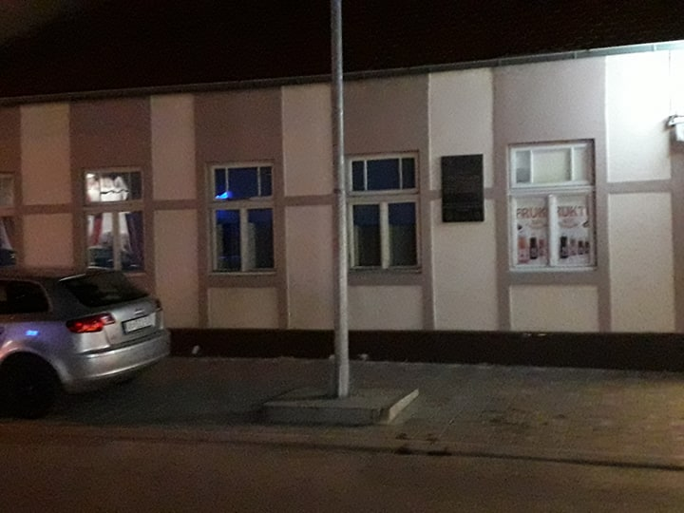
Birth house of Josip Runjanin
Josip Runjanin was born in Vinkovci. He was a composer and an officer in the Austrian-Hungarian anrmy. He composed music of Croatia’s national anthem Lijepa naša.

Slide 9
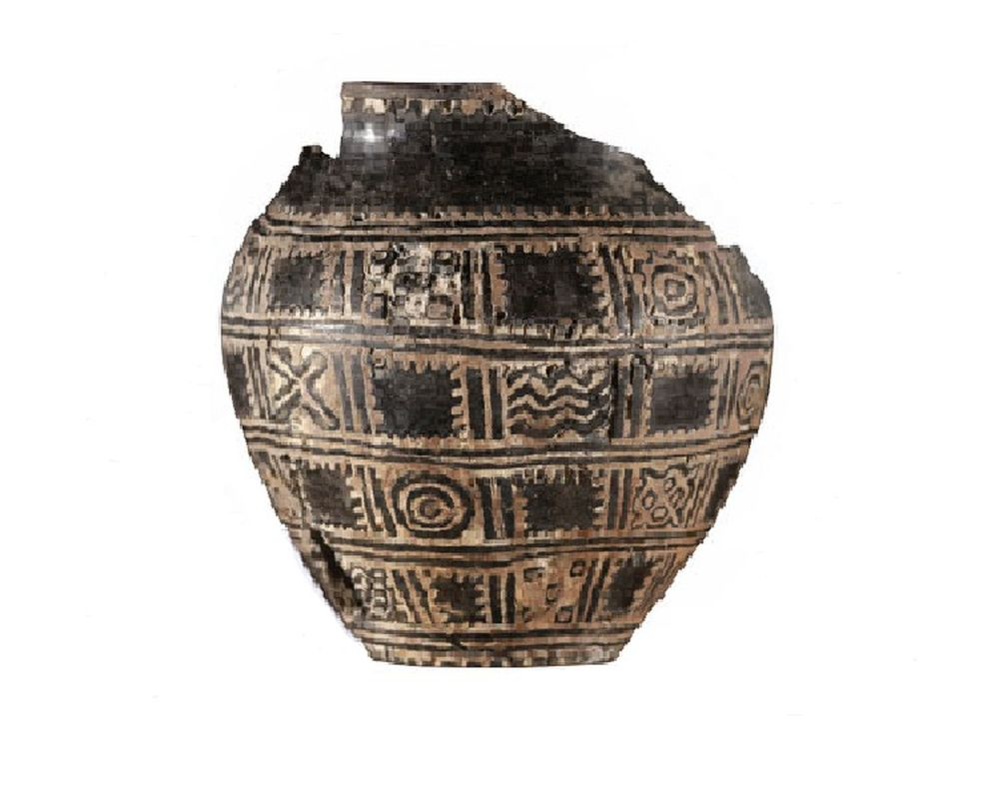
ORION- THE OLDEST EUROPEAN CALENDAR
Orion calendar was found in 1976 and it’s the oldest European calendar and valuable archeological achievement. Today we have a pedestrian zone with ornaments of the oldest European calendar. The pedestrian zone is a part of symbolic constellation. Orion in pedestrion zone in Vinkovci represents pride of all citizens, because they come from a town that has been inhabited for 9 000 years.

