Slide 1
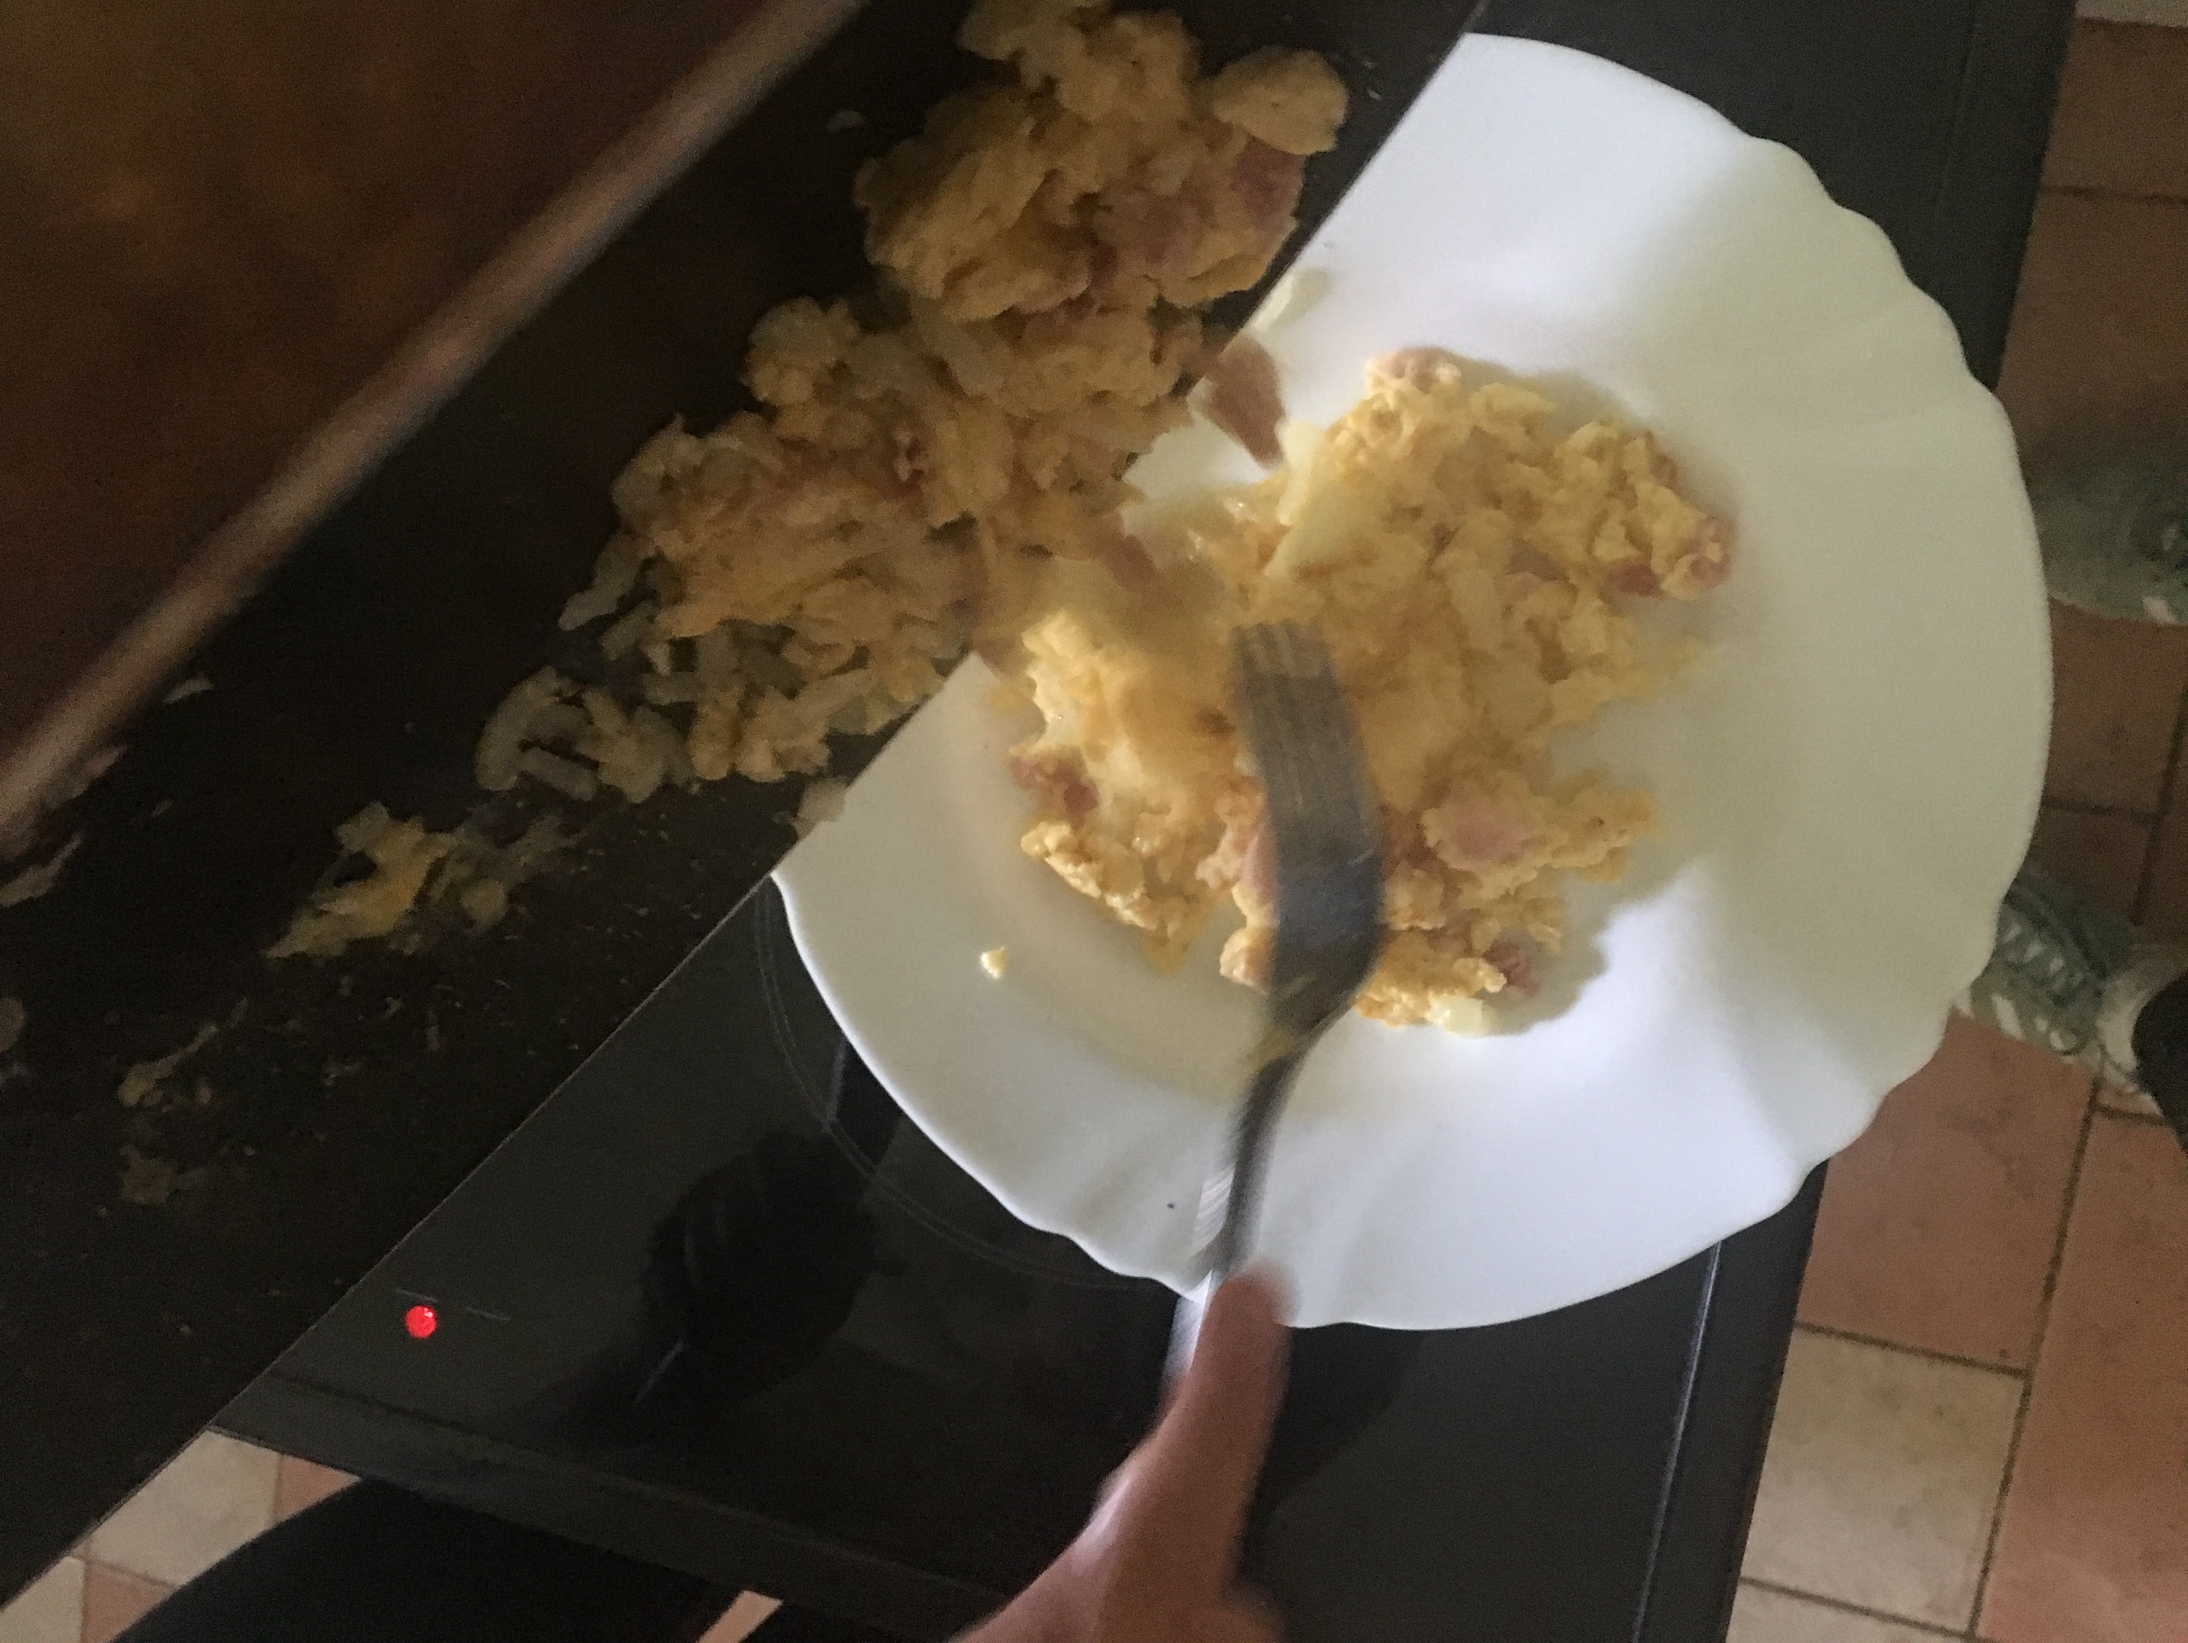
SCRAMBLED EGGS WITH HAM AND ONIONS
ANA SRPAK 7.A

Slide 2
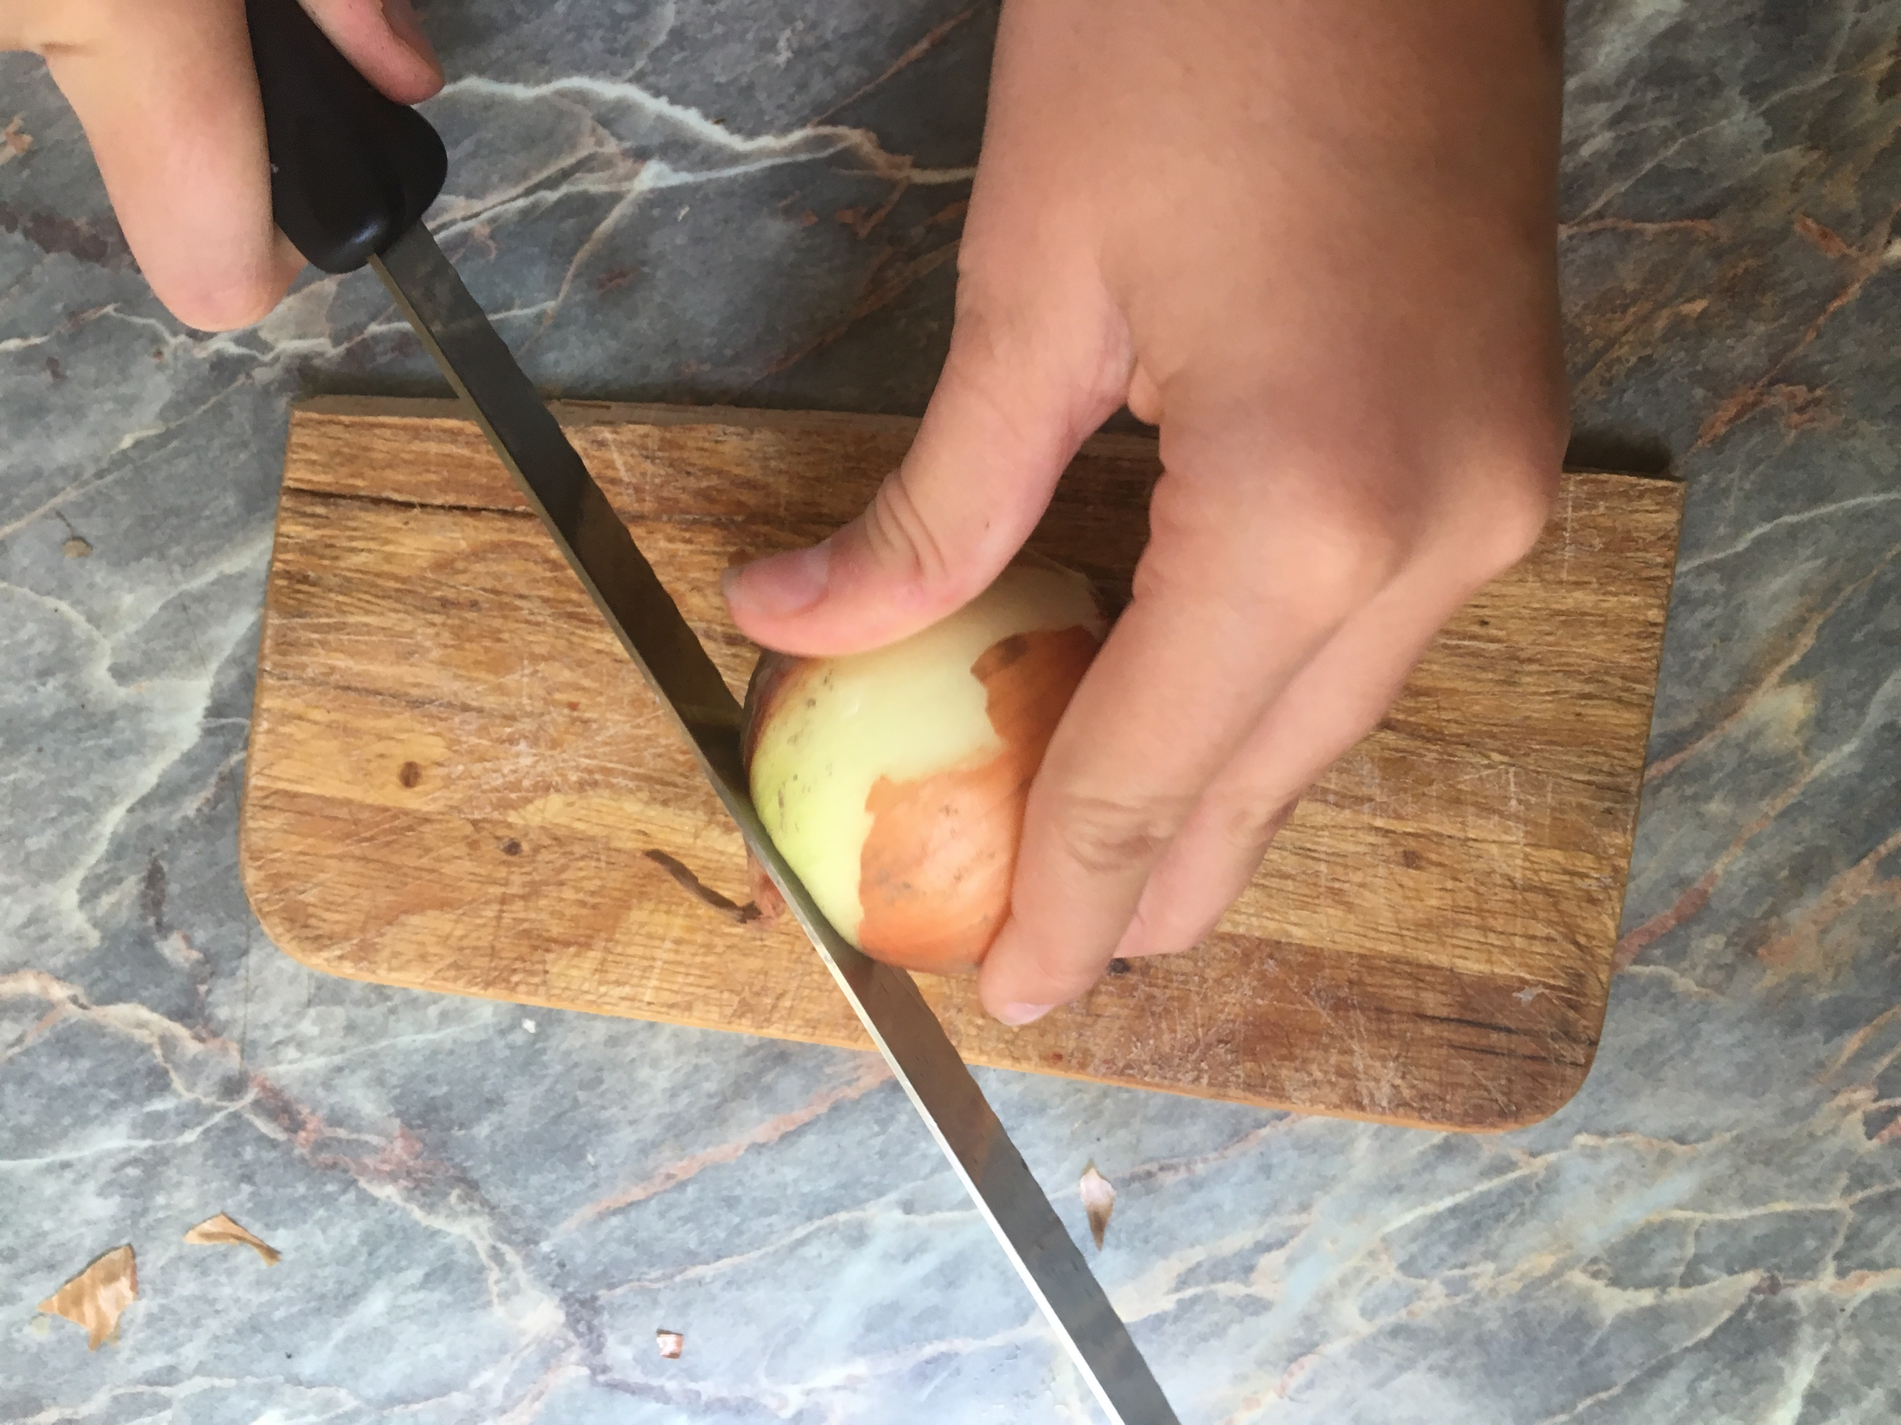
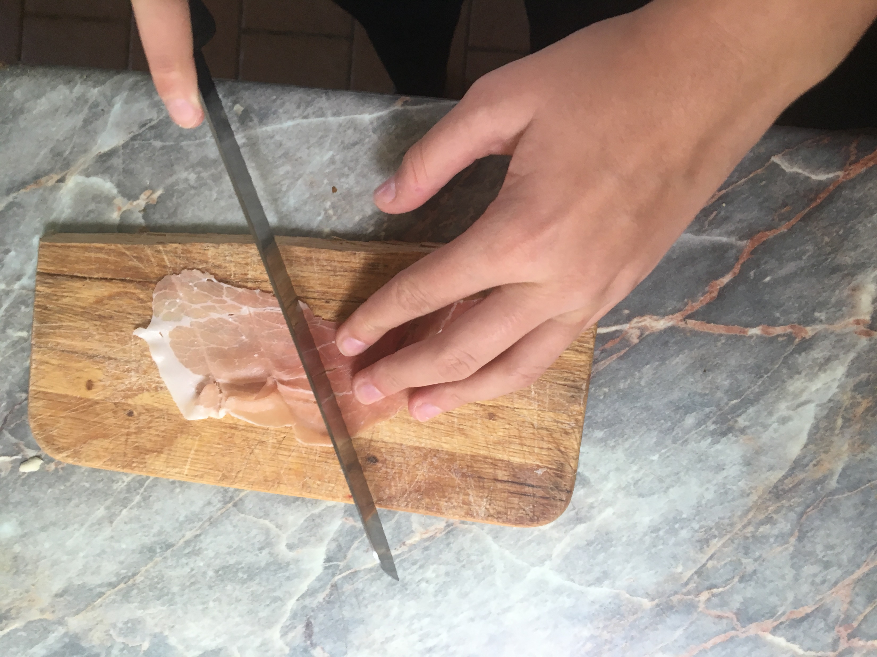
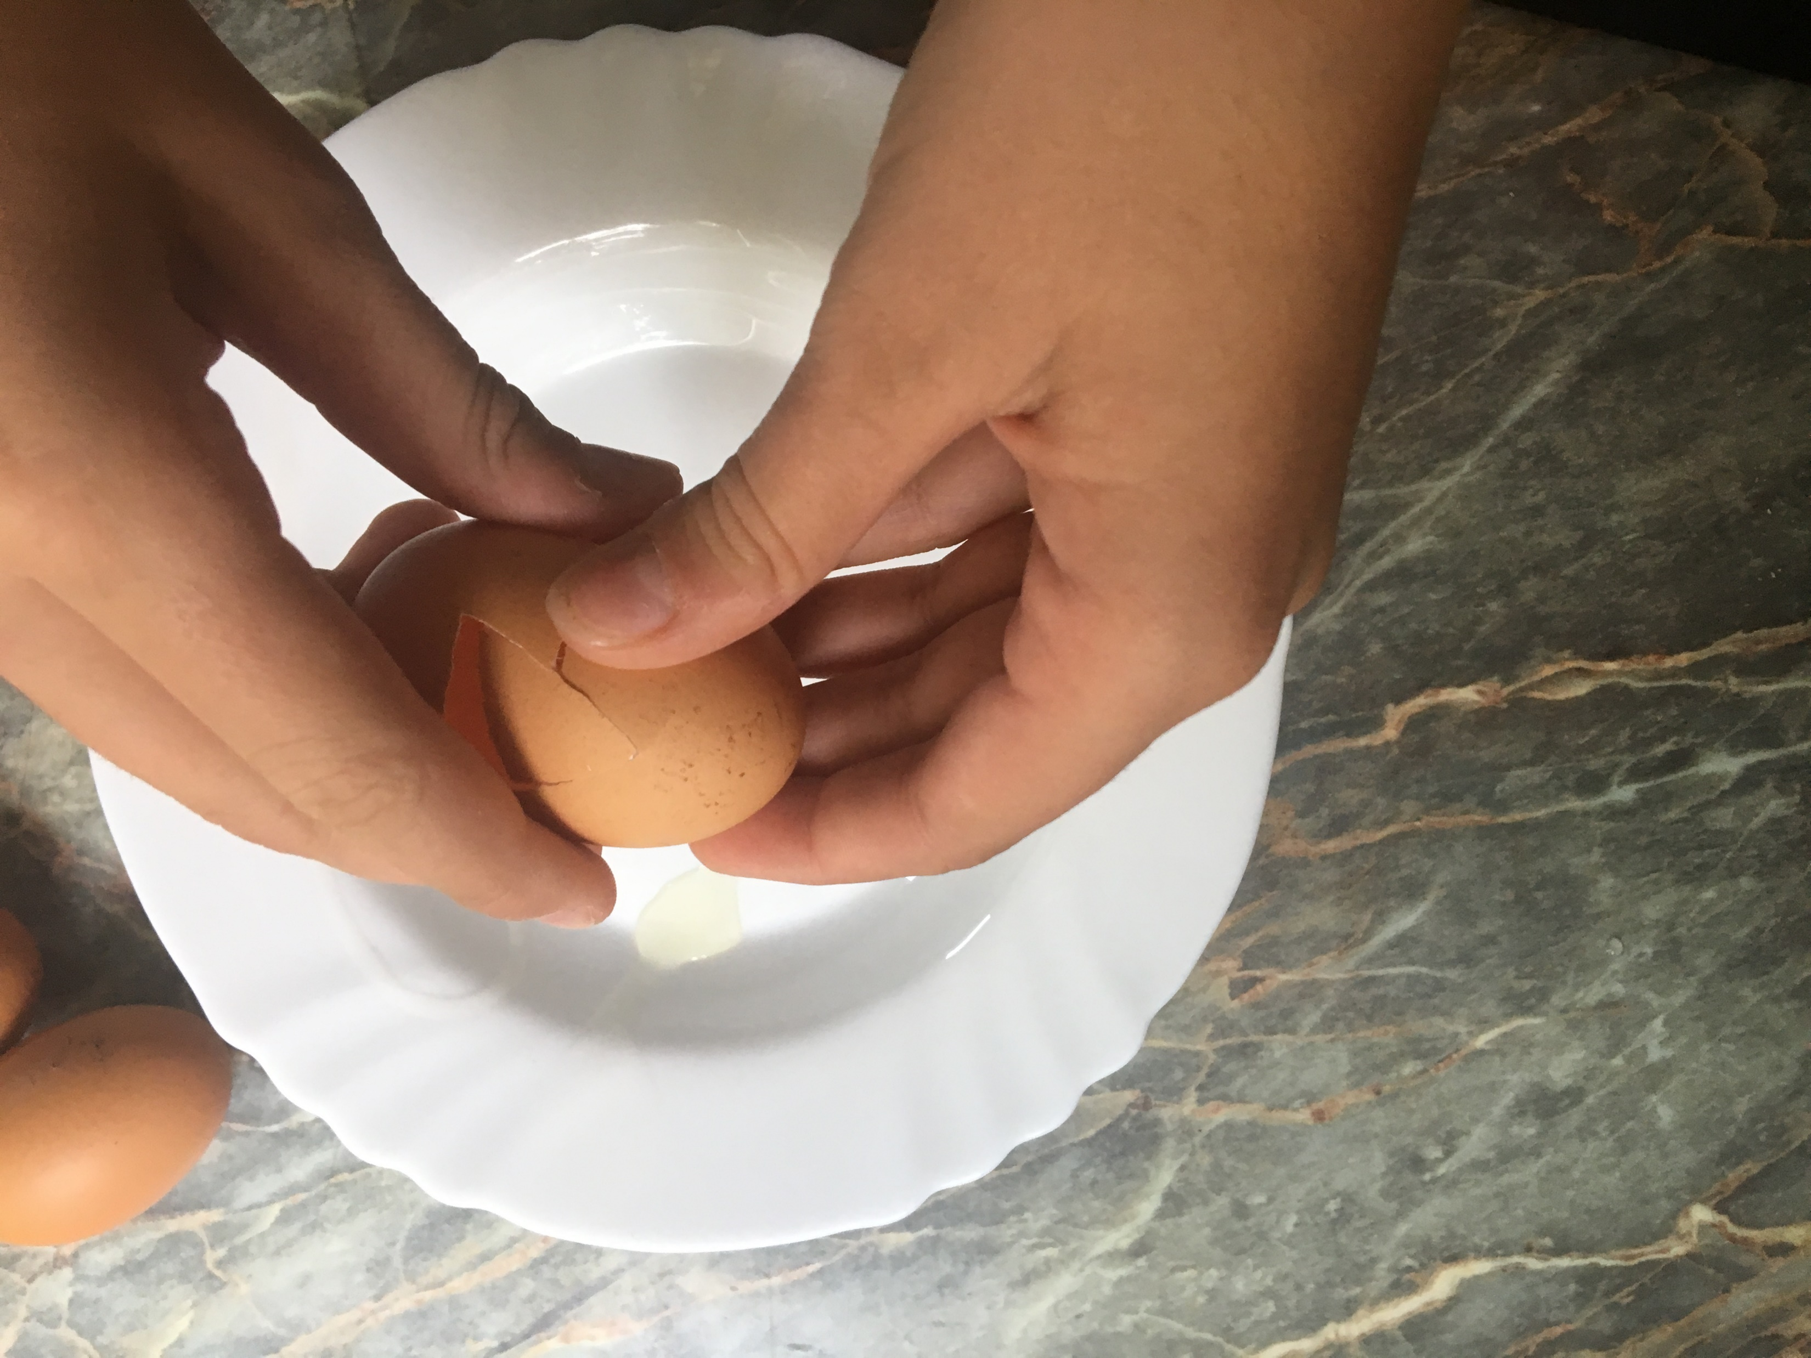
Ingridients
You will need:
2-3 eggs (it’s option to you)
1-2 slieces of ham
One small onion
Oil

Slide 3
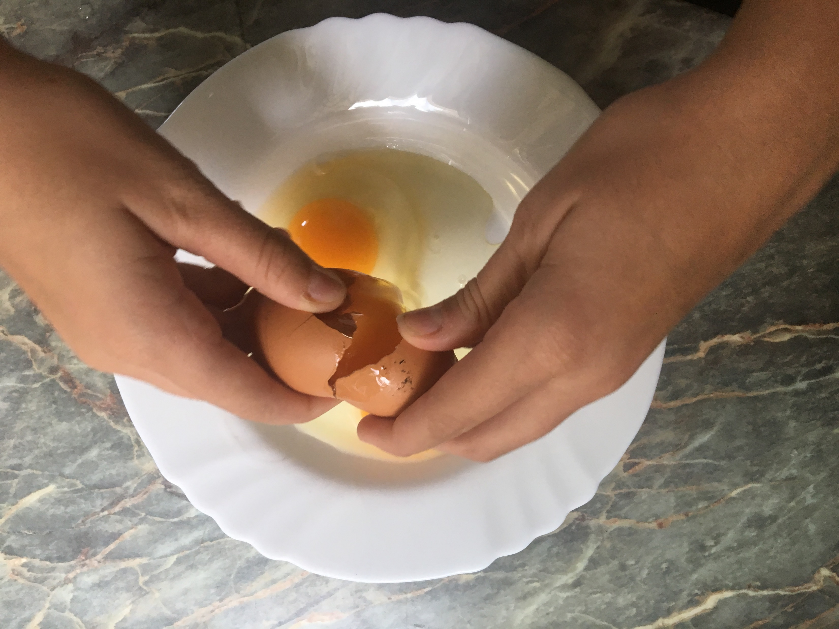
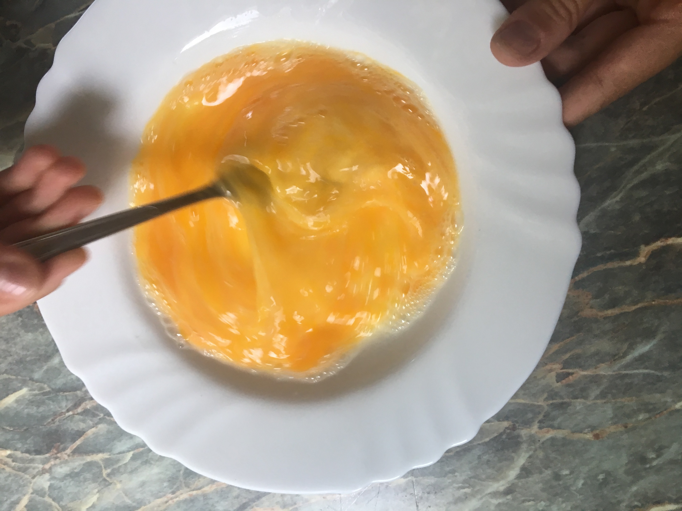
First step
First you will crack your eggs in one plate and mix them with fork

Slide 4
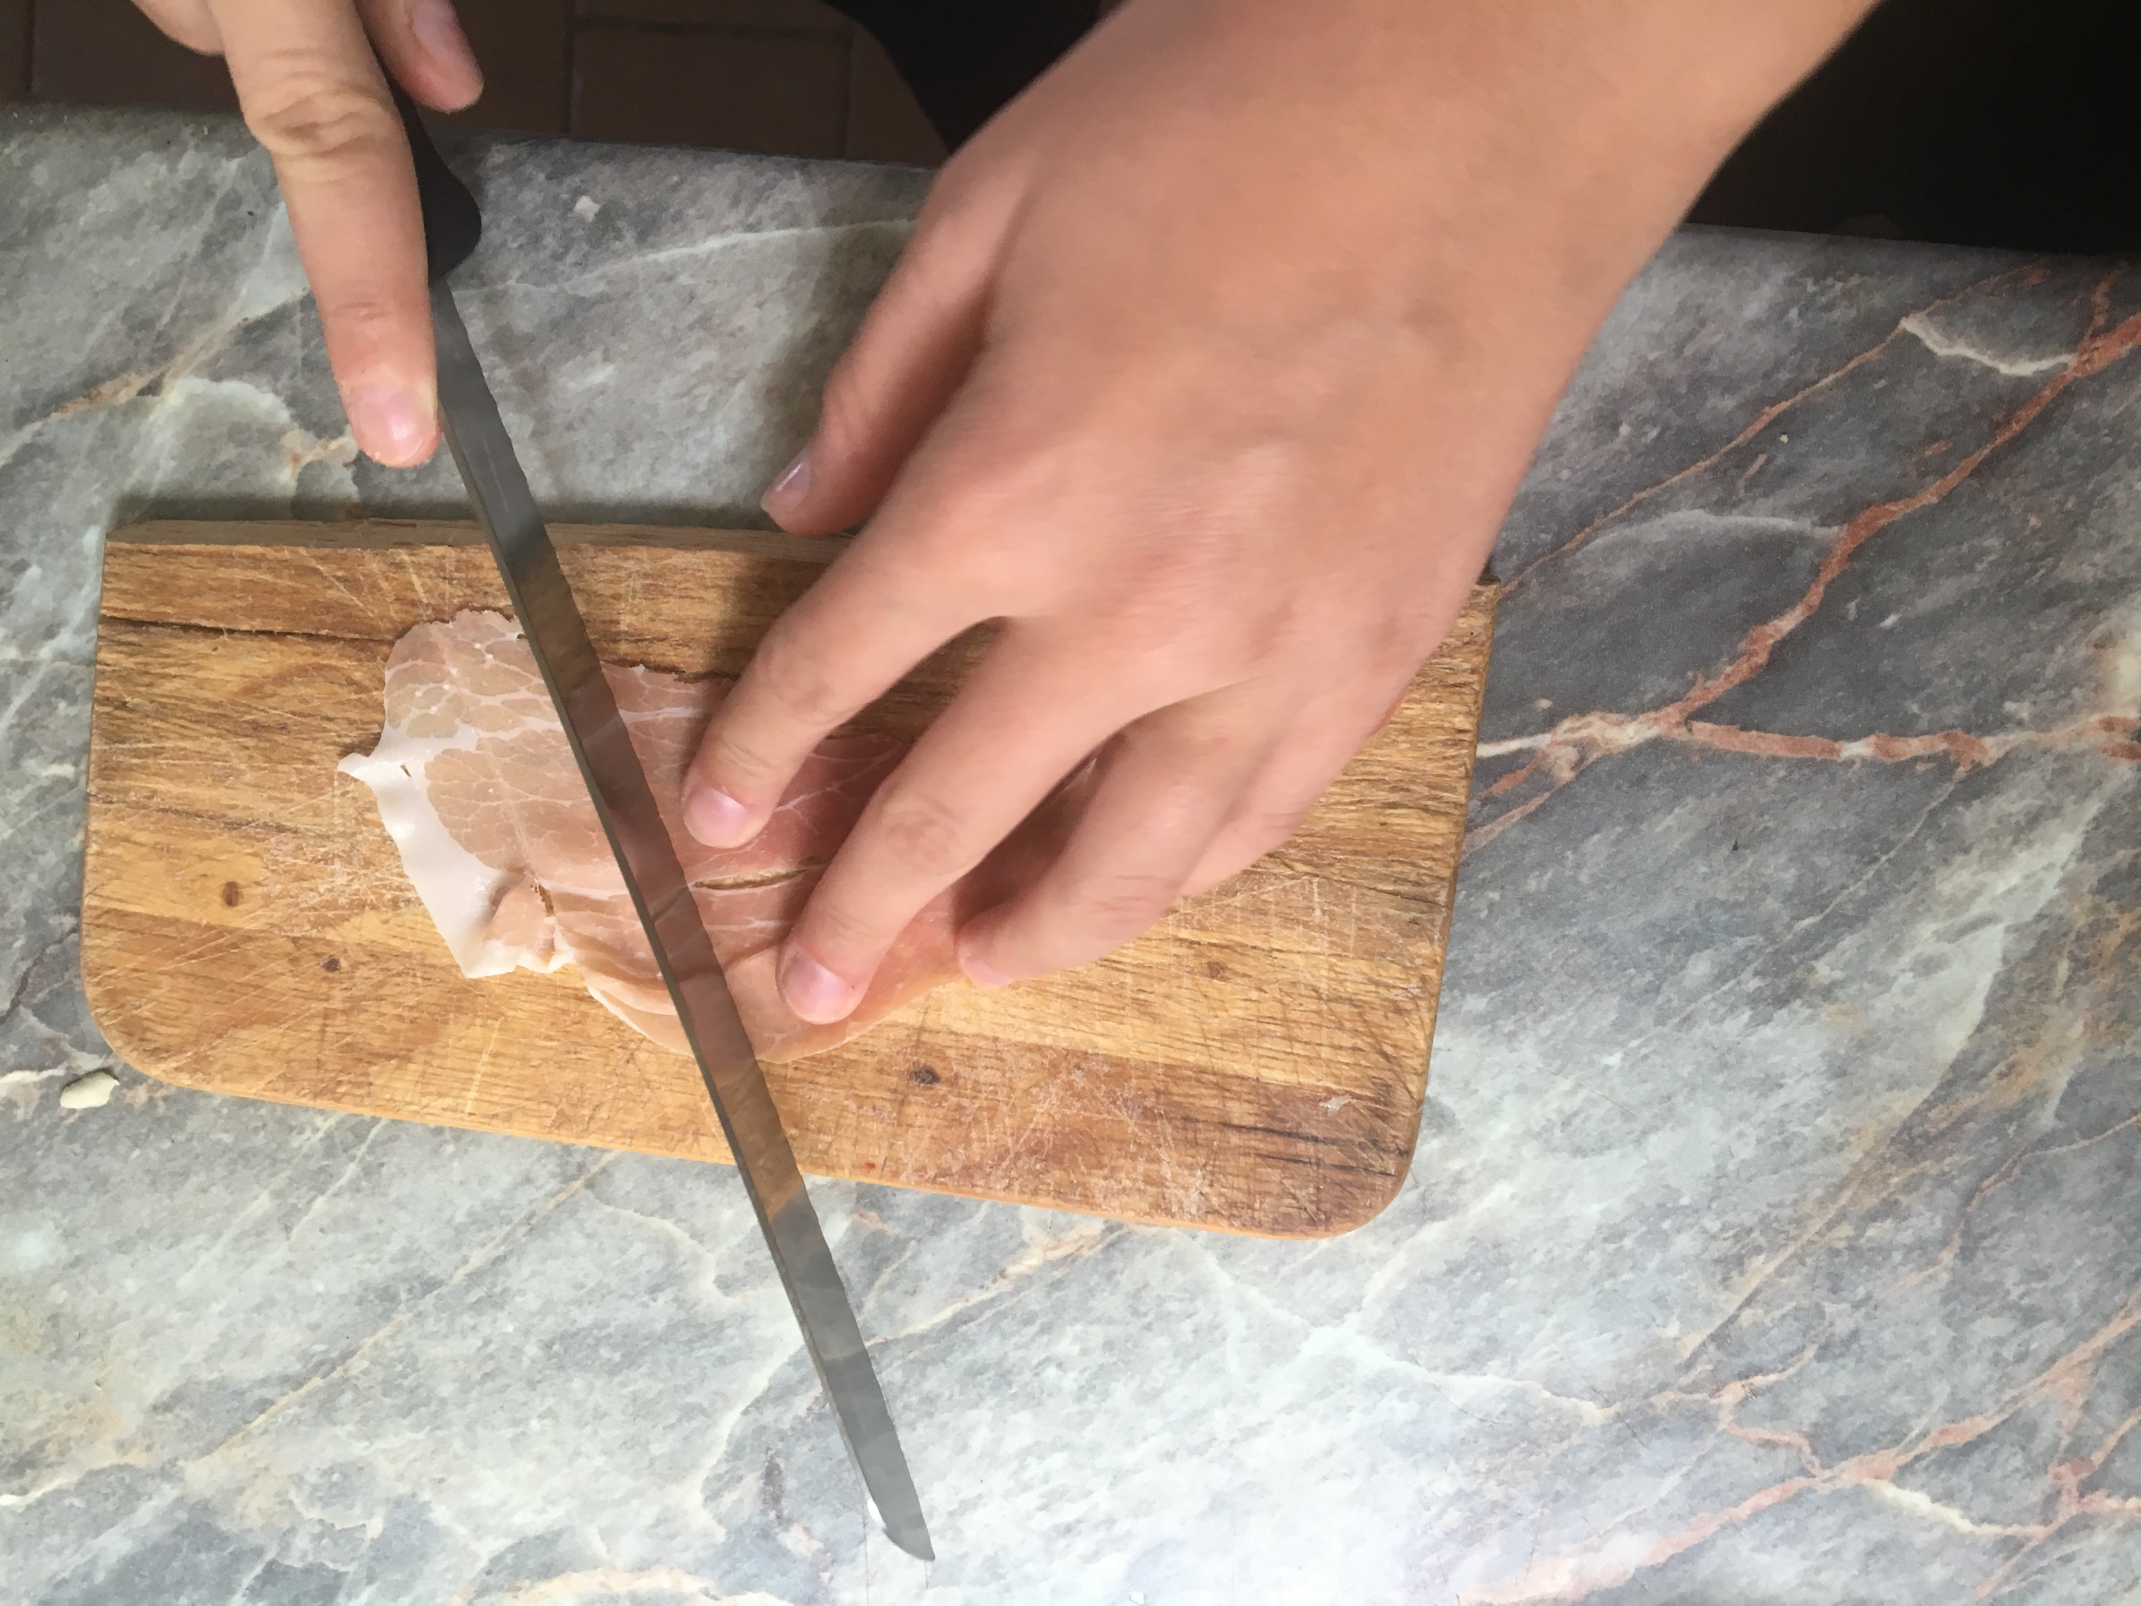
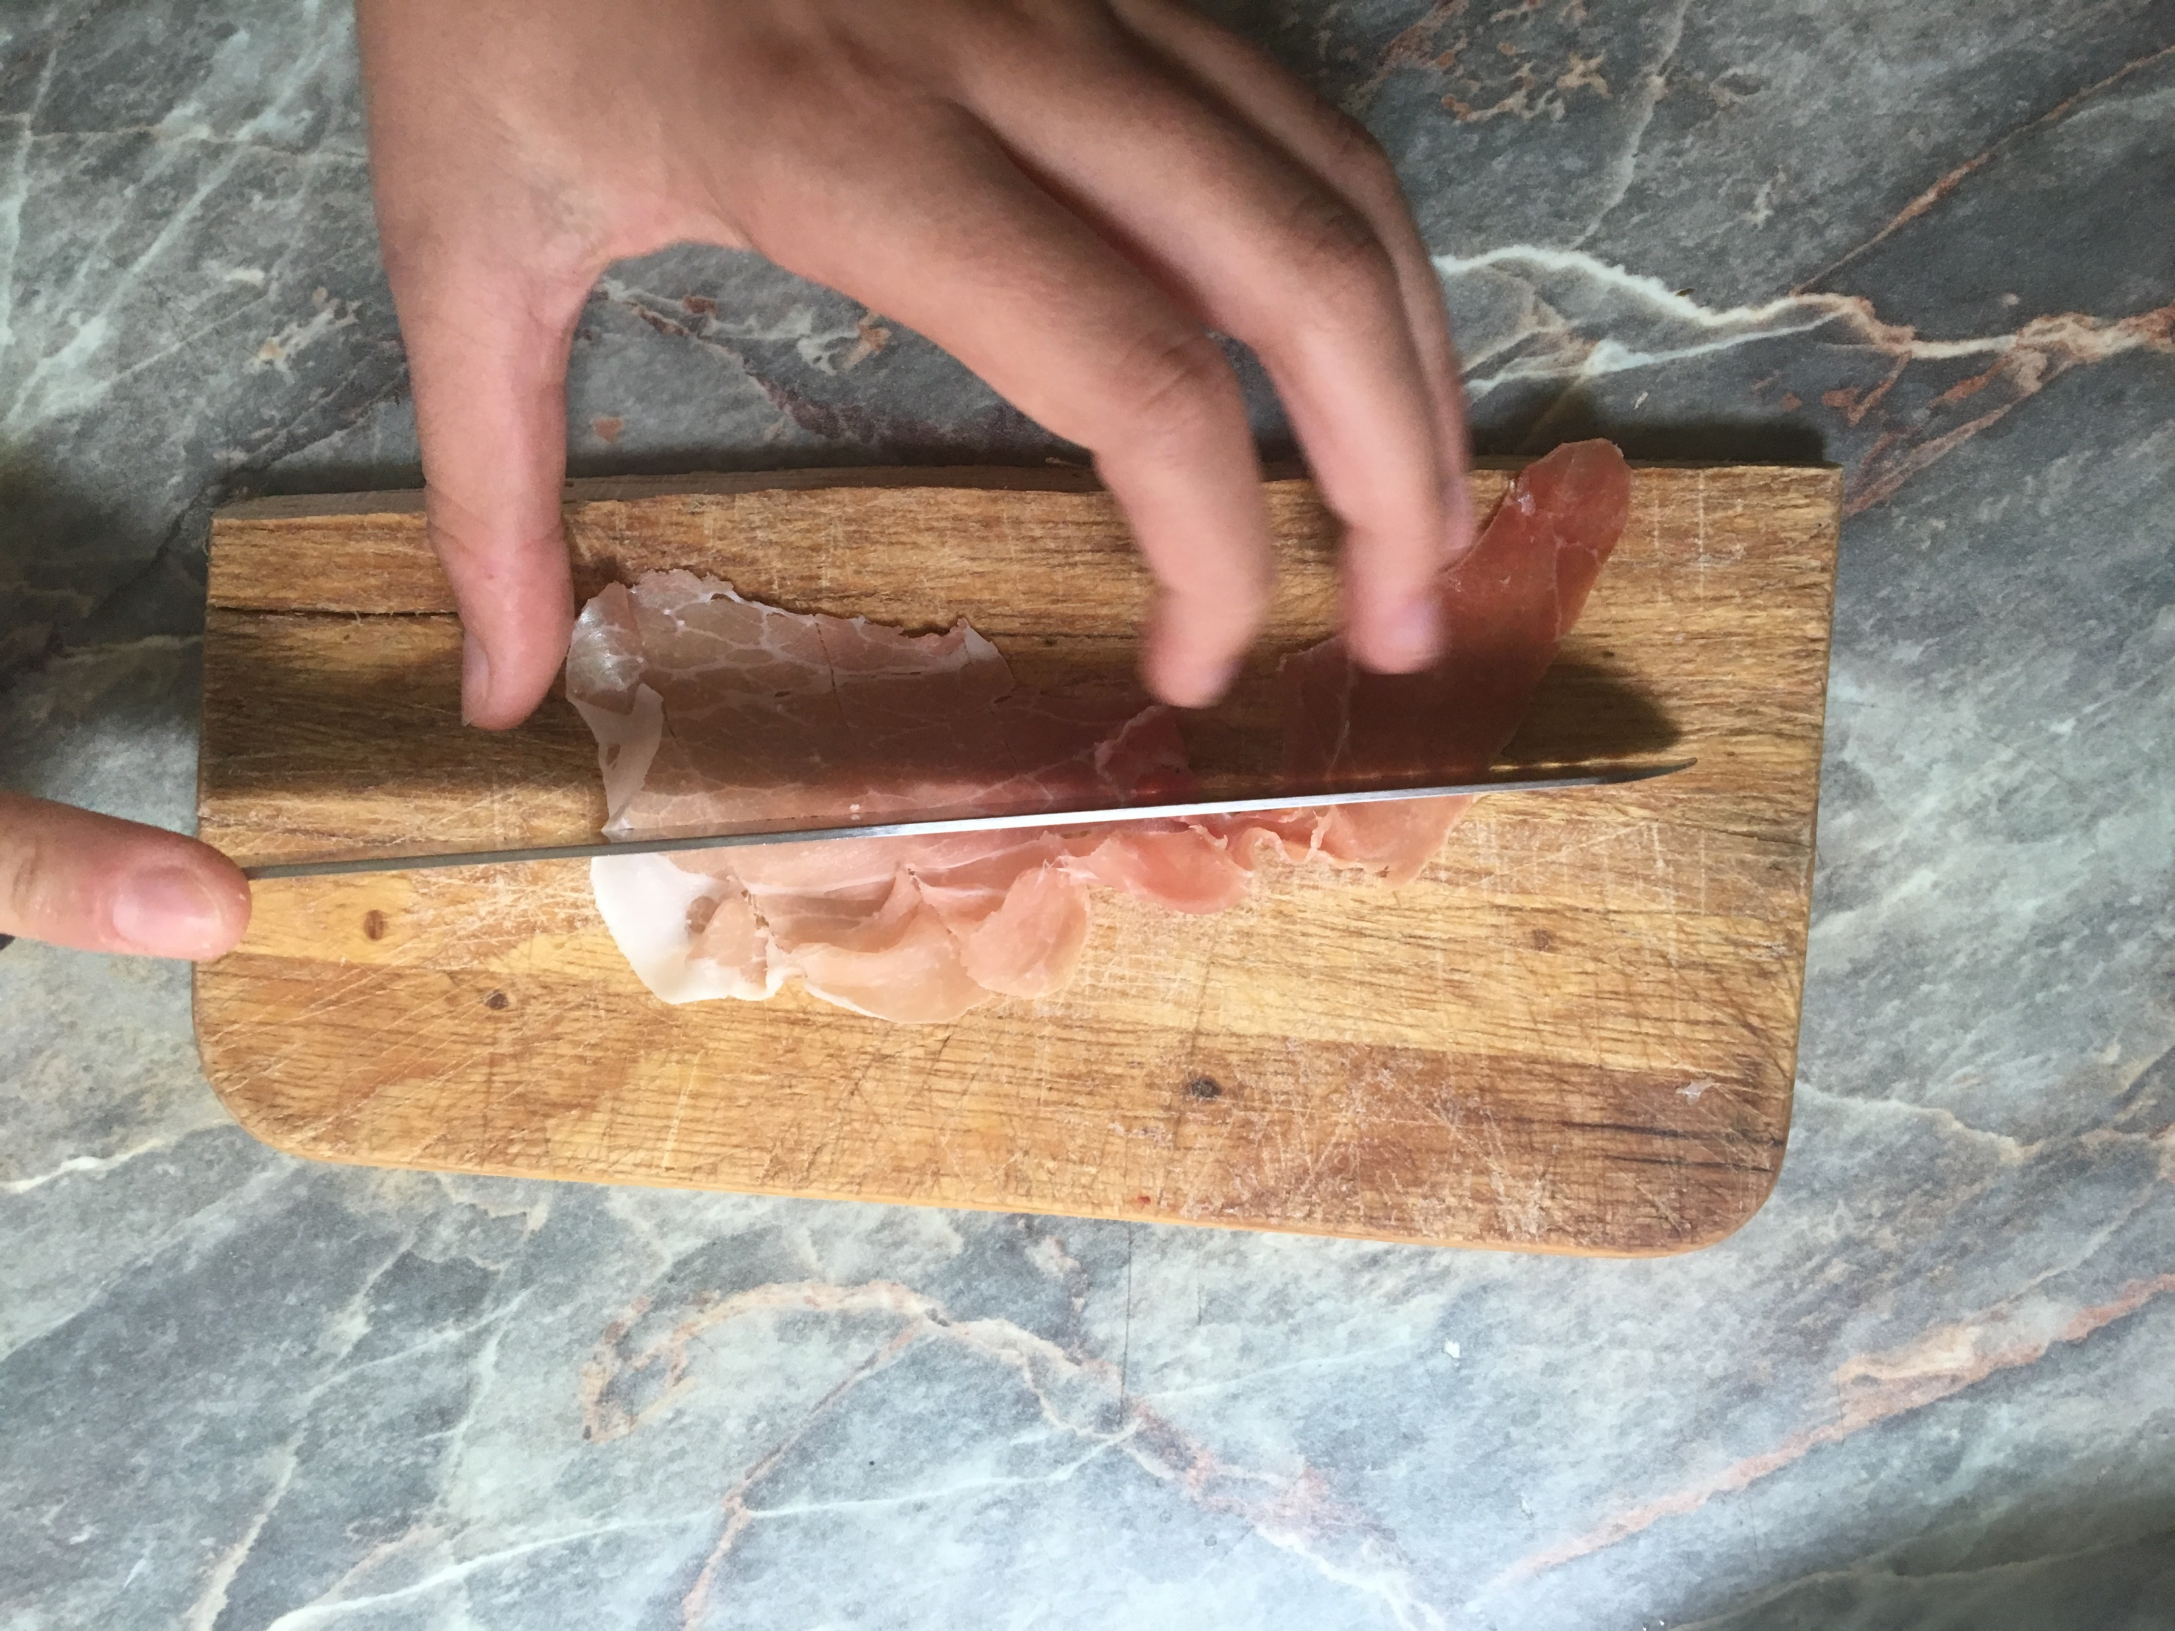
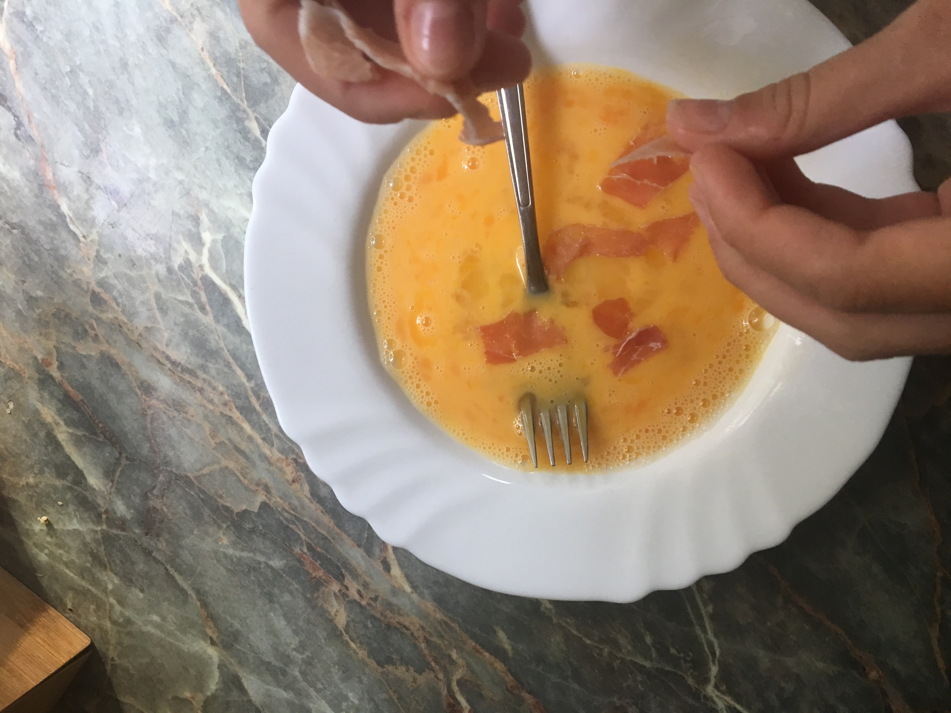
Second step
Second you will cut hamm on smal slieces and put them in eggs

Slide 5
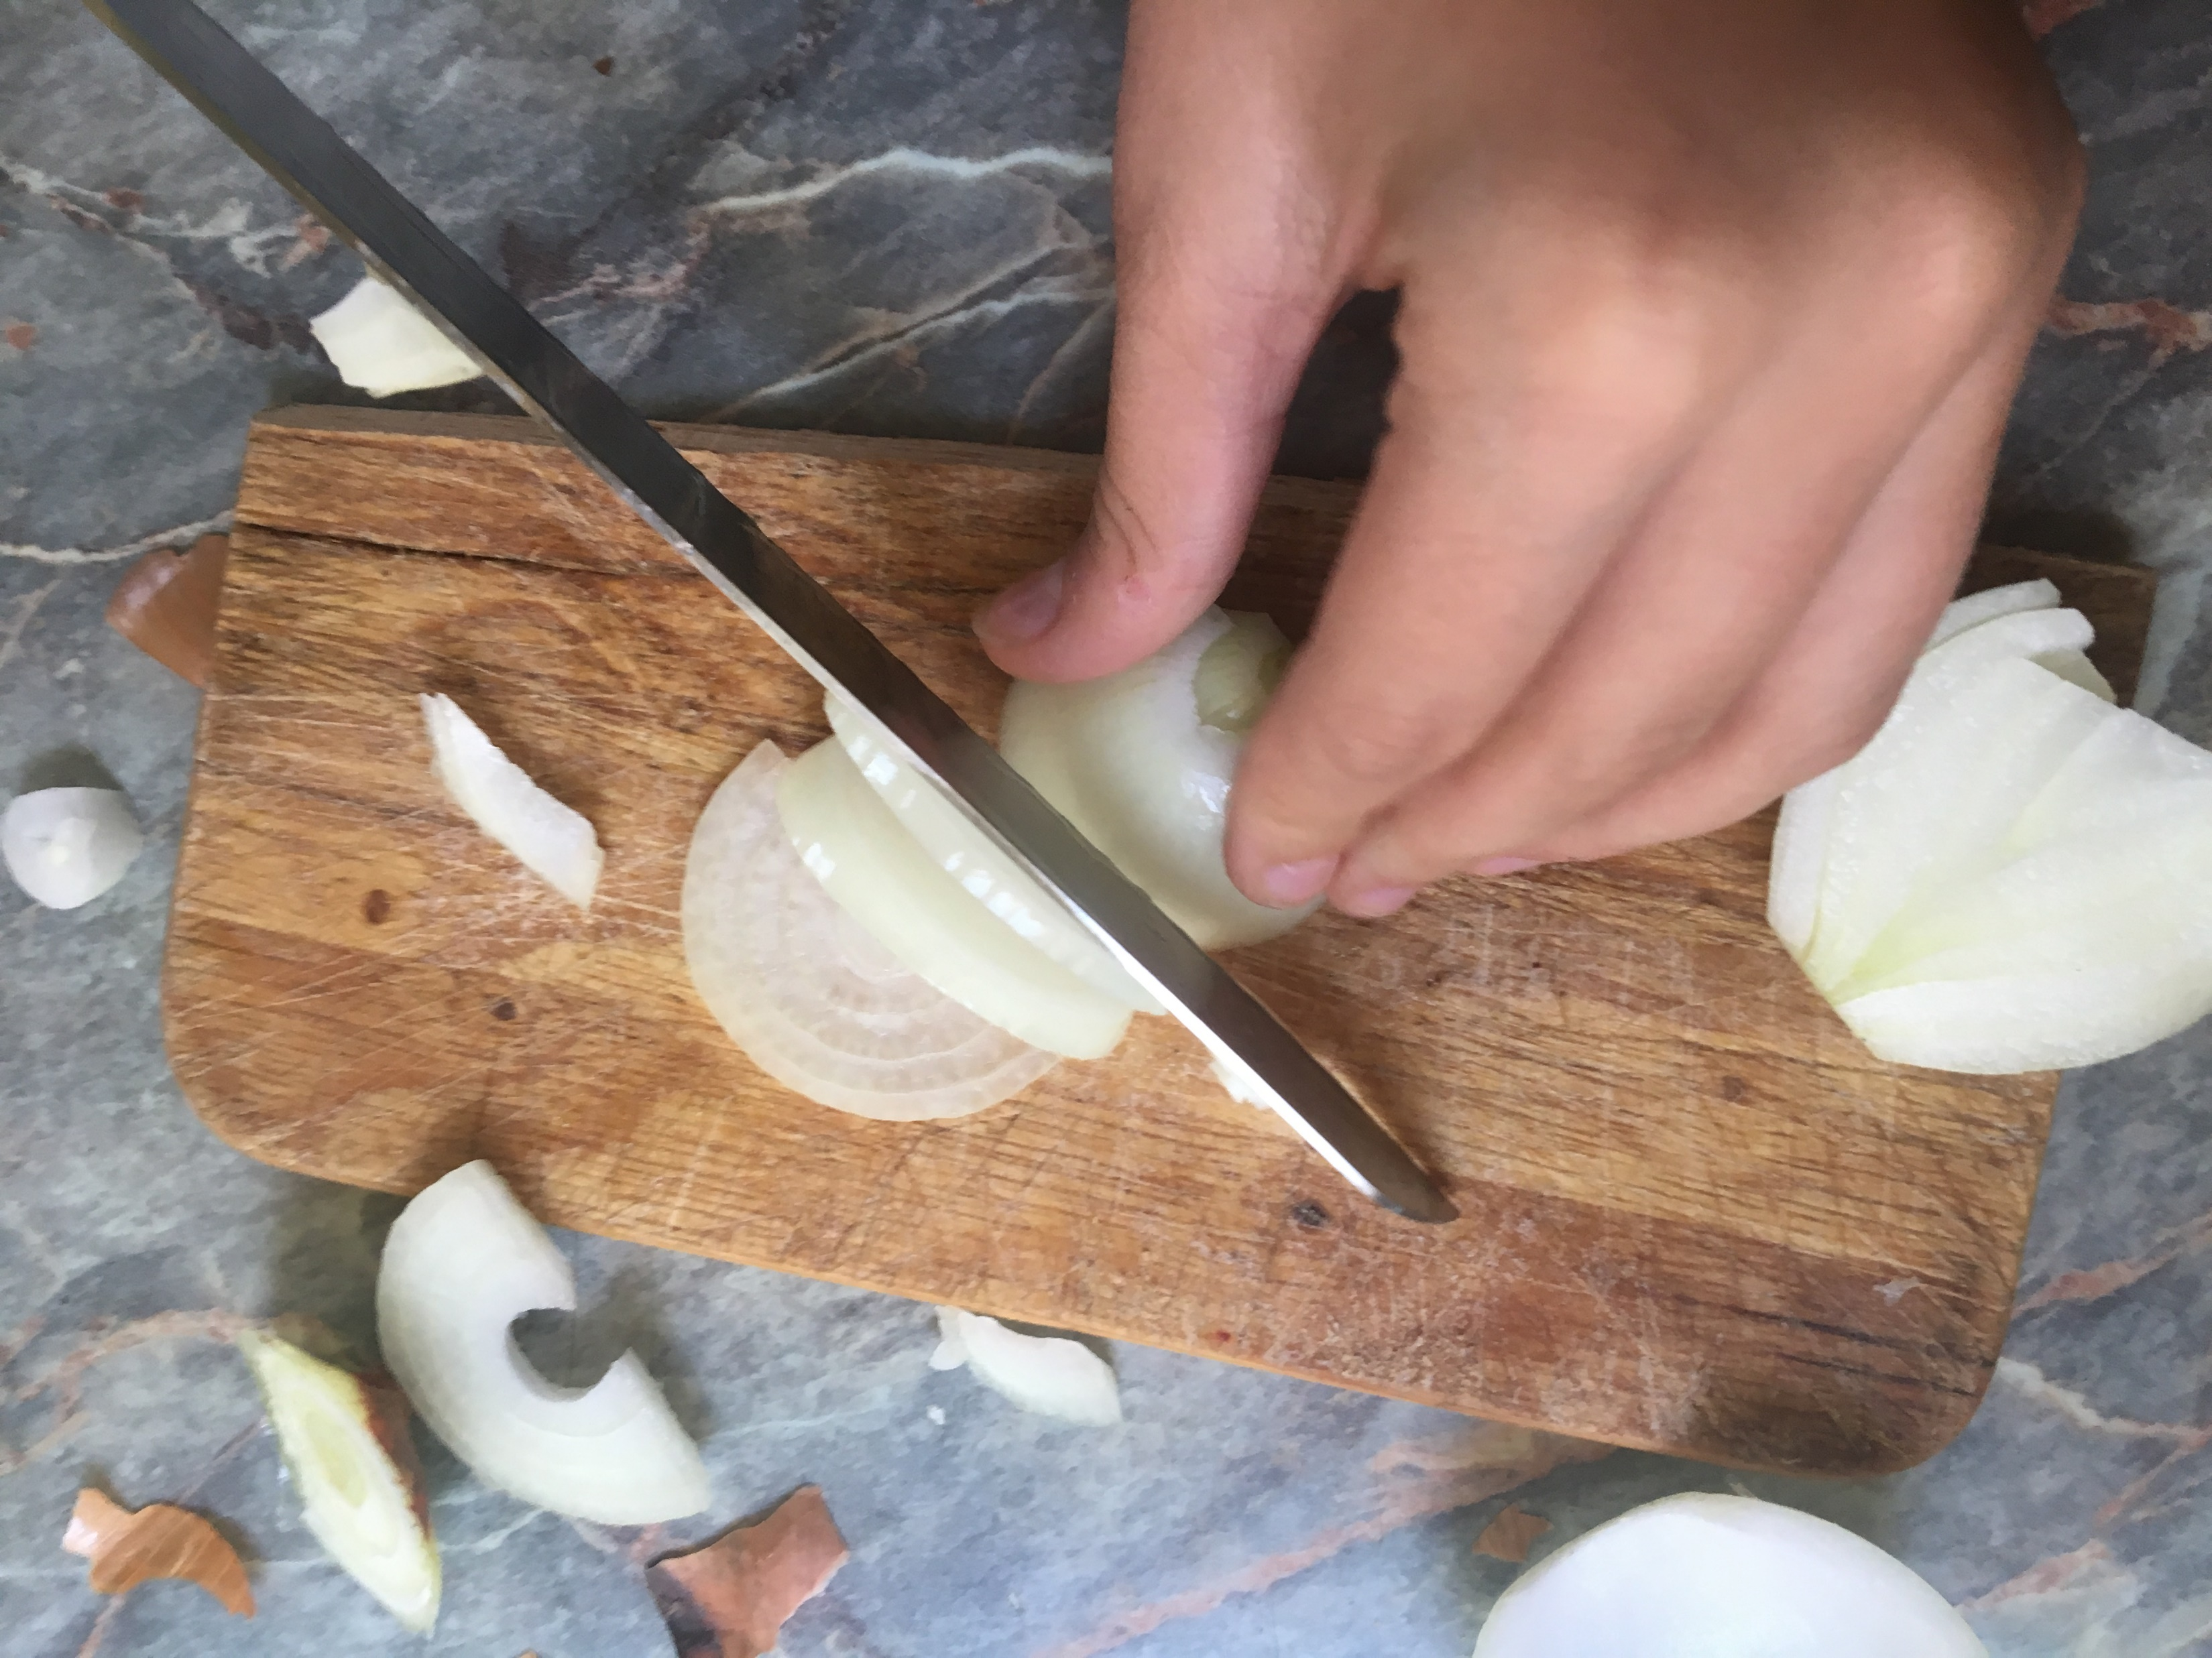
Third step
Now you will cut an onion on small slieces and mix it with ham and eggs

Slide 6
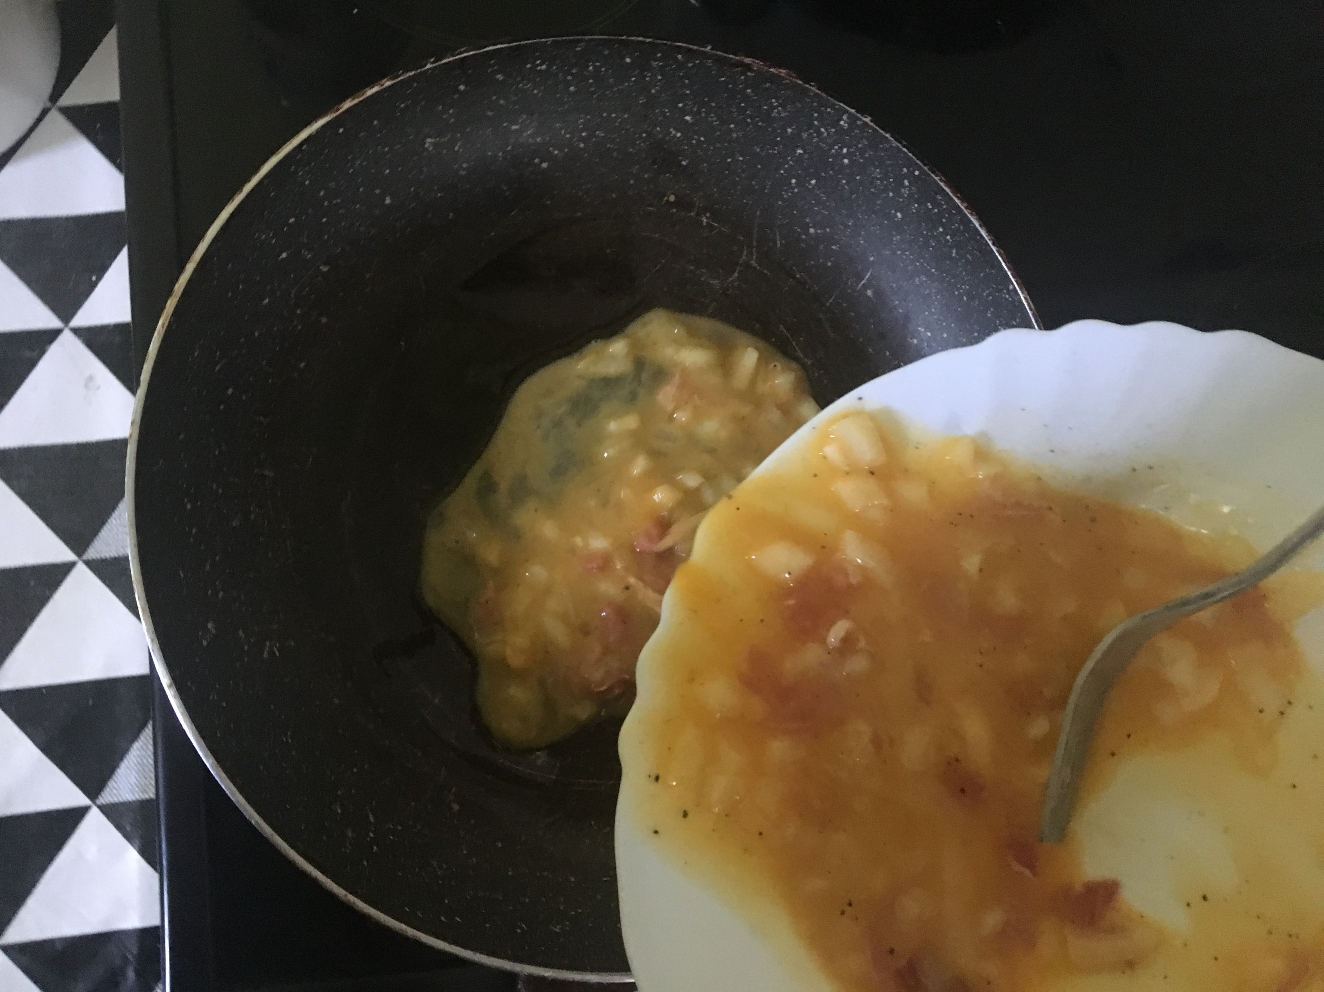
Fourth step
Now you will warm your pan and put few drops of oil in it
After oil is warm, you will put your mixture on it

Slide 7
Fifth step
When mixture is on pan, make sure to mix it with fork until if finish so it dosen’t stick on pan
After it’s ready, put it on your plate and eat!
(we forgot to take a picture on plate so
this is all I have, sorry)

