Slide 1
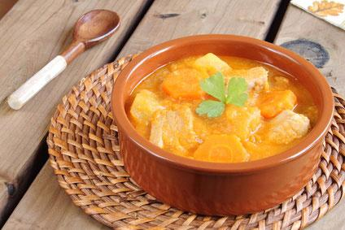
BASQUE DISHES

Slide 2
INDEX
Typical Basque Dishes
Best things about food
Nutritional value
Leek
Strawberry
Cabbage
Cauliflower
Pepper
Asparagus
Red Onion
Parsley
Cayenne
Apple

Slide 3
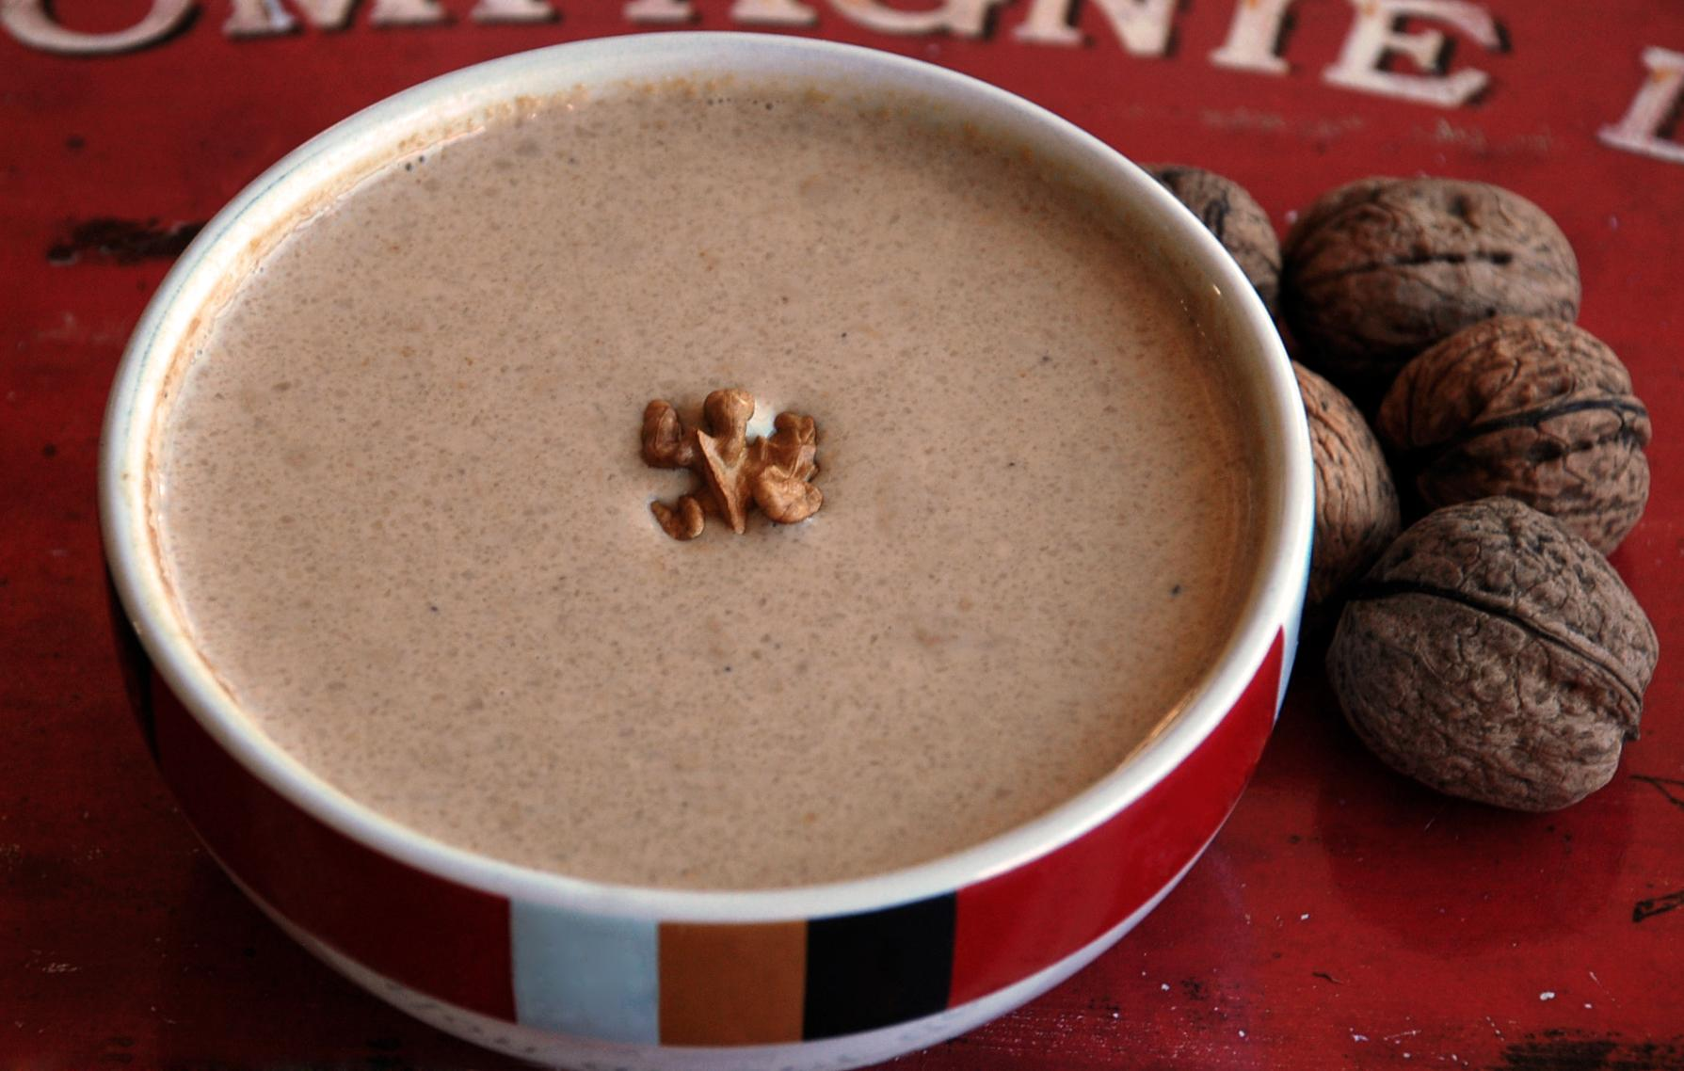
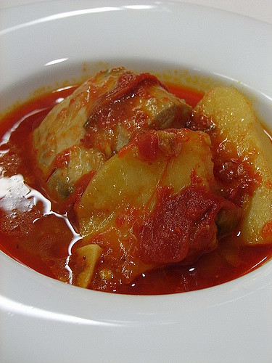
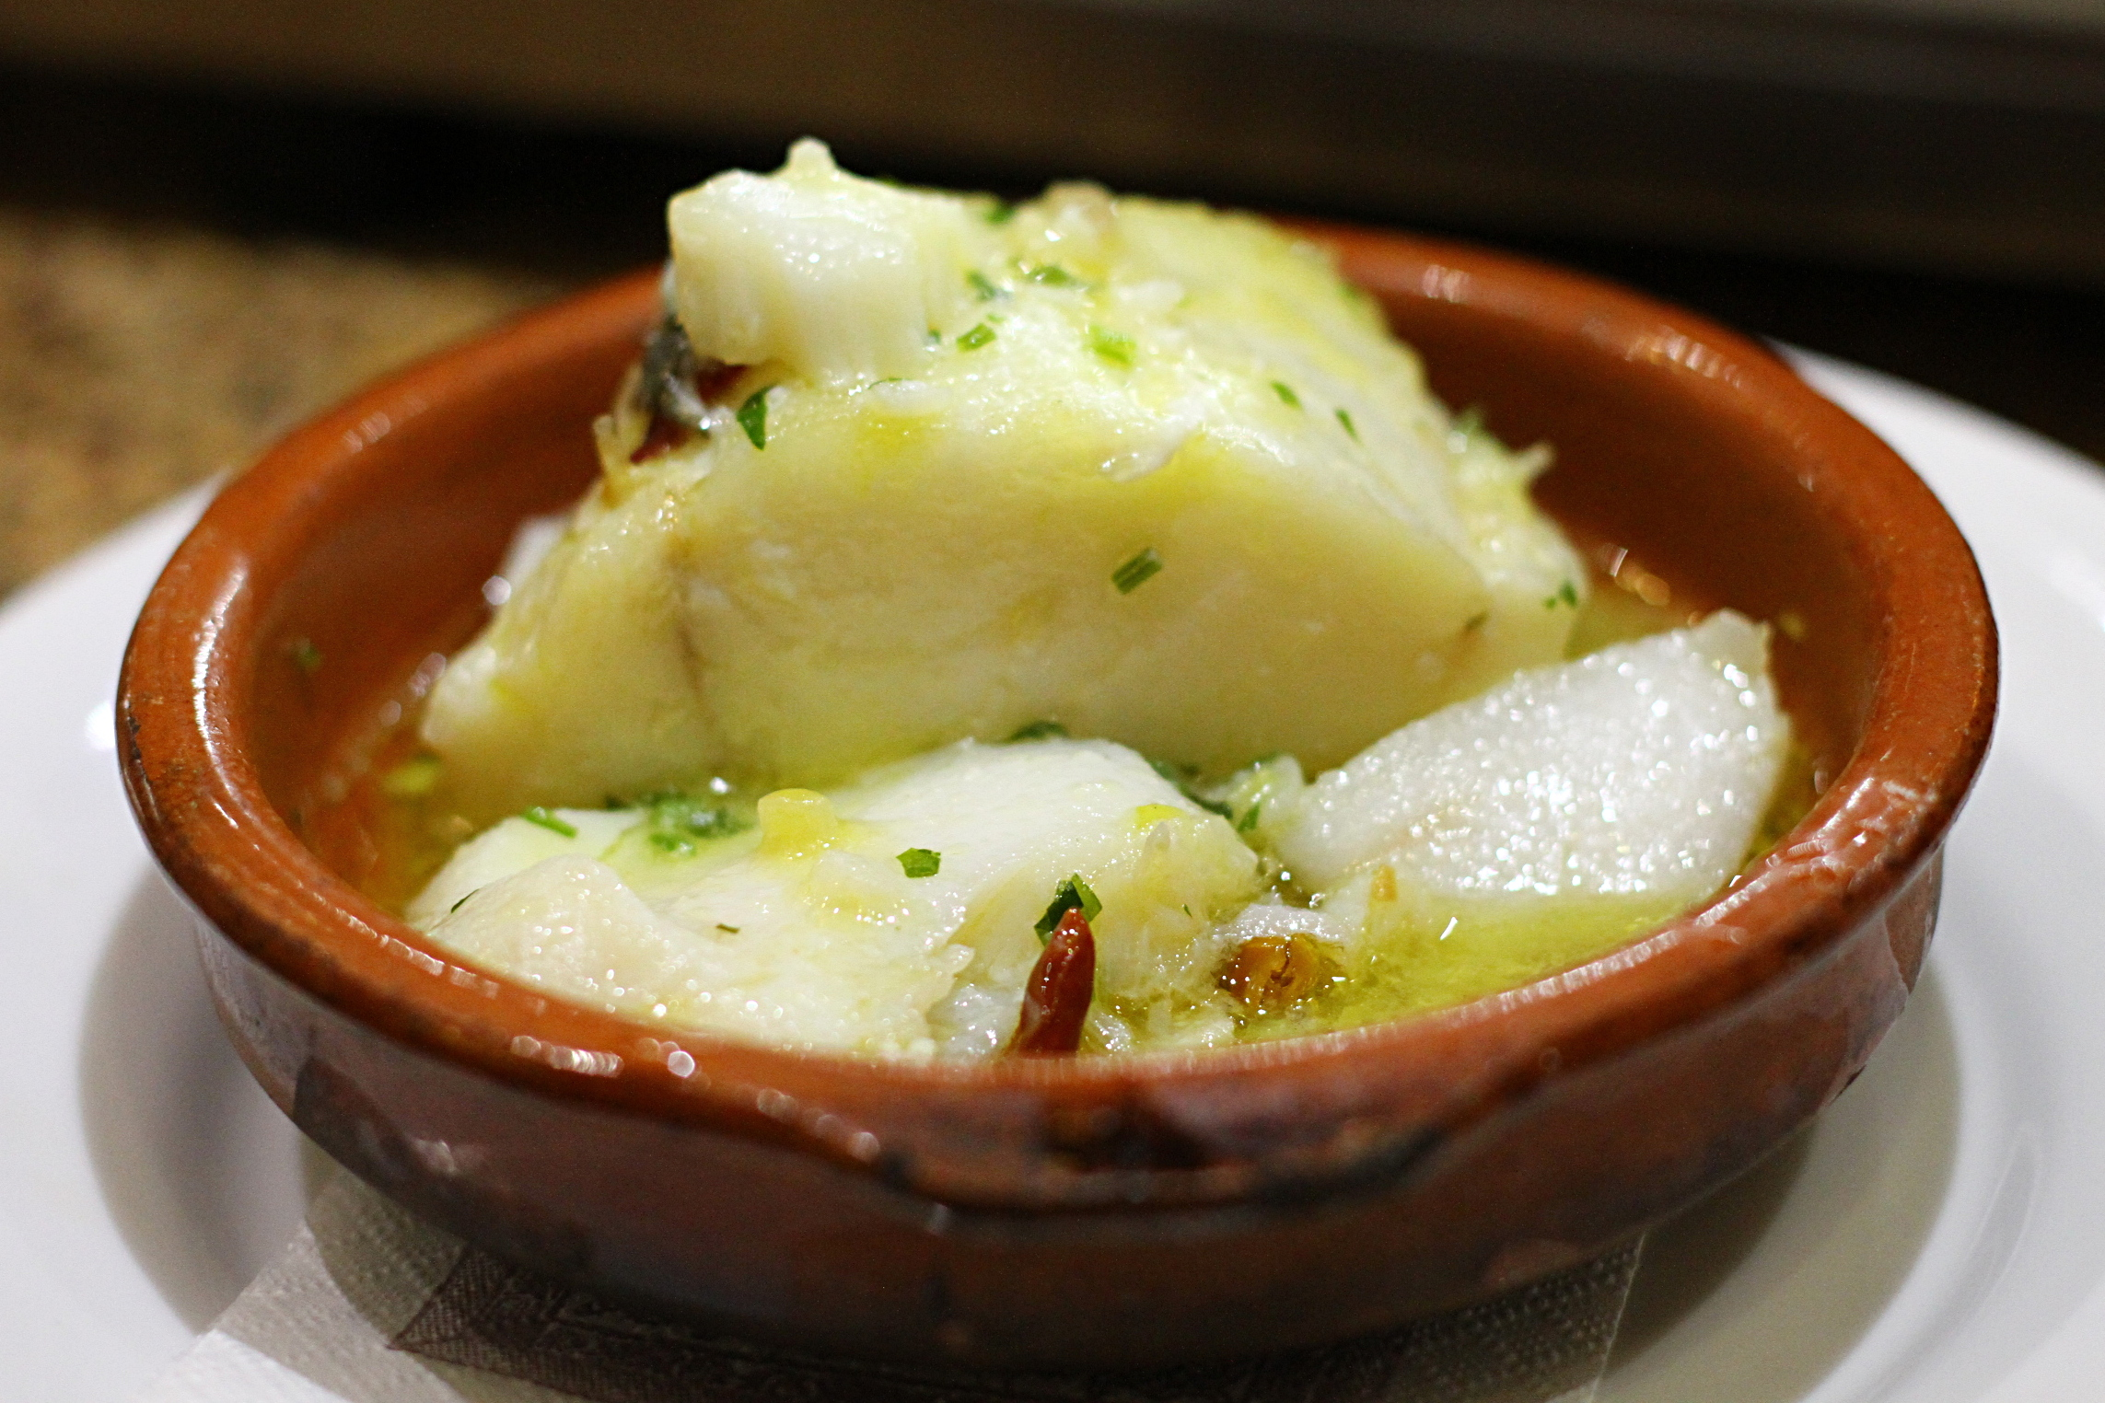
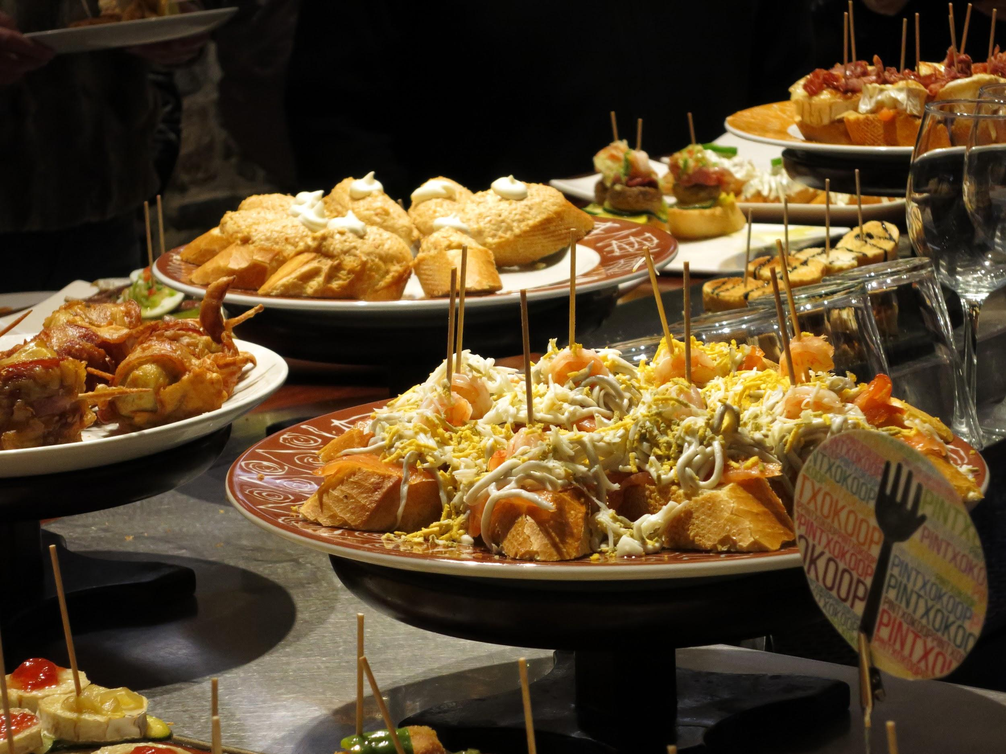
Typical Basque Dishes
-Hake in greeen sauce
-Marmitako
-Cod to pil-pil
-Pintxo
-Intxaursaltsa

Slide 4
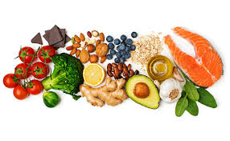
Best things about food
Food can help us with sickness, because most of the food has proteins and vitamins which can help us to recover our health.
Rice: It helps us when we have bellyache.
Honey: When we have sore throat it helps us to recover our health.
Sugar: When we do much sport our muscles contract themselves because they lose much glucose, sugar mixed with water is the best thing to drink after doing sport.

Slide 5
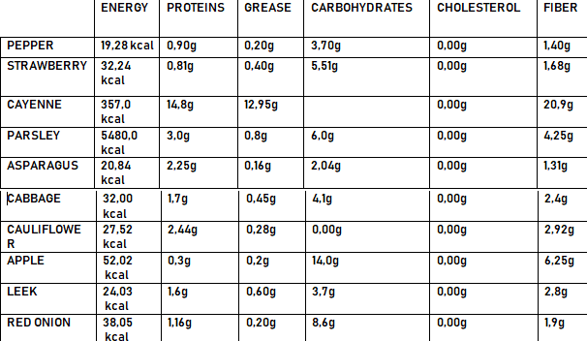
Nutritional Value

Slide 6
https://docs.google.com/forms/d/e/1FAIpQLSfP2tSJn3tNnWL0rwUDadpCUhsVBsQ_g1koaJHEvnB_tRB96A/viewform

Slide 7
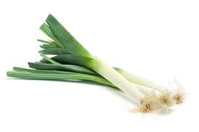
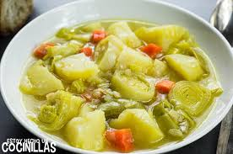
Leek
♦Scientific name: Allium ampeloprasum
♦Time to land it: We land it in July and we pick it up in November more or less.
♦Typical dishes with it: -Leek soup or “Porrusalda”
-Leeks with vinagrette or “ Porruak binagretara”

Slide 8
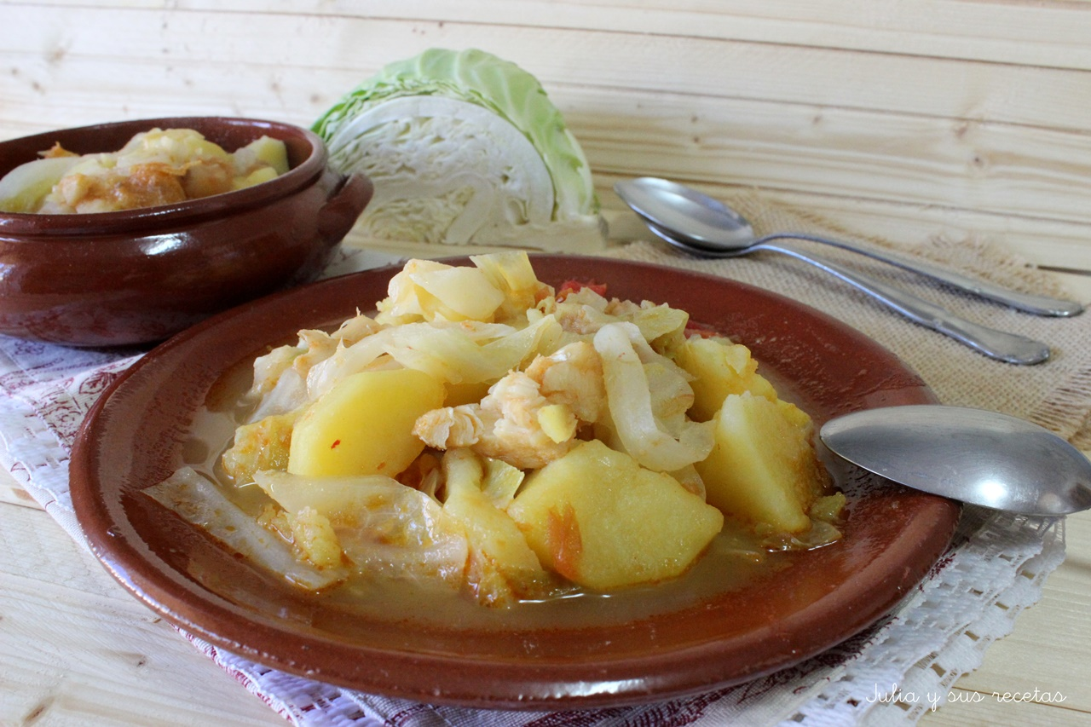
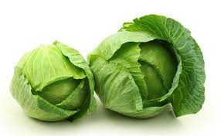
Cabbage
♦Scientific name: Brassica oleracea var. capitata
♦Time to land it: We land it in September and we pick it up in March more or less.
♦Typical dishes with it: -Cabbage with potatoes or “Aza patatekin”
-Chickpeas with cabbage or “Garbantzuak azarekin”

Slide 9
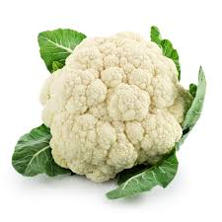
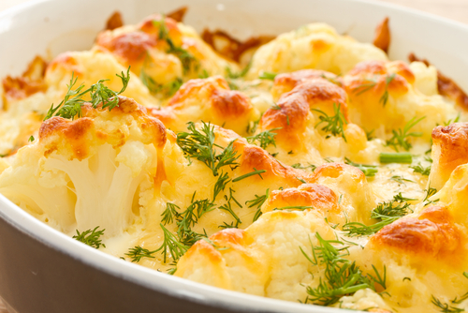
Cauliflwer
♦Scientific name: Brassica oleracea var. botrytis
♦Time to land it: We land it in May and we pick it up in November.
♦Typical dishes with it: - Cauliflower with cheese or “Azalorea gaztarekin”
-Cauliflower with salad cream or “Azalorea maionesarekin”

Slide 10
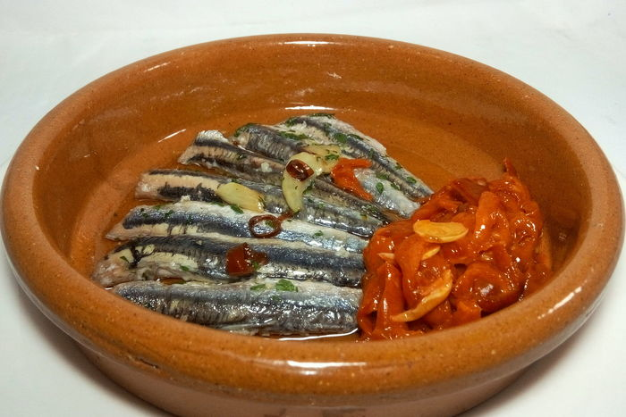
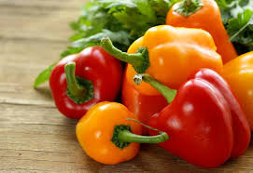
Pepper
♦Scientific name: Capsicum annuum
♦Time to land it: We land it in March and we pick it up in the end of August.
♦Typical dishes with it: -Anchovies to the casserole or “ Antxoak kazelorara”
-We also eat it like trimming.

Slide 11
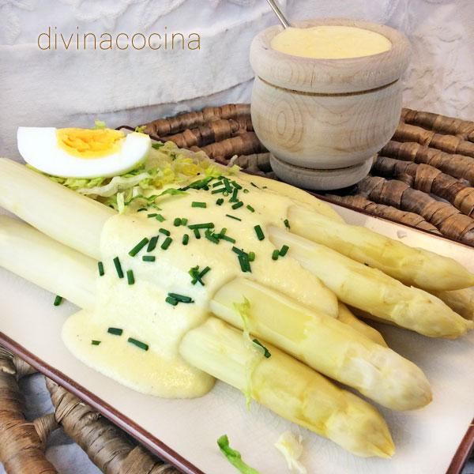
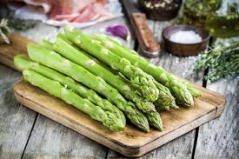
Asparagus
♦Scientific name: Asparagus officinalis
♦Time to land it: We land it in March and we pick it up a year later.
♦Typical dishes with it: -We usually eat them with salad cream.

Slide 12
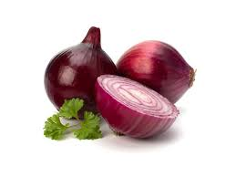
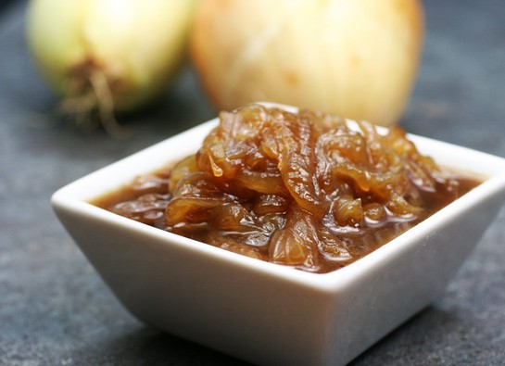
Red Onion
♦Scientific name: Allium Cepa.
♦Time to land it: We start landing it in March and we pick it up in July more or less.
♦Typical dishes with it: We usually eat it caramelized and tend to put it in most of our dishes.

Slide 13
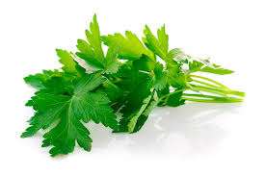
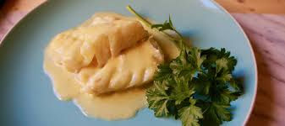
Parsley
♦Scientific name: Petroselinum crispum
♦Time to land it: We land it in May and we pick it up in August.
♦Typical dishes with it: -As it is an spice we don’t have a typical dish with it, but we tend to put it in most of our dishes.

Slide 14
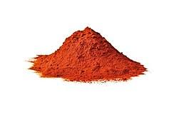
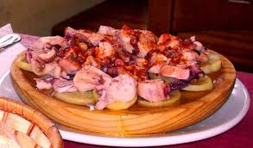
Cayenne
♦Scientific name: Capsicum annuum var. acuminatum
♦Time to land it: We do not plant it because it is the product of grinding dried peppers.
♦Typical dishes with it: -We usually eat it with octopus, but as is an spice we also eat it in a lot of dishes.

Slide 15
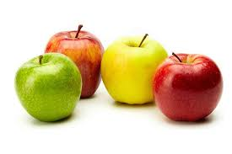
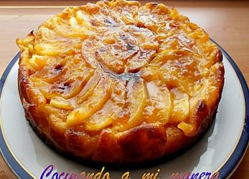
Apple
♦Scientific name: Pyrus malus L.
♦Time to land it: We usually don’t land it because it comes from a tree, but we pick it up in September more or less.
♦Typical dishes with it: -We have a very typical dish, the Apple pie.

Slide 16
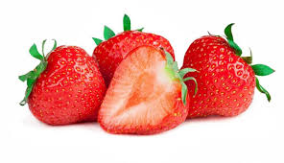
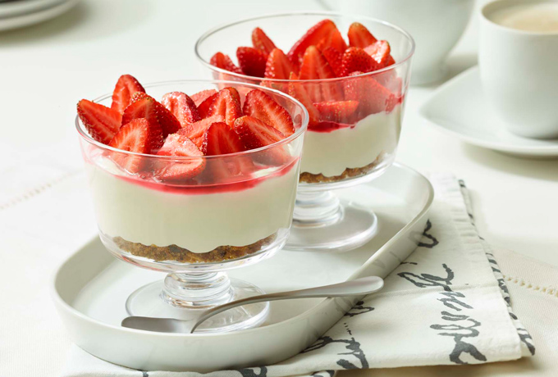
Strawberry
♦Scientific name: Fragaria
♦Time to land it: We land it in SEptember and we pick it up in May.
♦Typical dishes with it: -Strawberries with cream or “Marrubiak natarekin”

