Slide 1
Wealthy and healthy February 2019. OŠ Ivana Mažuranića Vinkovci, Croatia

Slide 2
Which fruit in Slavonia do you think is healthiest?

Slide 3
Which vegetable in Slavonia do you think is healthiest?

Slide 4
Which spice in Slavonia do you think is healthiest?

Slide 5
FRUITS

Slide 6
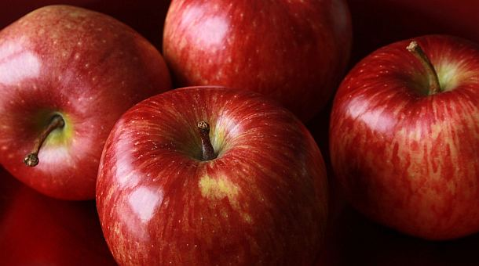
APPLES
Apples are juicy fruits, can be soar and sweet, red, green and yellow
you can make juice, various cakes, pies and more
They call it the "queen of fruit" because it is full of vitamins (A, C, D) and calcium

Slide 7
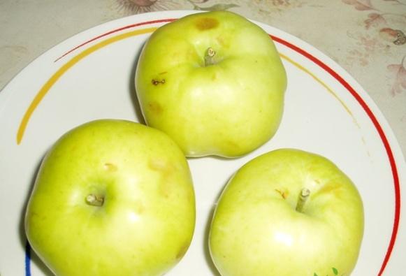
Local apples
ADAMOVKA – PETROVKA
Green apple of irregular shape, sweet with little juice. It matures in mid-June and it rises until mid-July. This is usually one of the earliest apples.
ADVENTKA
Large apple, red violet color. The meat is white, firm, thin skin, soar and sweet aroma are equal, the apples are very aromatic. Its origin are from the Našica region, it matures to the fall.

Slide 8
ALVALUŠA
Medium large apple, yellow green with some red trace. Apples are juicy, solid, white, medium sour. It belongs into winter varieties. It is located in the Ilok region.

Slide 9
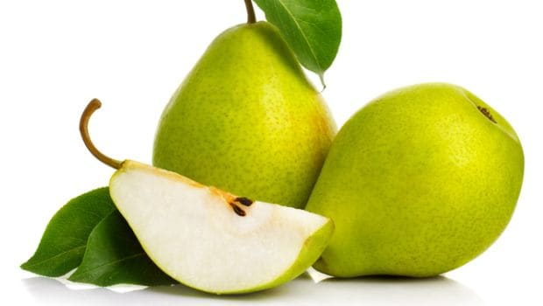
PEARS
They are a good source of dietary fiber which are healthy for our digestive system and for cardiovascular health.

Slide 10
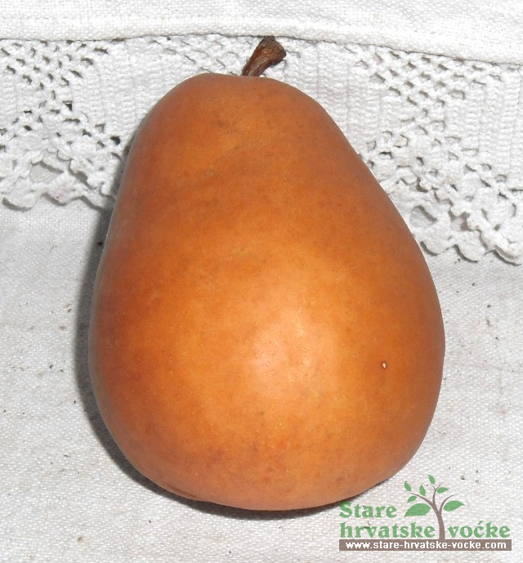
Local pears
AUGUSTINKA
Medium large, golden brown pear with skinny skin that is soft. The flesh of this pear is very juicy, sweet, soar so much that refreshes. This variety comes in the summer of autumn.

Slide 11
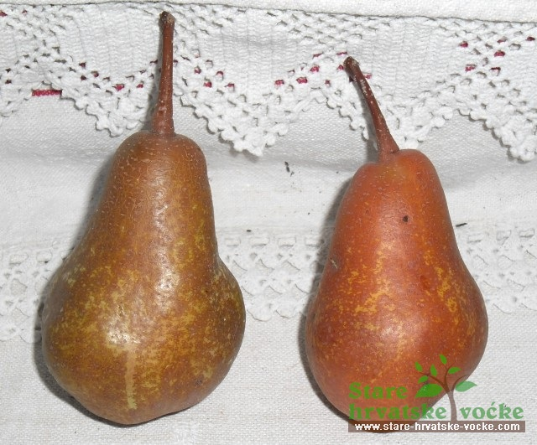
ŠEČERNA
smaller pear, irregular lines, rough skins, yellow red-brown color. The flesh is fine texture, very sweet and slightly tender, white, when maturing is completely soft. It belongs in autumn varieties.

Slide 12
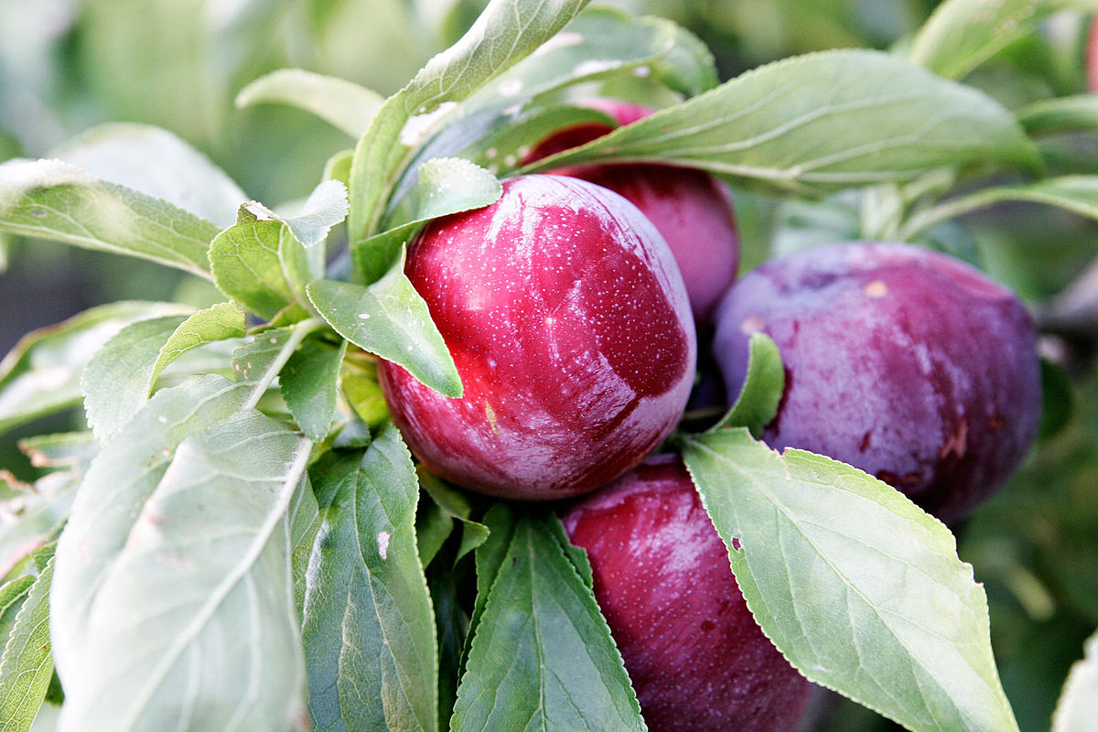
PLUMS
the fruits matures in August, September and October, depending of the variety.
Plums are rich in vitamins A and C.

Slide 13
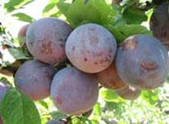
DINKA
It is sweet as melon, the meat is soft and greenish yellow. The tree is bushy and the branches grow upright.

Slide 14
VEGETABLES

Slide 15
POTATOS
Potato is good for health if you do not consume it in fried form.
It contains more potassium than bananas and more useable iron than any other vegetable. It is rich with fibers and carbohydrates.
Potato is a good source of vitamin B, magnesium, phosphorus and niacin. Several potatoes coveres daily amounts of vitamin C.

Slide 16
CARROTS
Carrot is rooted vegetables. The color of carrots indicates that it´s rich with beta carotene, followed by vitamin K, vitamin C, vitamin E, vitamin B1, B2, B3, B6, folic acid, phosphorus, potassium and manganese.
This vegetable is good for eyes, reduces the risk of stroke.

Slide 17
SPICES

Slide 18
PARSLEY
Spice used for soup and dish decoration. Plant leaves are a great source of vitamins A, C and K and have been used as a medicinal herb . The whole plant is rich with minerals such as potassium, magnesium, calcium, phosphorus and iron. The parsley root contains vitamin C four times more then a lemon juice. Parsley is a plant that helps reduce colds, flu, arthritis and is used in diseases of the rheumatoid arthritis, gout and diabetic diets.

