Slide 1
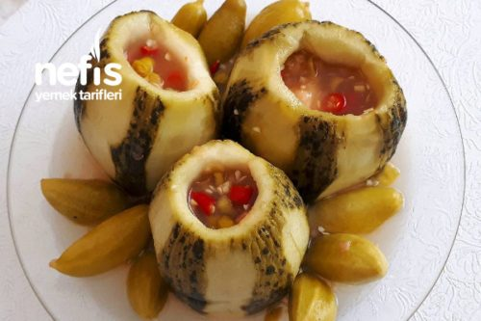
As Good As Fresh: Pickle Unripe Melon

Slide 2
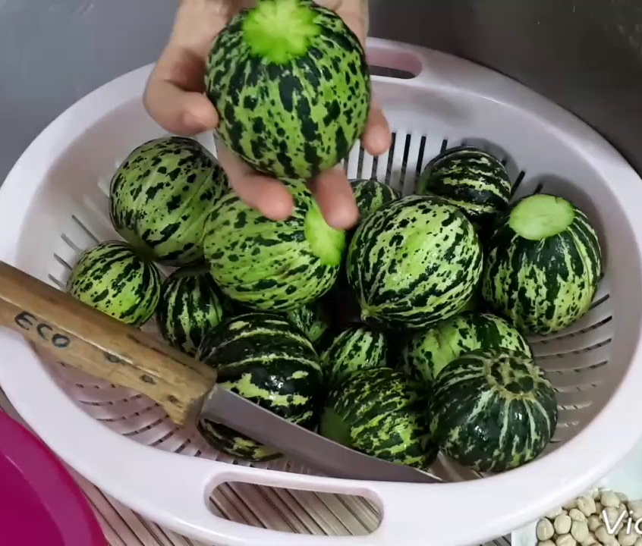
Ingredients
-Tomatoes
-Garlic
-Red Pepper
-Apple Vinegar
-Salt
-Water

Slide 3
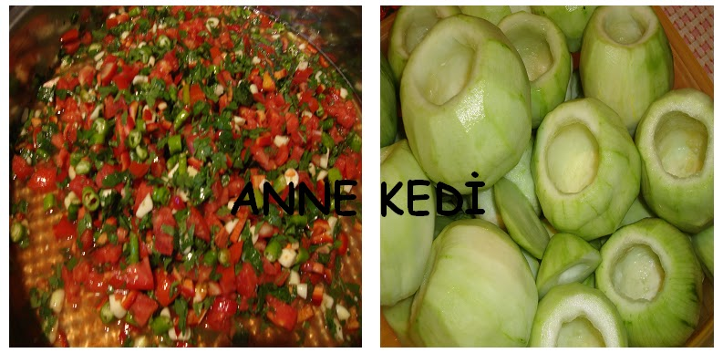
STEPS
1-Between August and September you can find smaller melons in bazaars.
2-Dice the tomatoes and peppers.
3-Put them in a bowl with garlic and mix them.
4-Carve the melons.

Slide 4
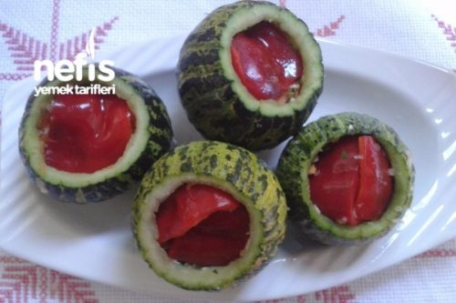
5-Put this salad-like mixture into melons.
6-Then you have to put the melons in to a jar.

Slide 5
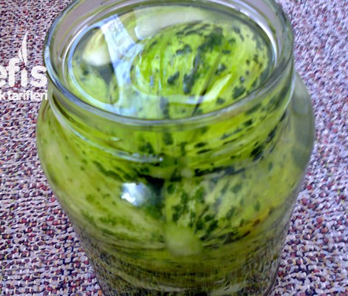
Pickle Water: Ingredients
-4 cups of water
-1 cup of apple vinegar
-1/2 cup of salt

Slide 6
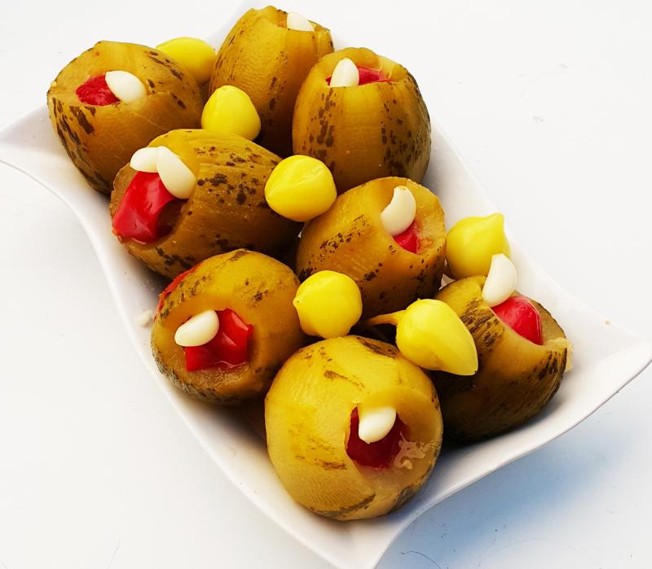
7-Pour the mixture into the jar.
8-Close the jar
9-Leave the jar at a cool and dark room for 30 days.
10-Enjoy!
(For 2 kilos of melons)

Slide 7
THANKS FOR WATCHING!
Ibrahim Efe Yakar 8-A
Ankara Final Schools – Eryaman Campus

