Slide 1
SMOOTHIE

Slide 2
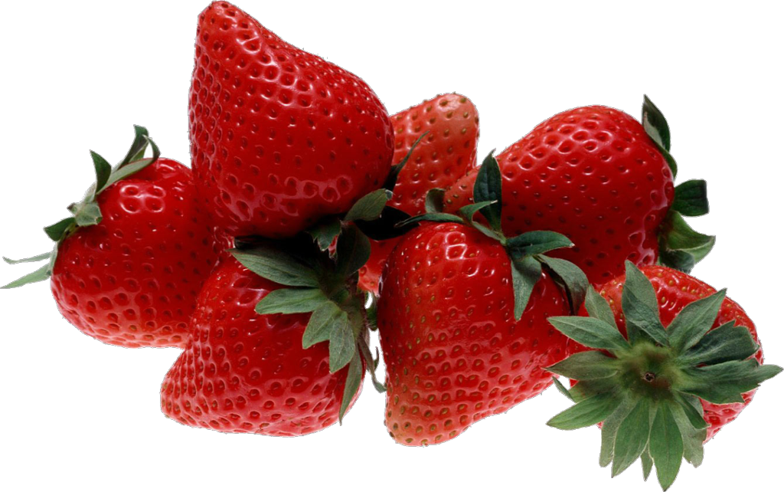
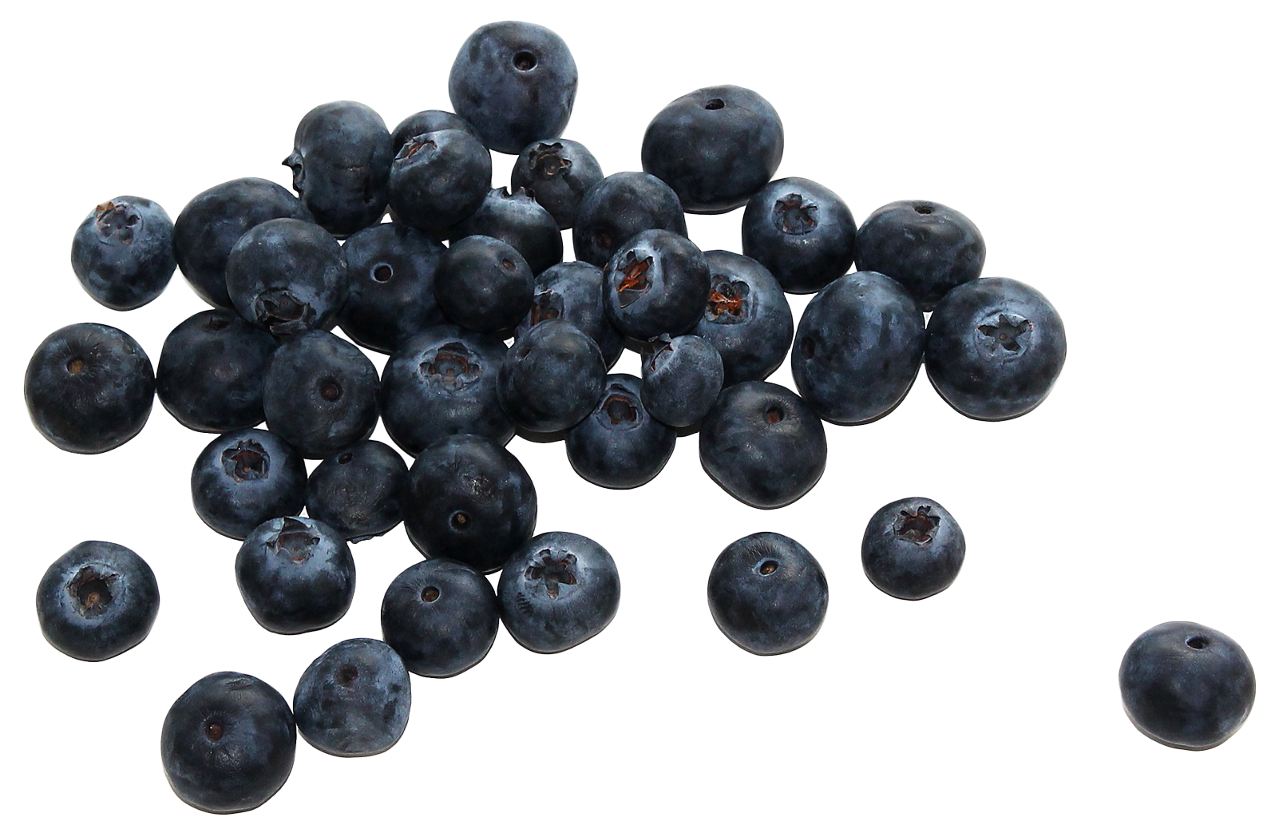
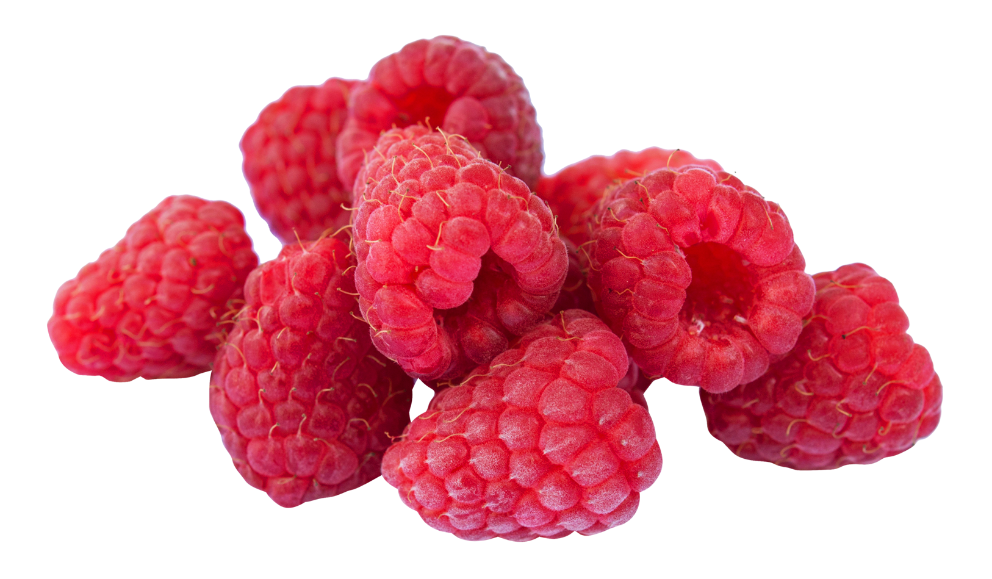
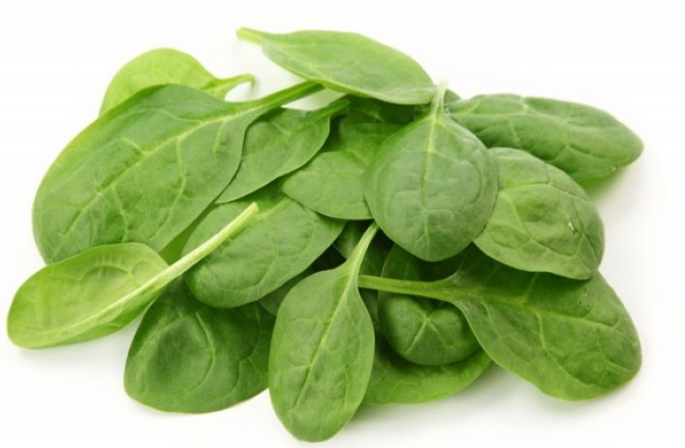
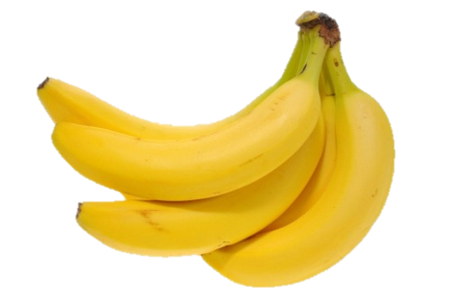
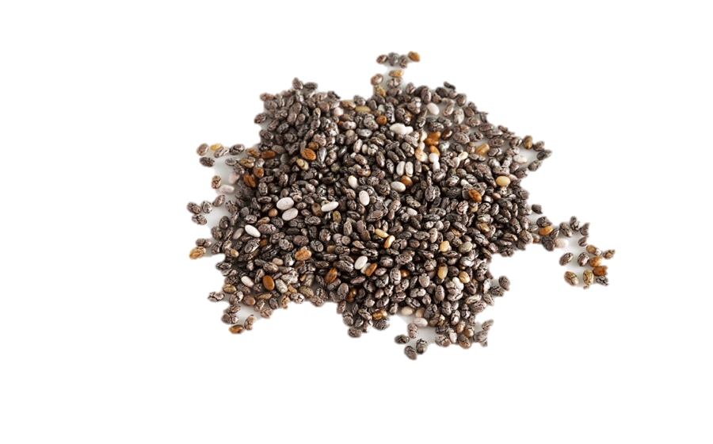
INGREDIENTS
Strawberries
Blueberries
Raspberries
Baby spinach
Chia seeds
Banana
Milk (optional)

Slide 3
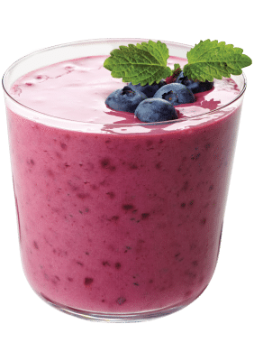
HOW TO MAKE IT
Wash the fruits
Peel the bananas and split them in half
Prepare the strawberries
Put everything in a blender
Mix
Ur done
xoxo

Slide 4
NUTRITIONAL VALUES
Calories in one serving – 142
Energy – 468 kJ
Carbs – 25g
Fat – 8g
Protein – 5g

Slide 5
STRAWBERRIES
One serving (100 g) of strawberries contains approx. 33 kilocalories, is an excellent source of vitamin C, a good source of manganese, and provides several other vitamins and dietary minerals in smaller amounts.
Strawberries contain a modest amount of essential unsaturated fatty acids in the achene (seed) oil.

Slide 6
BLUEBERRIES
Bluebrries have lots of health benefits. They have a powerful antioxidant level.
Anthocyanin is responsible for the blueberry's characteristic blue color. It also contributes to the numerous advantages of blueberries. There is 57 calories in 100g.
They reduced risk of many lifestyle-related health conditions.

Slide 7
RASPBERRIES
A high consumption of plant foods, such as raspberries, appears to decrease the risk of obesity, diabetes, heart disease, and overall mortality. It can also promote a healthy complexion, increased energy, and overall lower weight.
Raspberries contain vitamine C, K and B. One cup is 64 kcal.

Slide 8
BANANAS
Bananas are one of the most widely consumed fruits in the world for good reason. Eating them could help lower blood pressure and reduce the risks of cancer and asthma.
They contain lots of vitamins such as vitamin B6, C and magnesium, which can prevent cramps and spasms. One banana has 98kcal.

Slide 9
SPINACH
Spinach is a superfood. It is loaded with tons of nutrients in a low-calorie package. Dark, leafy greens like spinach are important for skin, hair, and bone health. They also provide protein, iron, vitamins, and minerals. The possible health benefits of consuming spinach include improving blood glucose control in people with diabetes, lowering the risk of cancer, and improving bone health.

Slide 10
THANKS FOR YOUR ATTENTION!
DT

