Slide 1
FRUITS AND VEGETABLES
TURKEY

Slide 2
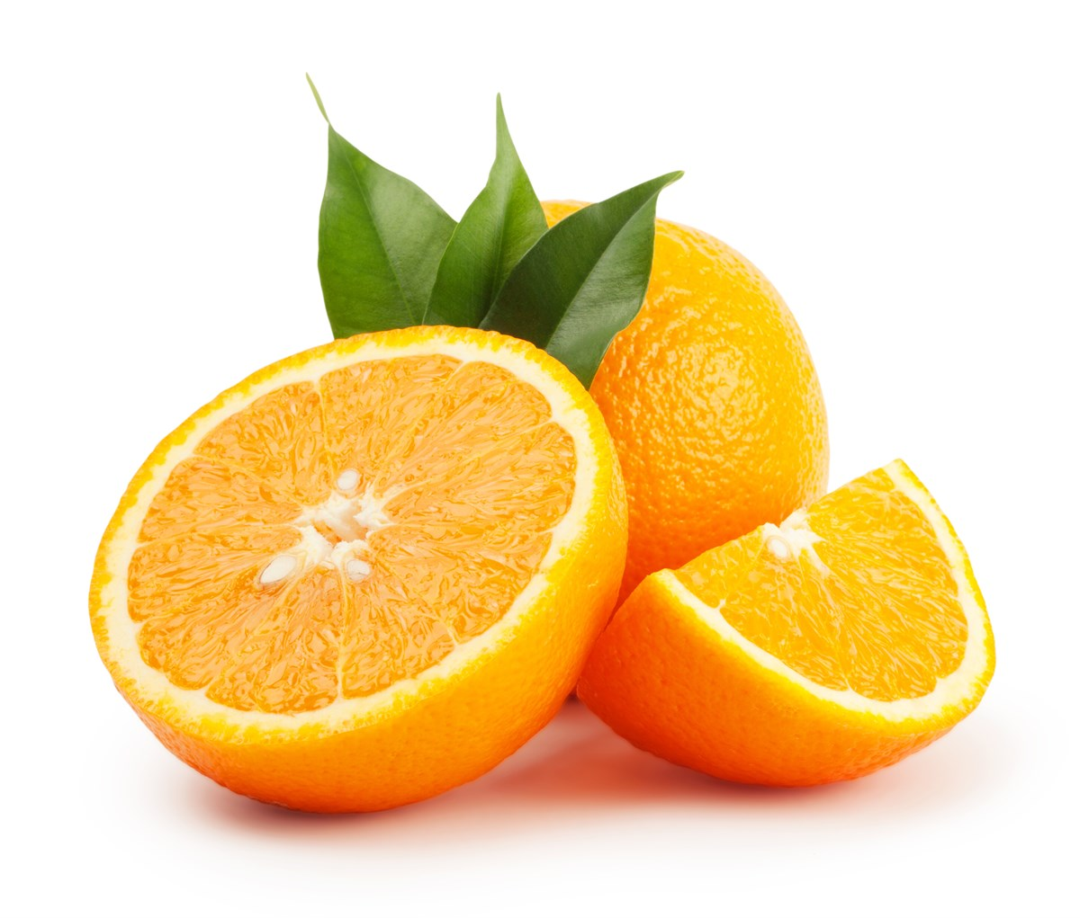
ORANGES
-Oranges are usually grown in Mediterranean ‘s coasts.
-It has huge Vitamin C supply. It is used on making medicine.
-It’s my favourite fruit. I can’t stop eating oranges.

Slide 3
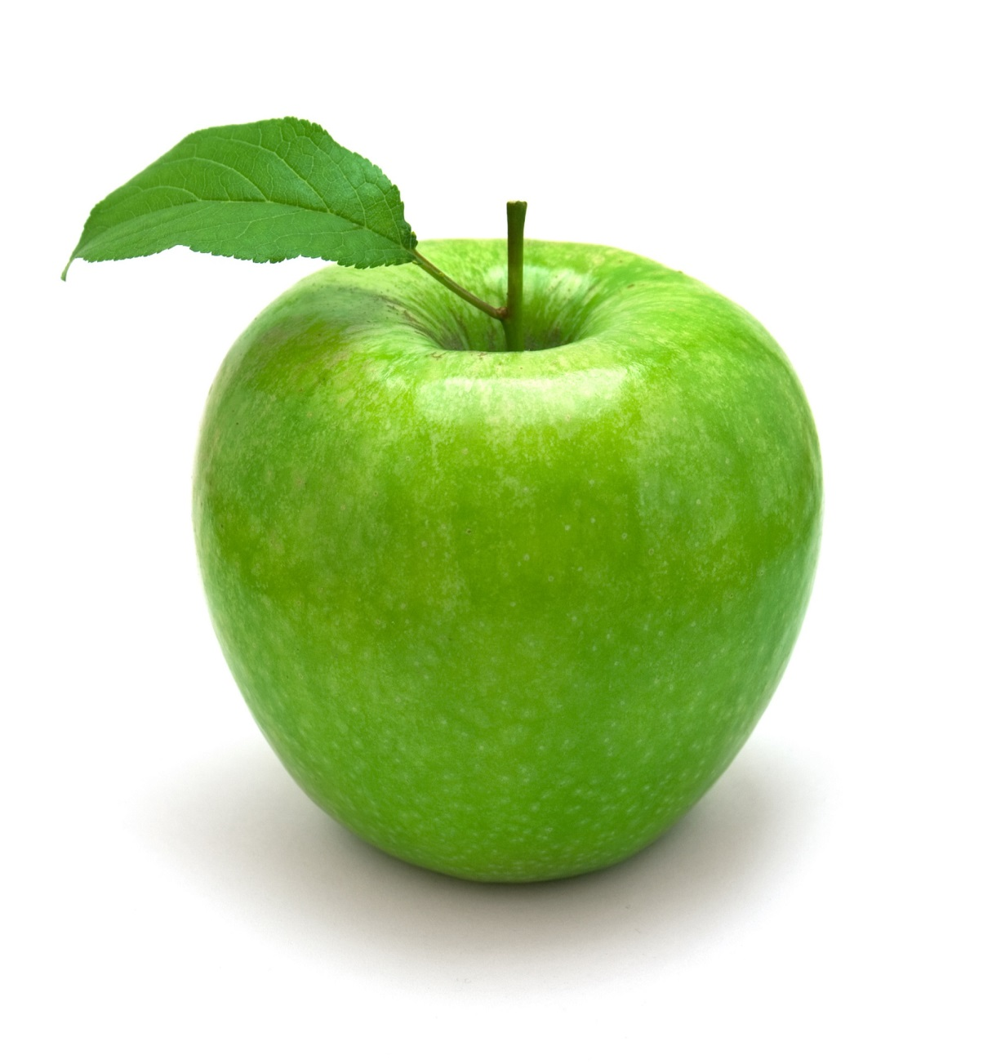
APPLES
-It is usually grown in central of Turkey.
-Amasya is famous with its apples.
-It lacks from Vitamin B but It has a lot of Vitamin A and C.

Slide 4
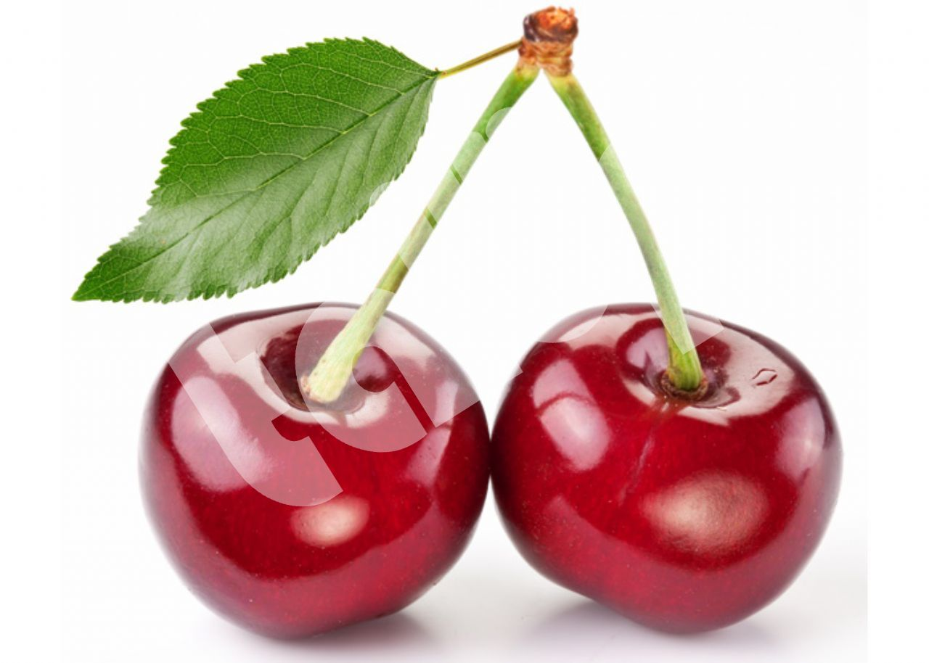
CHERRIES
-It’s mostly grown in Marmara and Agean Regions.
-Though It tastes good, we use it for making jam and juice.
-It’s harvest remind the people that summer is coming.

Slide 5
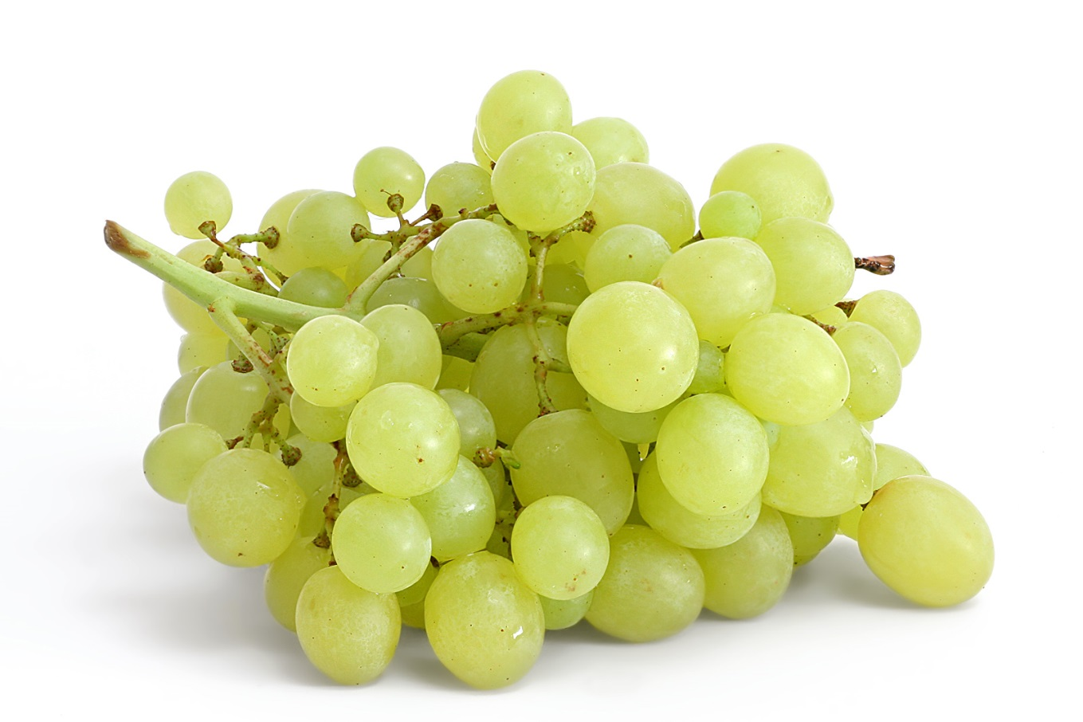
GRAPES
-Grapes are usually grown in Aegean and Marmara Regions.
-They have Vitamin B and C which is used on treatments.
-It is used to make wine.

Slide 6
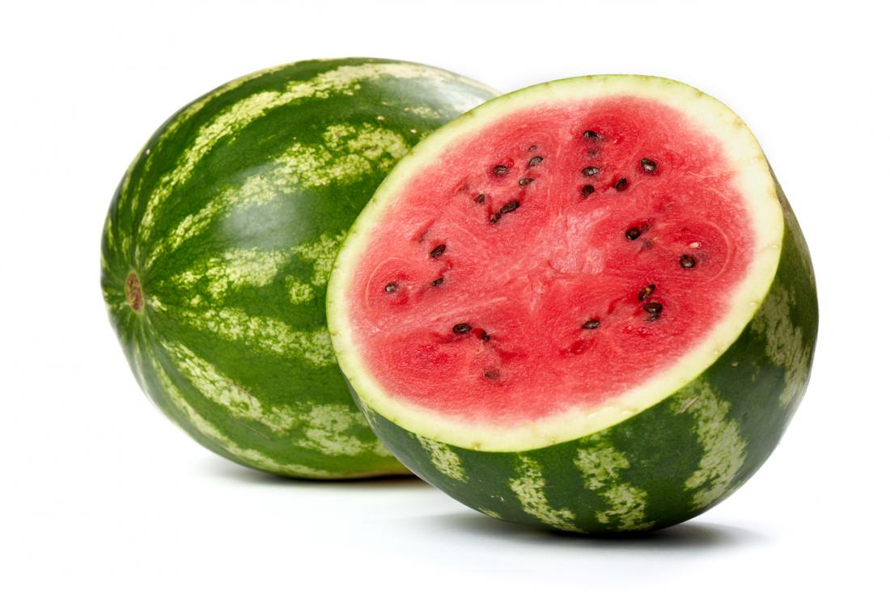
WATER MELONS
-It’s almost grown in every single region in Turkey.
-It has so many types since It’s grown in so much places.
-It is the most loved fruit in Turkey.

Slide 7
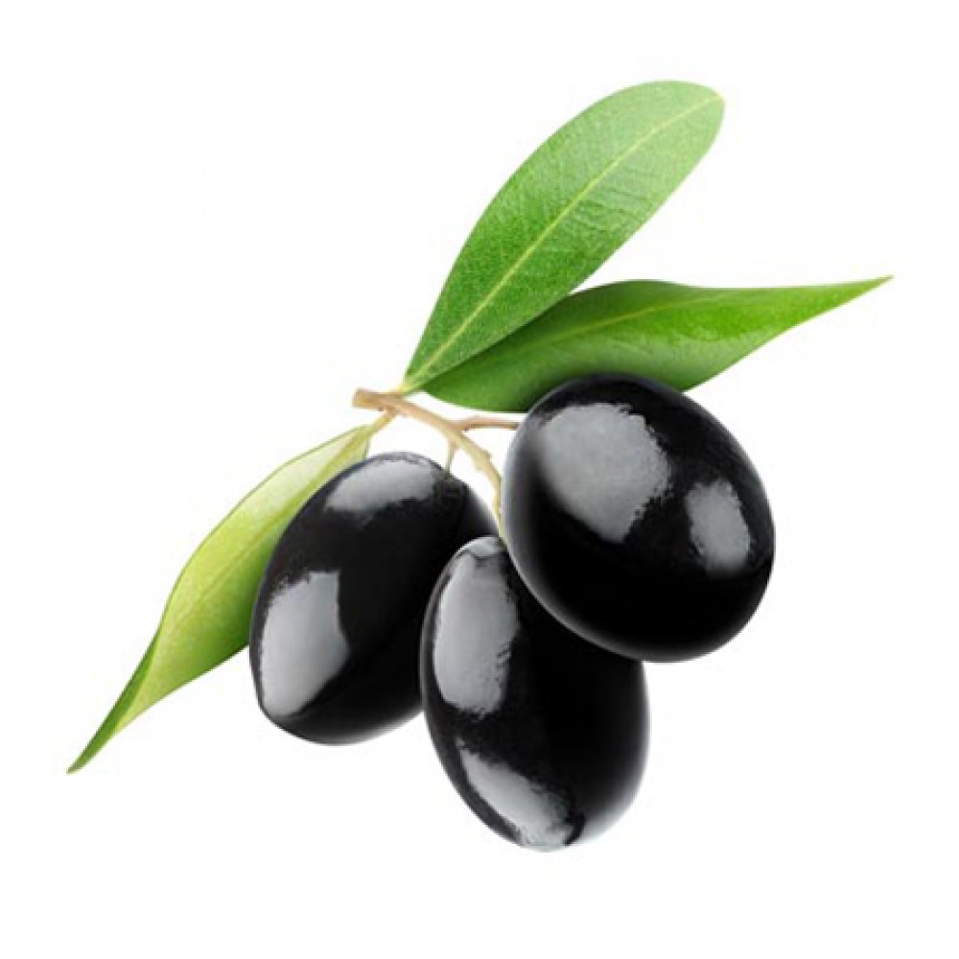
OLIVES
-It is what makes Aegean, Aegean.
-It’s so important for us. We make oil from it which we make so much that our oil is 9% of the World’s reserves.
-I don’t like it. So sour for my taste.

Slide 8
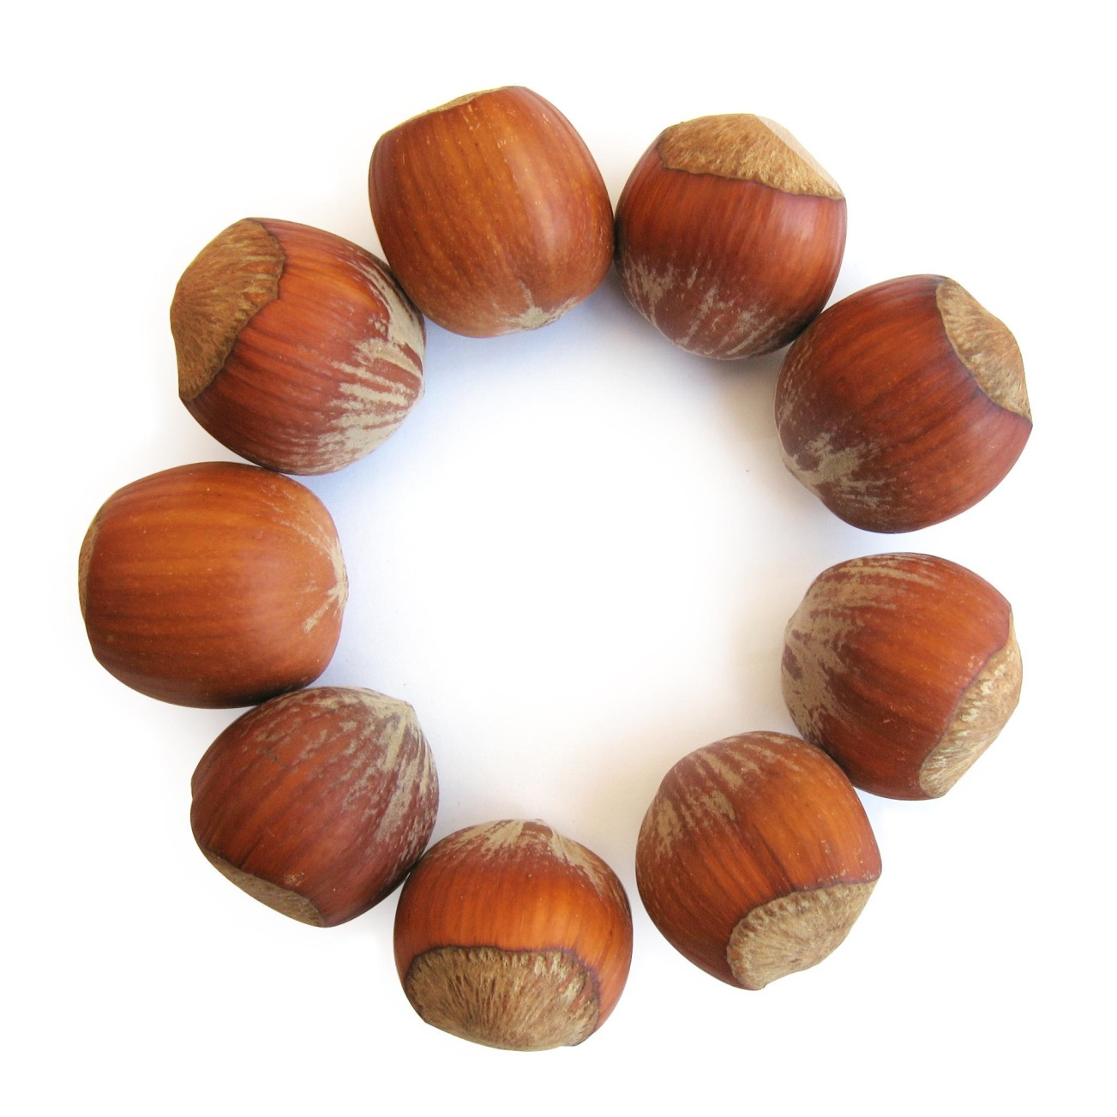
HAZEL
NUTS
-It is mostly grown in Black Sea Region.
-We have the World’s biggest hazelnut source with around %70.
-It gives energy and lowers the heart attack risk.

Slide 9
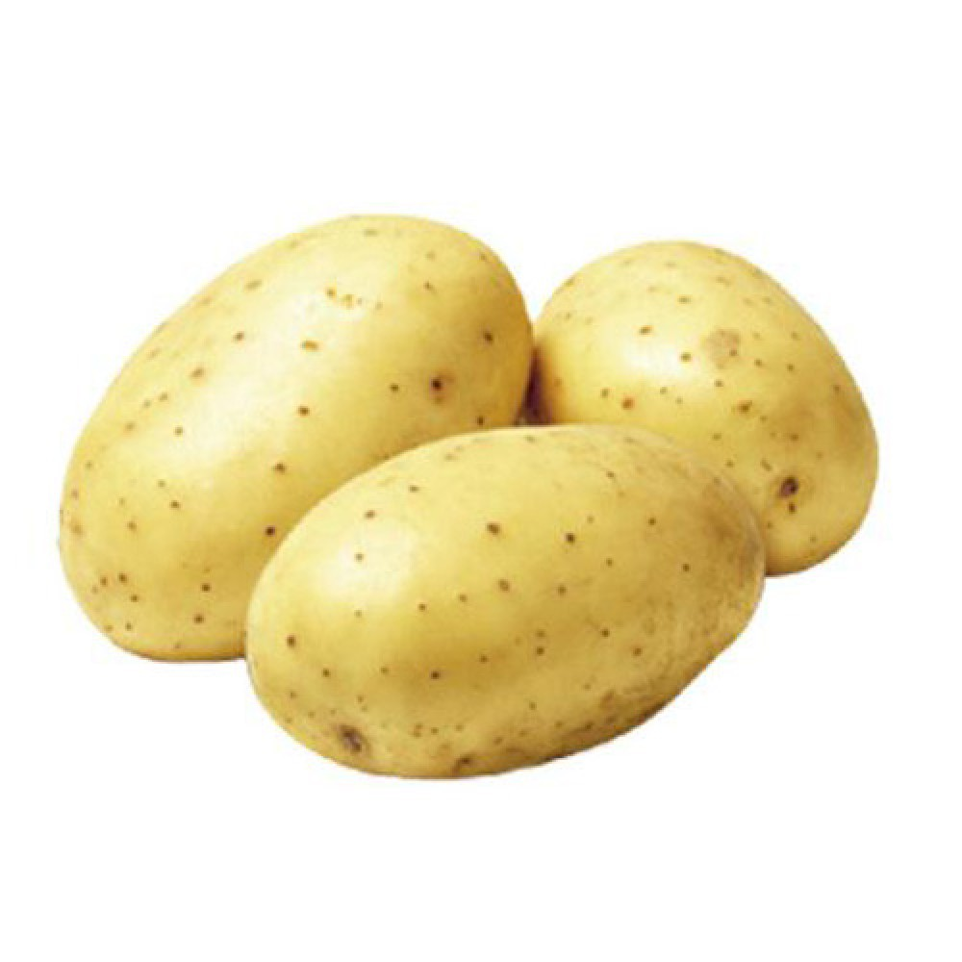
POTATOES
-Like watermelons, It can be grown in almost every region.
-It helps with digestion problem.
-They actually relate with eggplants.

Slide 10
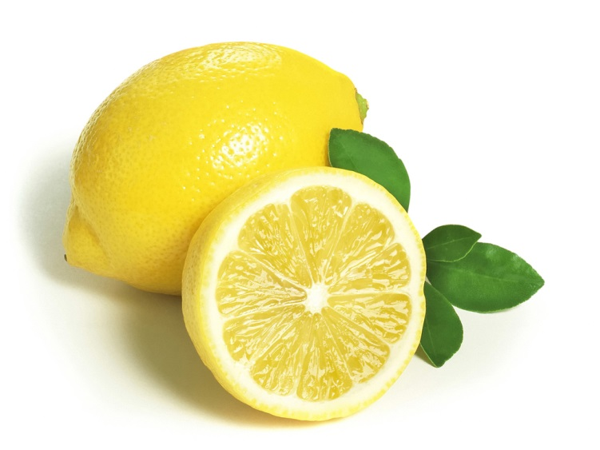
LEMONS
-Like oranges It is mostly grown in Mediterranean Region.
-It’s sour. Really sour.
-Like all the asidic fruits mentioned, this fruit has Vitamin C too.

Slide 11
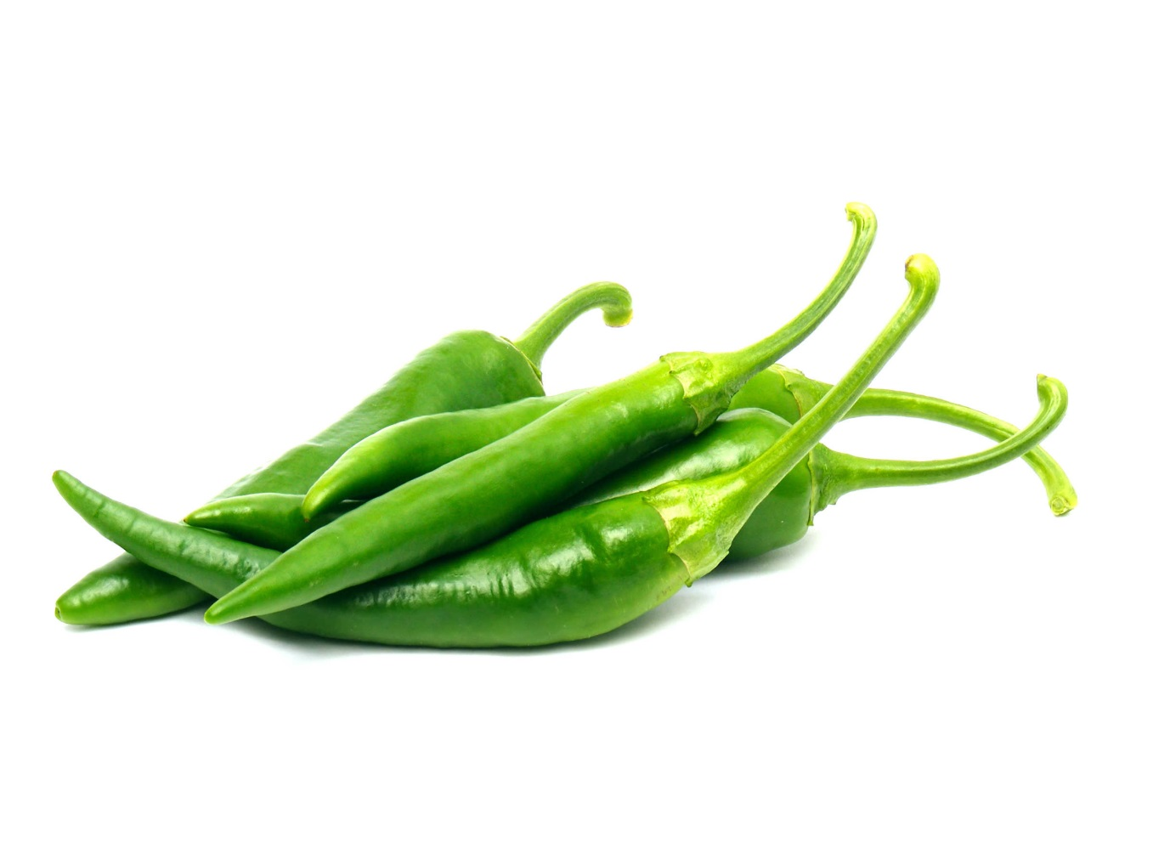
GREEN PEPPERS
-This vegetable has Vitamins A,C,E.
-It’s grown in Edirne and is hot as Edirne.
-It’s so hot that if you make paste from it, you have to mix with tomatoes.
-But we love green peppers.

Slide 12
-BY: Ibrahim efe yakar

