Slide 1
Smoothie
Michal Heleš, Šimon Hodál, Nela Soldová, Ivona Ševčovičová

Slide 2
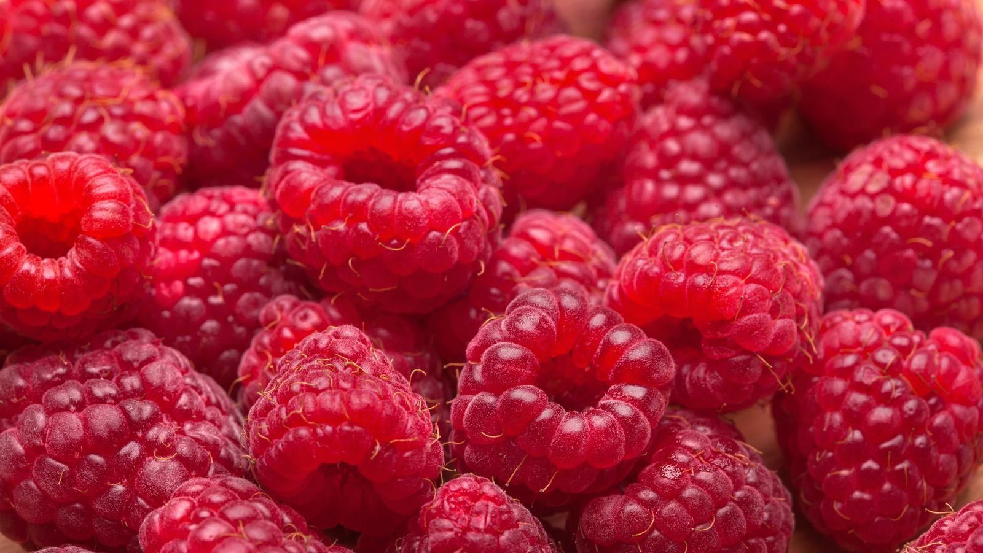
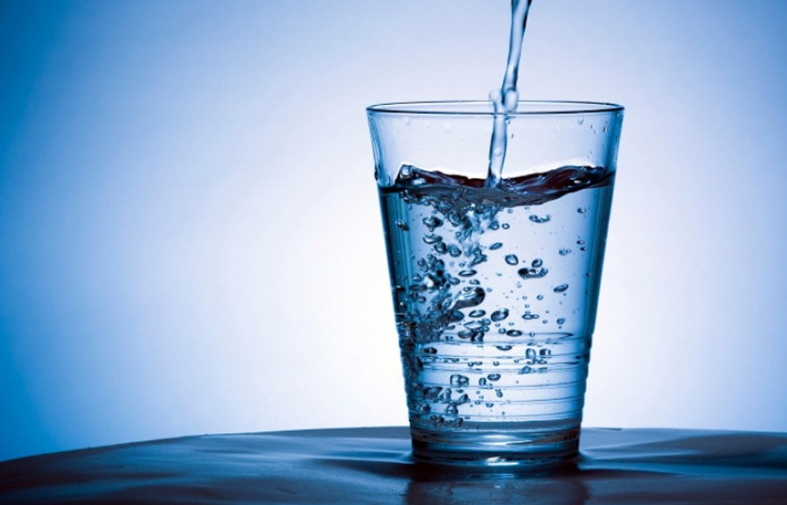
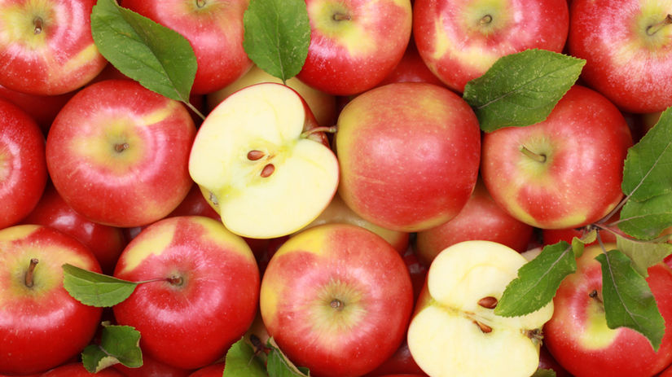
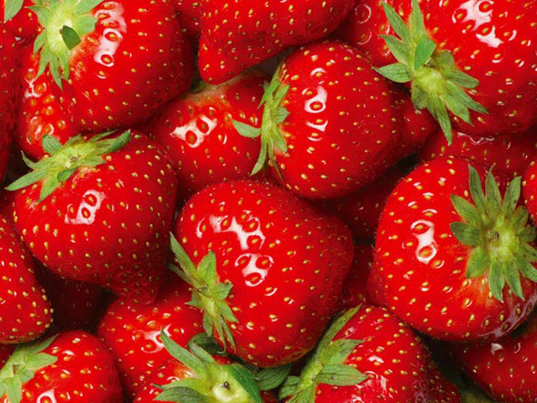
INGREDIENTS:
Raspberries
Apples
Strawberries
Raspberries
Water
Water
Apples
Strawberries

Slide 3
HOW TO MAKE IT
1) Wash the fruit
2) Cut the fruit
3) Put it to the blender
4) Pour the water to the blender
5) We can mixed it
6) Now we can serve it

Slide 4
NUTRITIONAL VALUES
Apple:
Calories:57 kcal
Energy: 238 KJ
Protein: 0,37g
Carbohydrates: 13g
Fat: 0,4g
Fiber: 3g

Slide 5
Strawberries:
Calories: 17 kcal
Energy: 73 KJ
Protein: 0,39g
Carbohydrates: 3g
Fat: 0,19g
Fiber: 0,88g

Slide 6
Raspberries:
Calories: 52,6 kcal
Energy: 99 KJ
Protein: 1,5g
Carbohydrates: 14,7g
Fat: 0,8g
Fiber: 8g

Slide 7
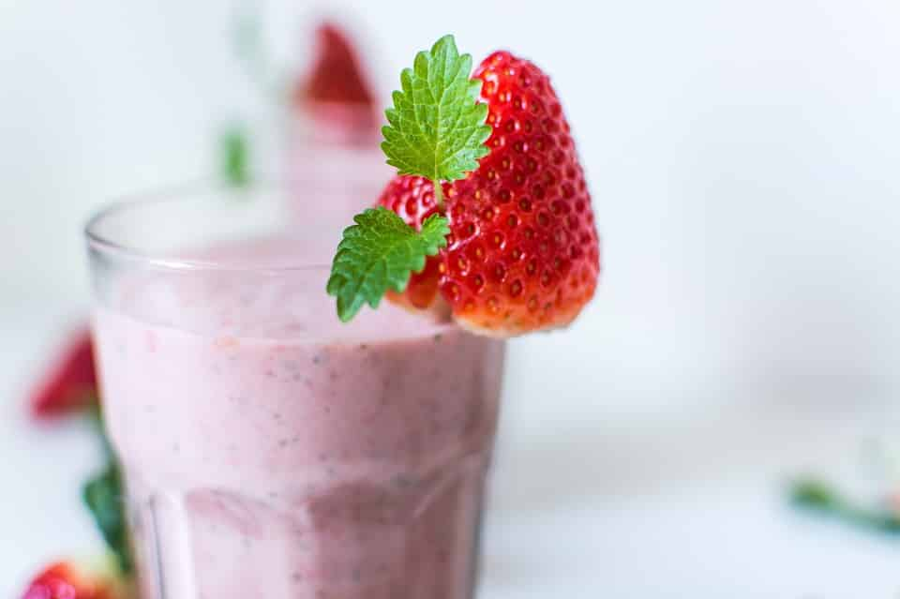
WHY IS OUR SMOOTHIE GOOD?
Carbohydrates are good for liver
Because fruit have lots of energy and vitamins (C,A,B,E)

