Slide 1
POTATO OMELETTE RECIPE
UNAI LLANO

Slide 2
INGREDIENTS
Potatoes, eggs, oil and salt.

Slide 3
FIRST
Peel the potatoes and wash them to remove dirt.

Slide 4
SECOND
We dry the potatoes

Slide 5
THIRD
We cut the potatoes into thin slices.

Slide 6
FOURTH
We put the potatoes in a large bowl.

Slide 7
FIFTH
Salt is added.

Slide 8
SIXTH
We put oil in a pan.

Slide 9
SEVENTH
Add the potatoes. Fry them for 20 minutes over low heat

Slide 10
EIGHTH
Beat the eggs in the bowl.

Slide 11
NINETH
Removed the potatoes from the pan. You have to drain them well.

Slide 12
TENTH
Mix the potatoes in the bowl with the beaten eggs.
Let this mixture stand for 15 minutes.
Put this mixture In the same pan for 5 minutes

Slide 13
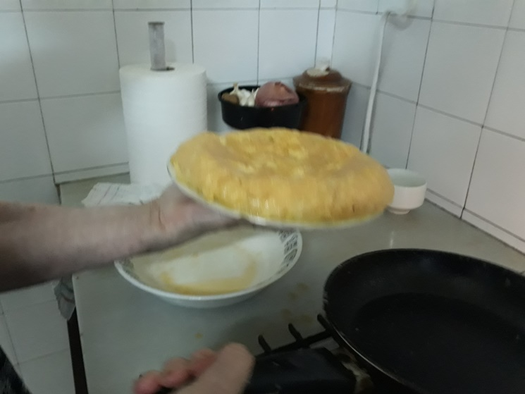
ELEVENTH
To turn the omelette around use a large flat plate.

Slide 14
FINISH

