Slide 1
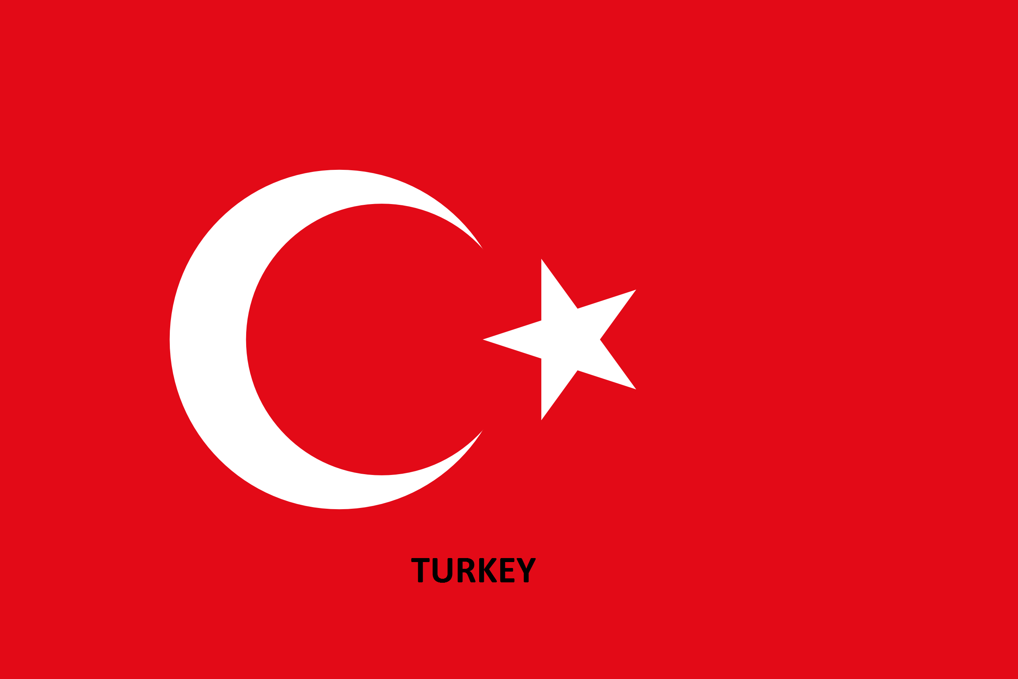

Slide 2
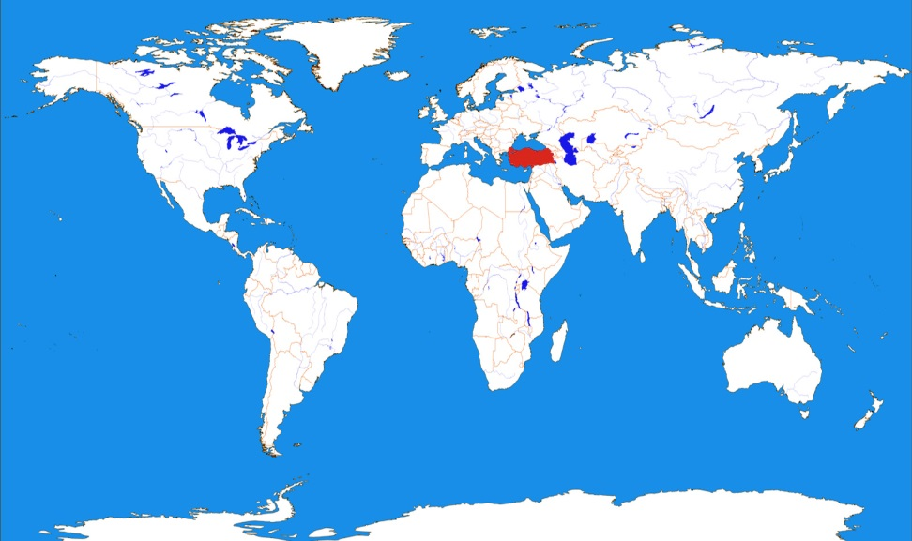
TURKEY
Turkey,
The bridge between continents, a great potential in farming and industry. Has been home to great nations, and now is home to us. Let me introduce you to one of the greatest countries of the world, Turkey.

Slide 3
INTRODUCTION
Turkey divides into 7 districts, these are :
-Marmara -Aegean -Mediterranean
-Black Sea
-Central Anatolia
-Eastern Anatolia
-Southeastern Anatolia
There will be 2 parts for each district:
Some fun facts about the district
Things that are famous there

Slide 4
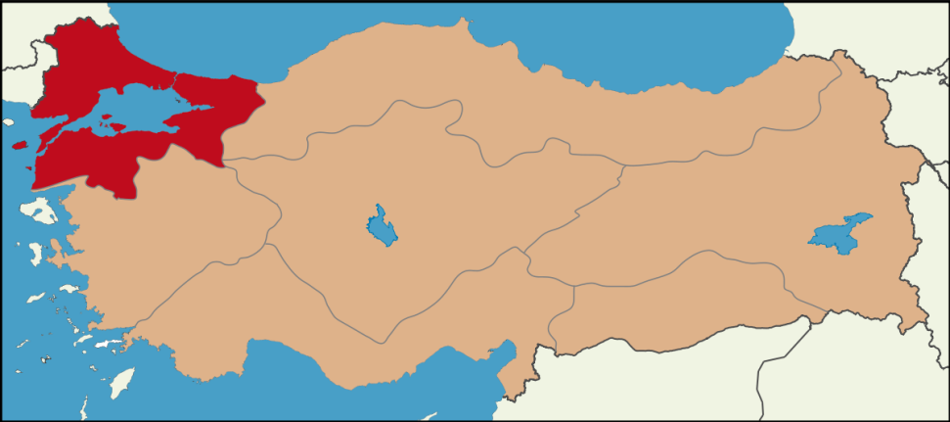
MARMARA DISTRICT
Imagine, only this district has more population than Sweden, Norway and Denmark all together!
The biggest city of this region is Istanbul, which has 14,657 million population making it the world’s 4th most crowded city!
There is Cannakkale here which was one of the most dangerous fronts at World War I. You can find martyrdoms of Anzacs as well.
The best skiing place in Turkey for the most of the people, Bursa-Uludag is here.

Slide 5
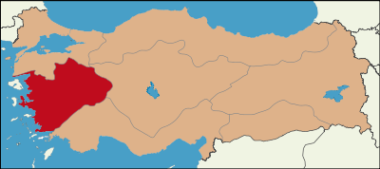
AEGEAN DISTRICT
Even though Aegean District is beatiful, we won’t be talking about that here because I know you all want to hear about farming! Aegean District is one of the best sources of fig and olive reserve of Turkey. Money has been firstly used here once upon a time by Lydians. The sea is so clean that you can easily see the fish under 10 meters from the surface.

Slide 6
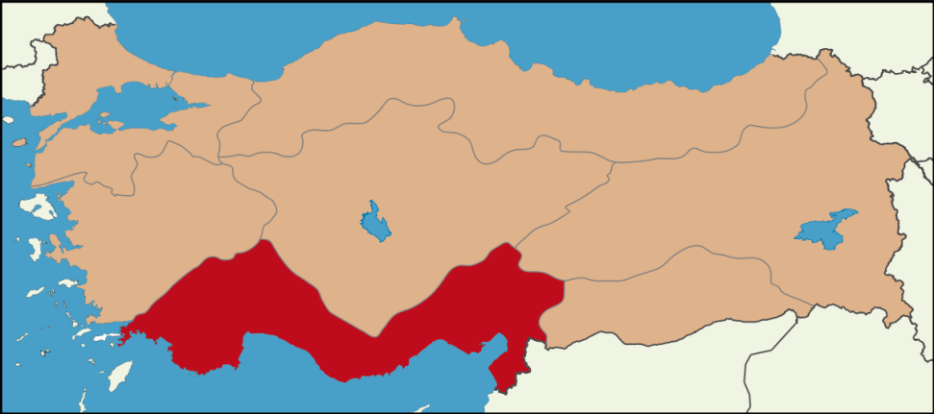
MEDITERRANEAN DISTRICT
Best oranges are grown up here.
All in all the marvellous great sea, ancient buildings, ruins of some civilizations and of course its dishes, this district gets tourist floods every year.

Slide 7
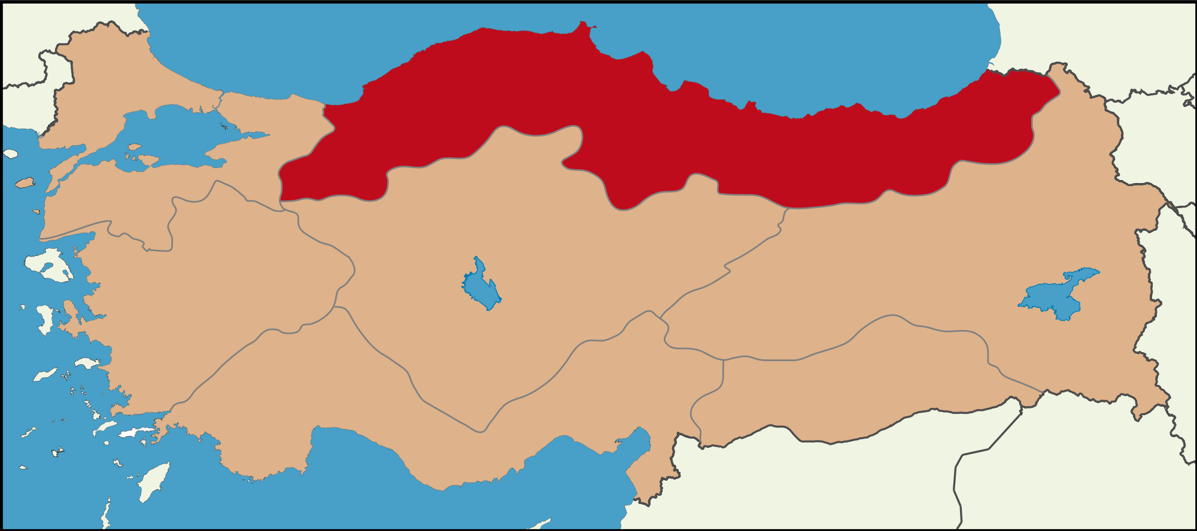
BLACK SEA DISTRICT
If you start to see hazelnuts and tea plants everywhere, congrats! You somehow reach Black Sea region. 75% of the World’s hazelnuts reserve is in this district. Even though our tea growing isn’t as good our hazelnuts we are 5th at tea growing. Its climate is rainy and humid all the time in all seasons.

Slide 8
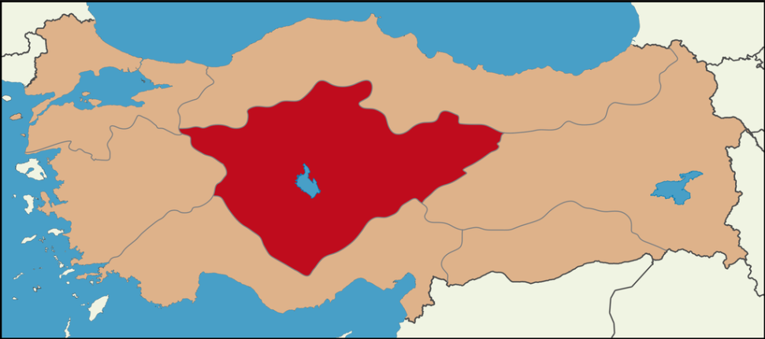
CENTRAL ANATOLIA DISTRICT
Well, farming! And Politics! And all those dishes! Central Anatolia is a great place to live, rather than travel. I live here after all I know a lot of things from here. So the capital, Ankara is here. Which means the Turkish National Assembly is here as well. There are big forests like AOC (Atatürk Orman Ciftligi) which is the best place to eat ‘’kokoreç’’ in the world. If you don’t know what kokorec is well, you have to try it☺ Konya has one of the best kitchens of the world. Having tastes like pide, cooked kebab and borek.

Slide 9
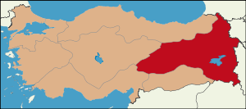
EASTERN ANATOLIA DISTRICT
Coldest district of Turkey! Most of Turkey’s animal farms take place in here. Also we have been here since 350s. Impressive huh? And we also started the migration period here. There are lots of meaty dishes.

Slide 10
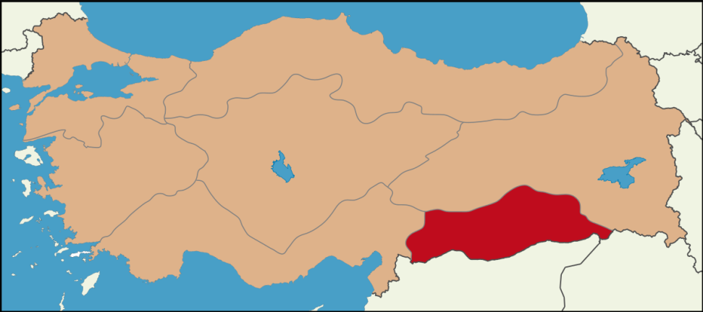
SOUTH-EASTERN ANATOLIA DISTRICT
The smallest district but you can find a lot of great dishes, animal farms, and 96.7% of the Turkey’s lentil.

