Slide 1
Workshop
Bath bombs

Slide 2
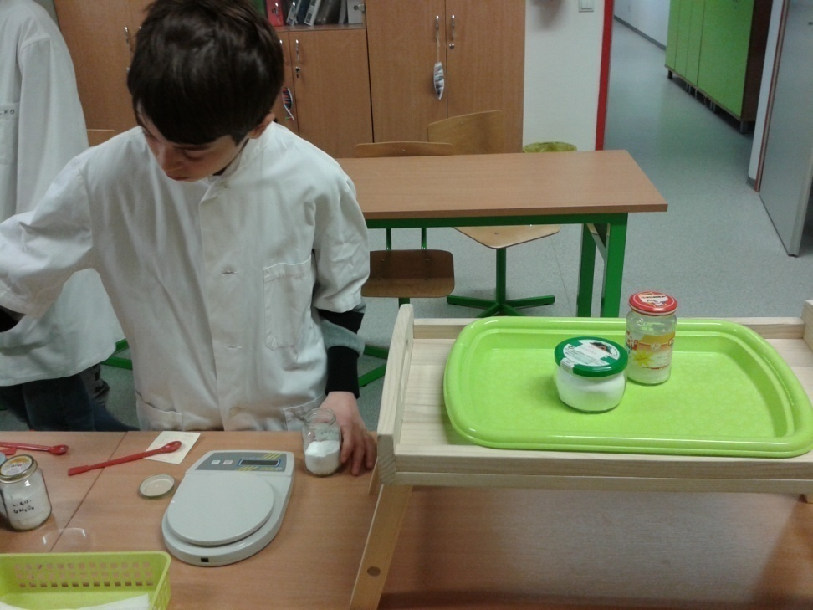
Preperations of chemicals
Weigh the right amount of chemicals

Slide 3
One of the ingredients is LEMON ACID
C₆H₈O₇
Organic acid, present in many types of fruit.
It is used in production of non alchoholic drinks and in medicine.
It is a normal ingredient in human blood and urin.
It is used in production of bubble pills and vitamin drinks.

Slide 4
One of the ingredients is also SODIUM HYDROGEN CARBONATE
It is used in cosmetics, in production of bubble drinks, in production of artifical mineral water
In baking as the main ingredient, in production of diffrerent baking powders, powders for rolls and baking
Due to poor alkalinity in medicine it is used as a neutralizer surplus of gastric oxiden (Most HCI), and for neutralizing acids in different chemical proceses
Sodium hydrogen carbonate
NaHCO₃

Slide 5
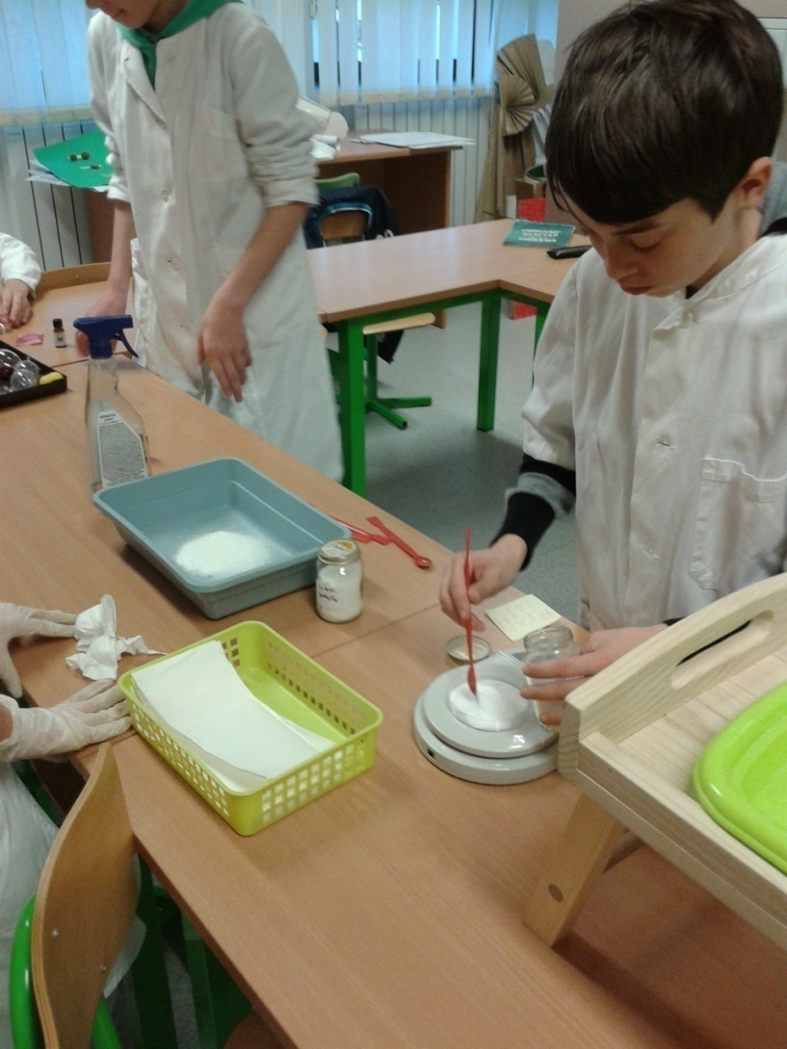
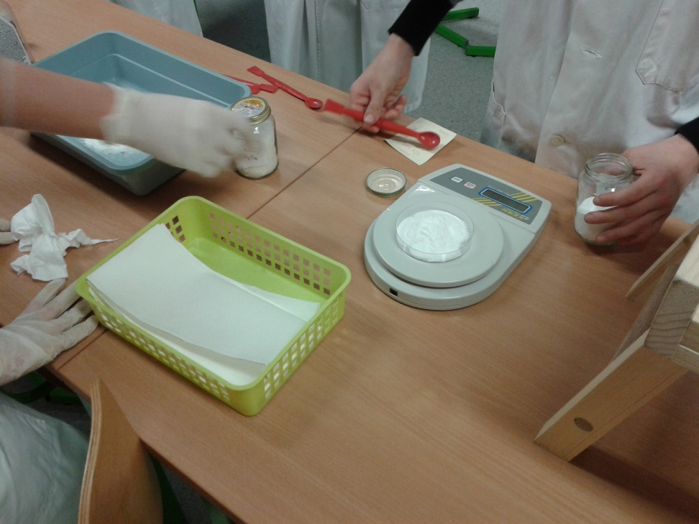

Slide 7
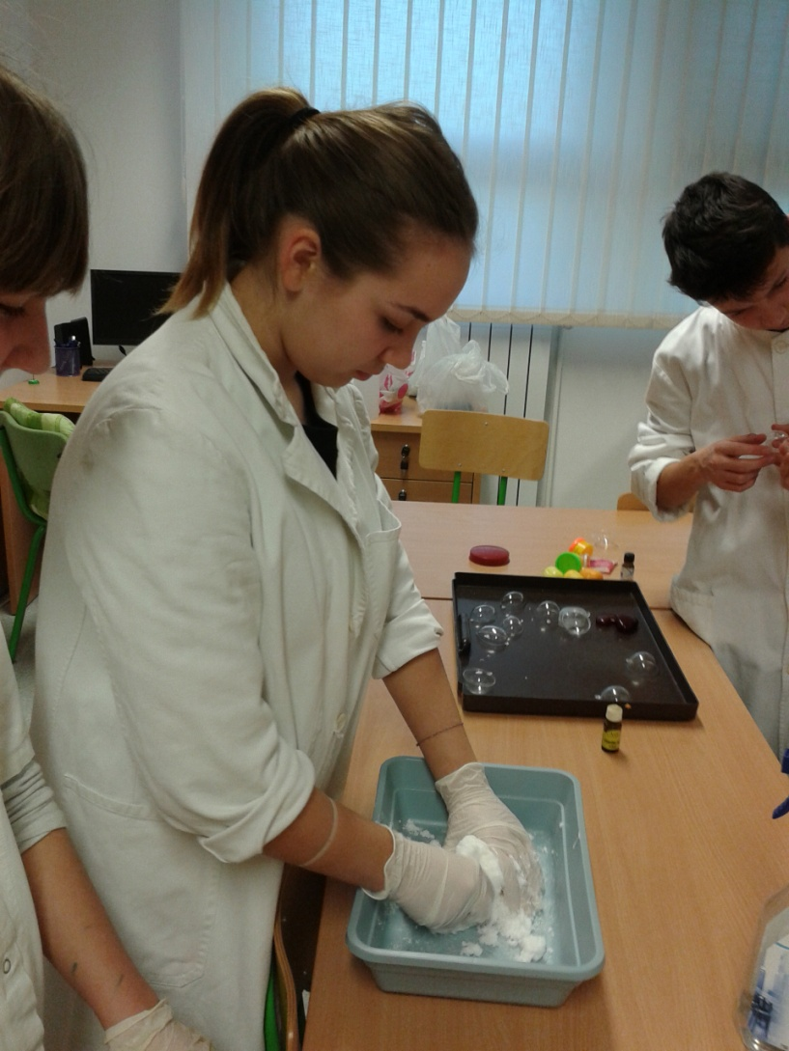
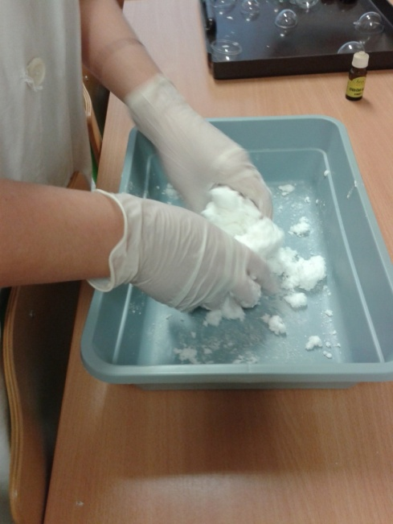
Mixing the ingredients
We mixed the ingredients using gloves because of
corrosion.
The mixture is endothermic

Slide 8
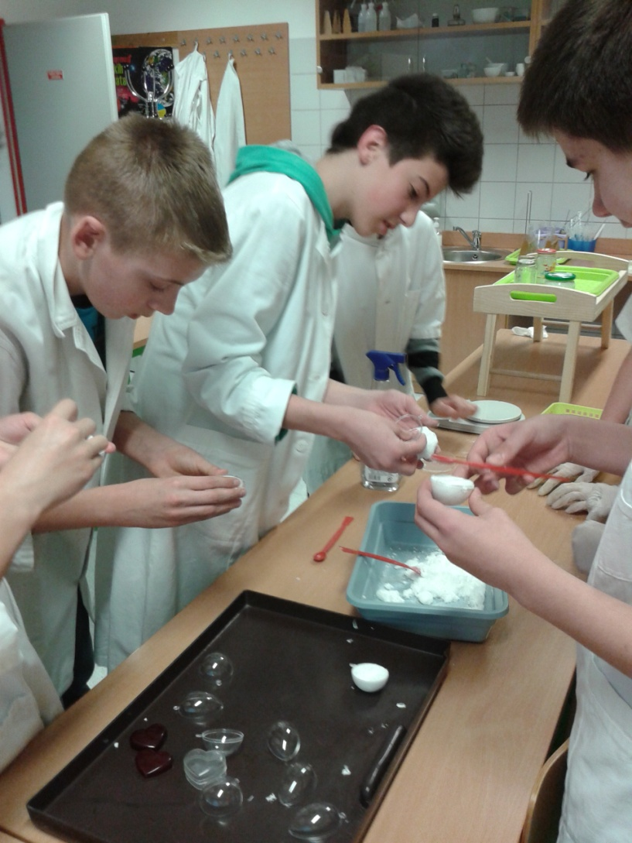
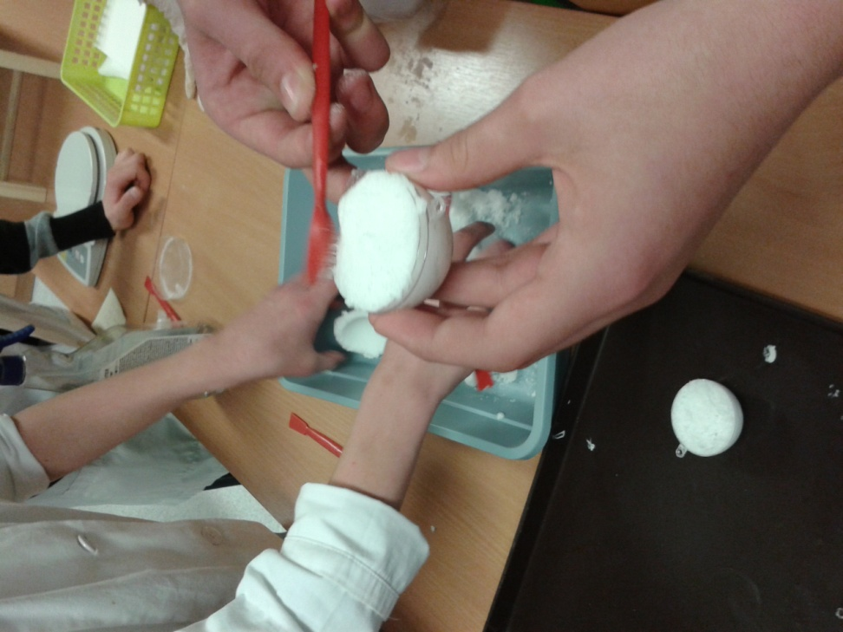
Filling the calups

Slide 9
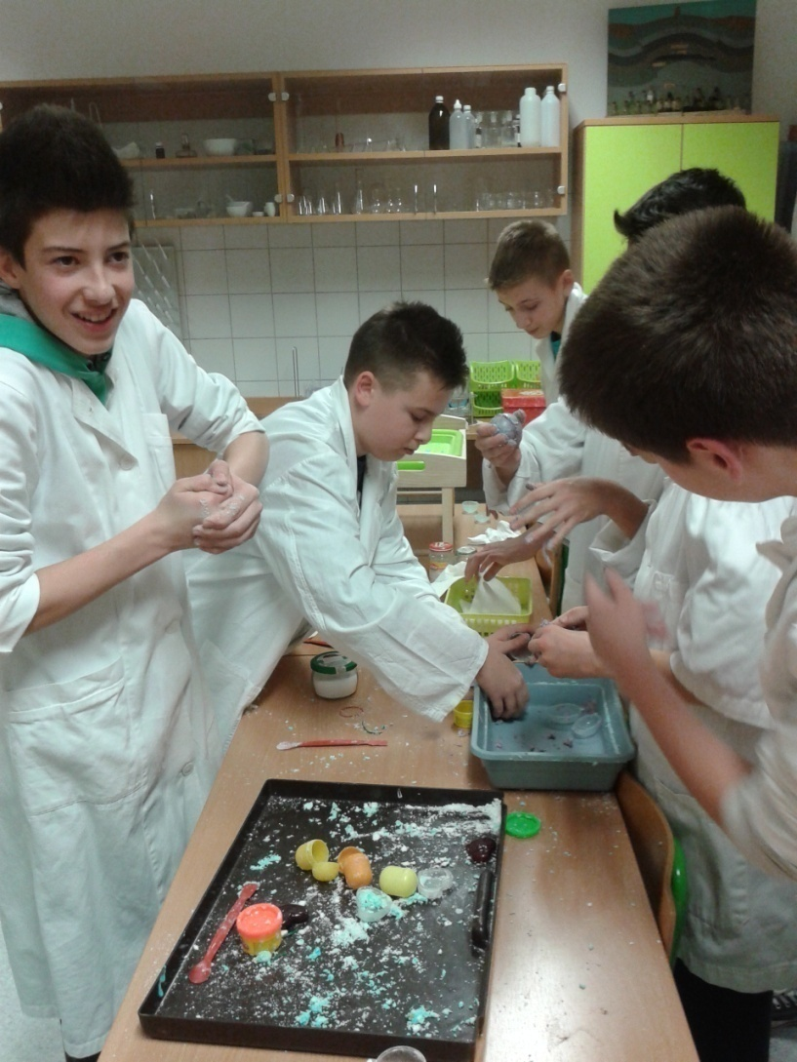

Slide 11
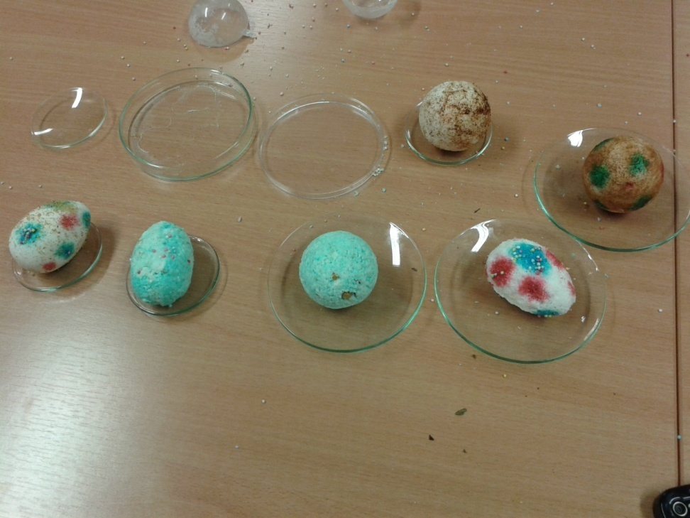
Drying

Slide 12
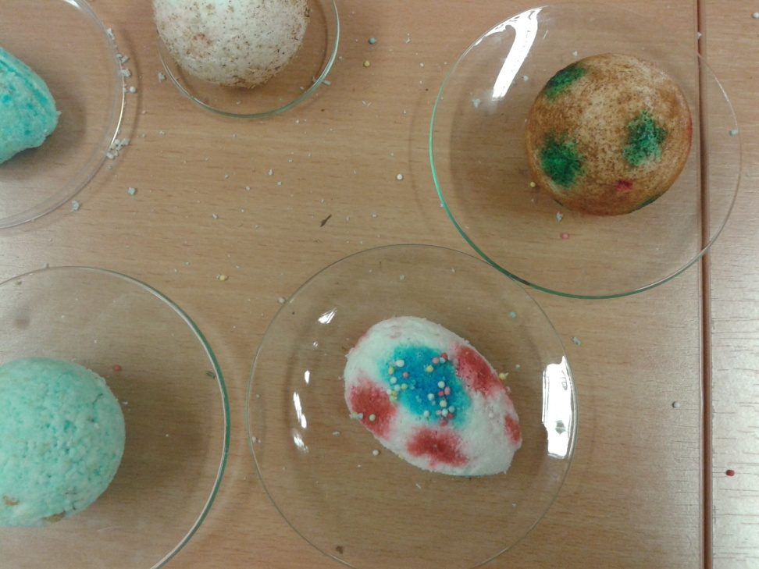
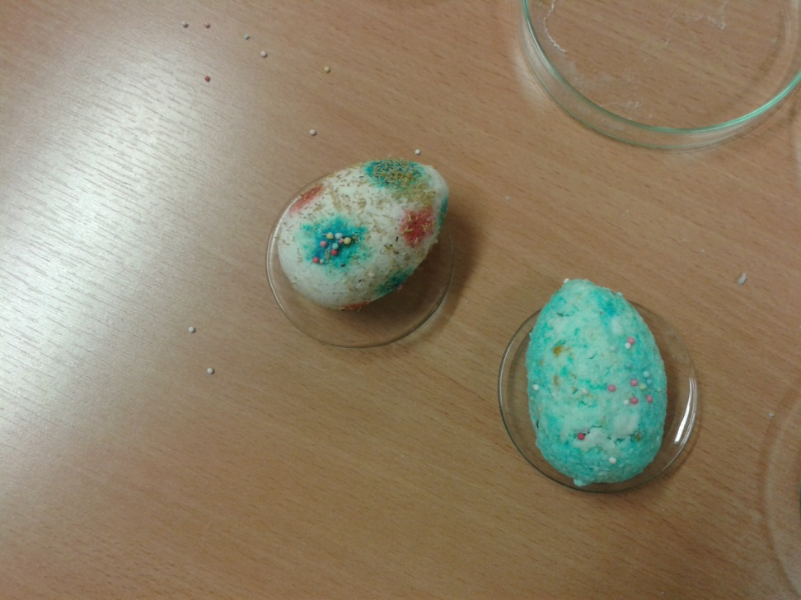
Finished shapes

Slide 13
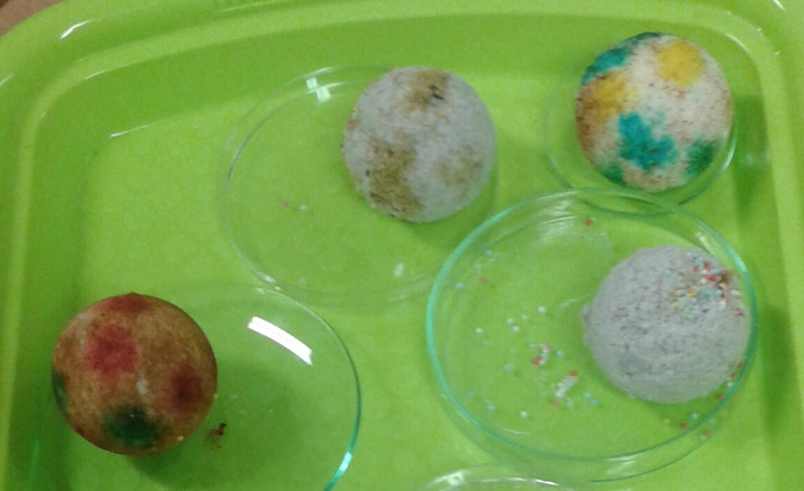

Slide 14
