Slide 1
Beauty of naature
Croatia, December 2018.

Slide 2
Students working….

Slide 3
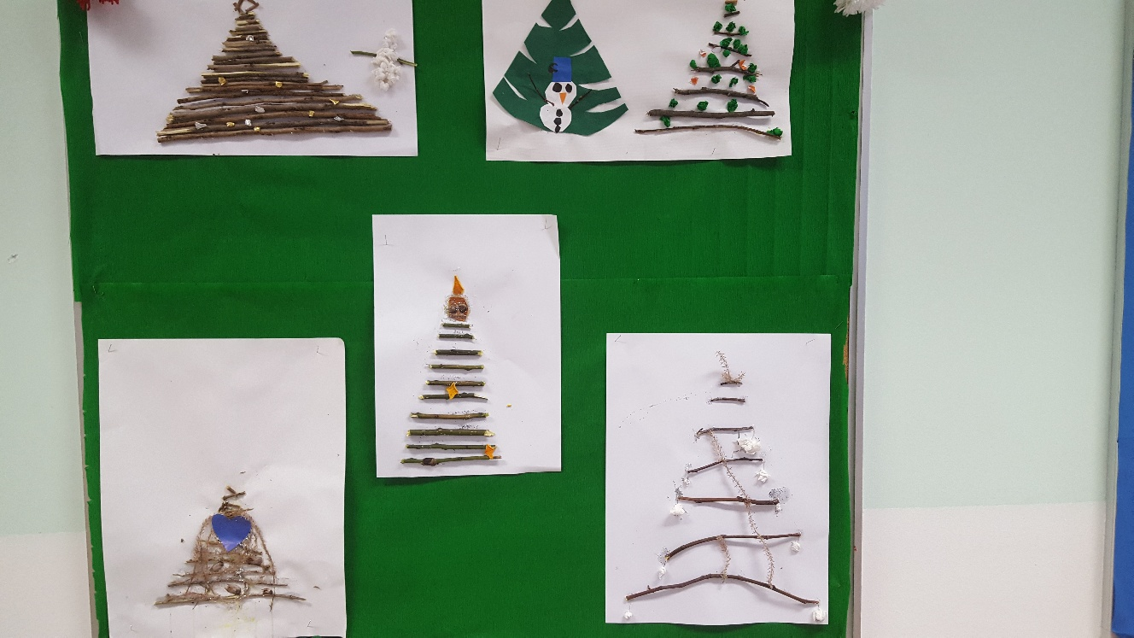
Christmas cards – wood and wool

Slide 4
Christmas tree – wool, dry orange

Slide 5
Artwork – seeds, popcorn, straw…

Slide 7
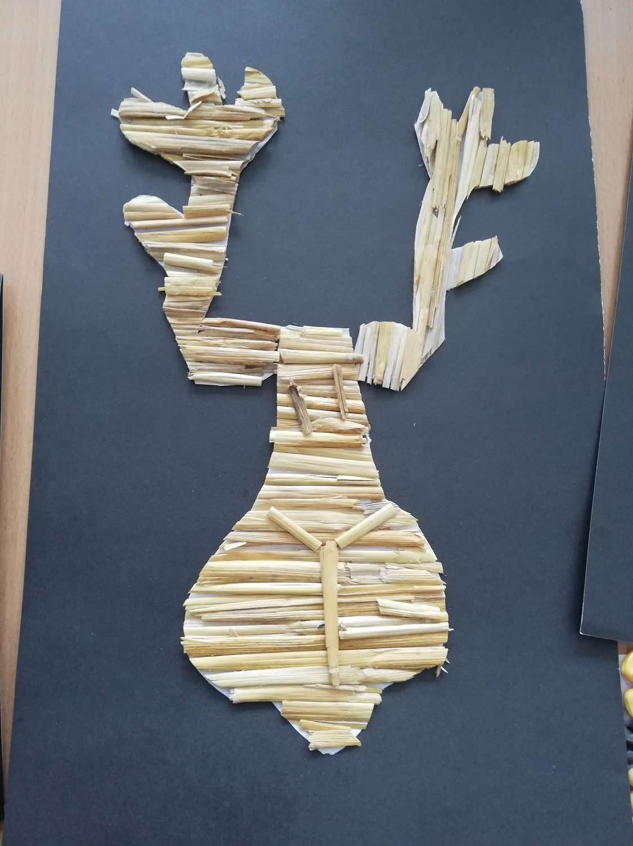
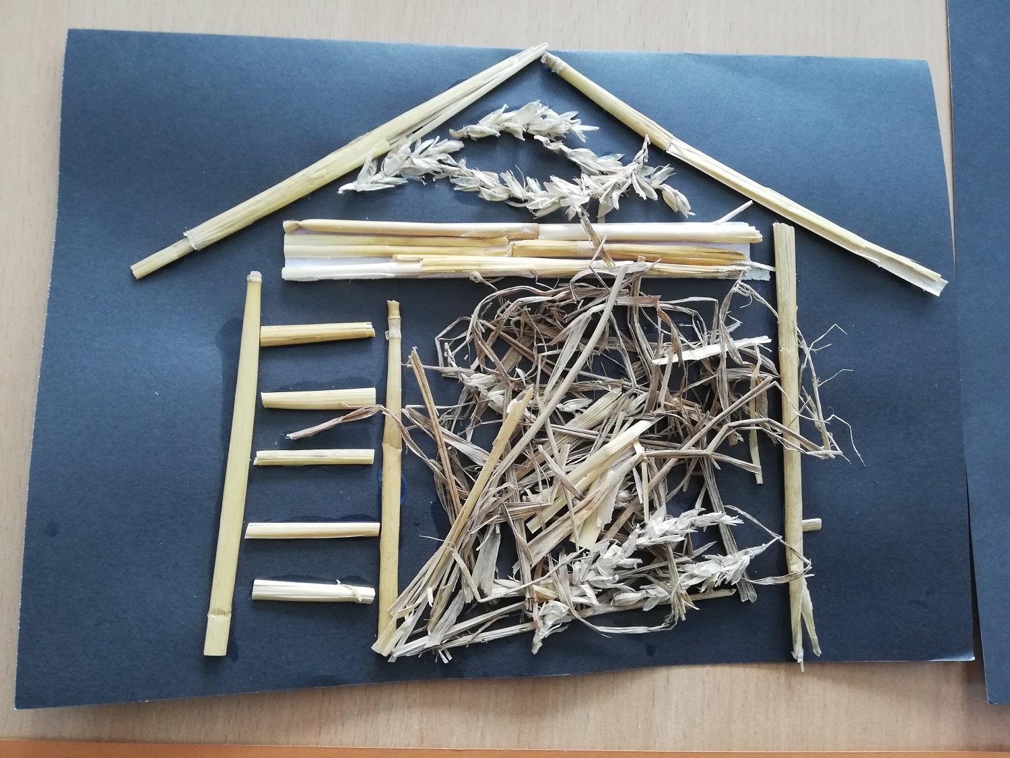

Slide 8
