Slide 1
Preparing the work materials
First we prepared the chemicals and accesories.
We need: plastic bottles, a bottle for destilled water, destilled water, ethanol, essential oils of sandalwood, tea tree, cedar, sweet orange and cinnamon.

Slide 2
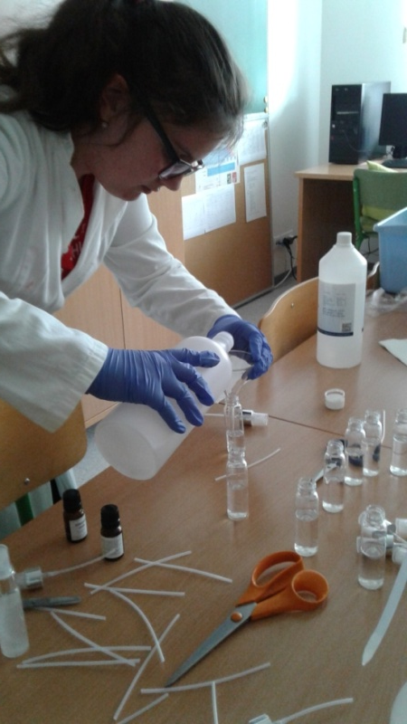
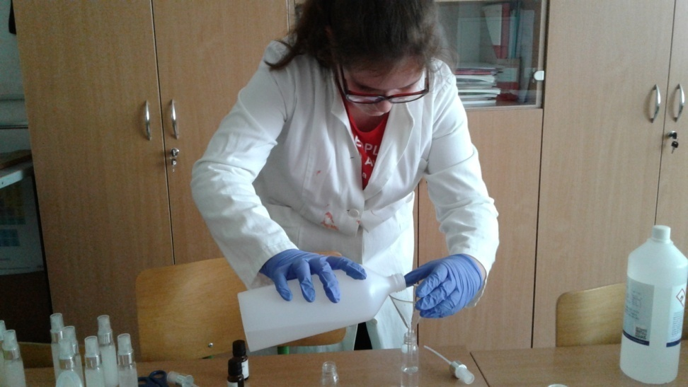
Procedure
According to the instructions of the chemistry teacher, we prepared solutions of disinfectant which filled the previously prepared packaging.
First in every bottle we put the same ammount of ethanol.

Slide 3
Procedure
Then we added the essential oil of tea tree and we shook the bottles.

Slide 4
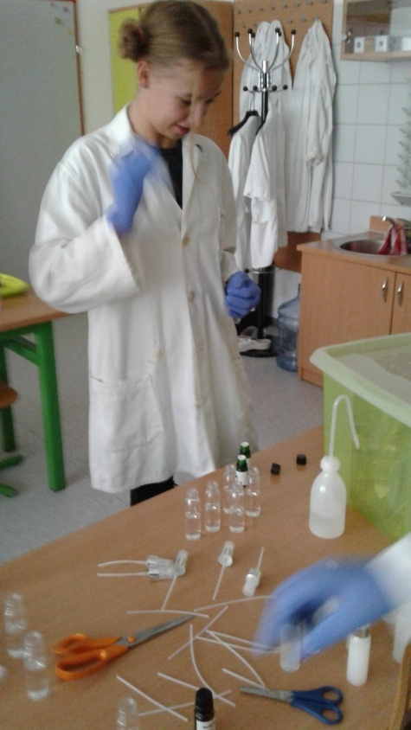
Procedure
Then we added the essential oils of sandalwood, cedar, sweet orange and cinnamon.
There was 10 bottles with each essential oil.

Slide 5
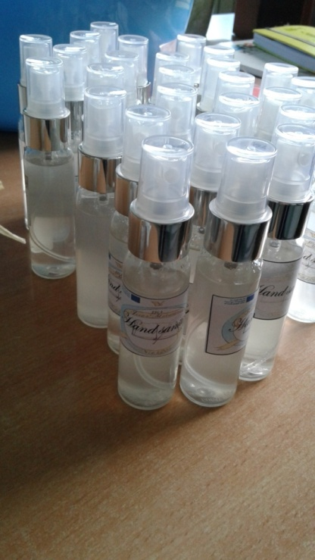
Decoration
We split the bottles into groups based on their ingredients. Then we decorated them.

Slide 6
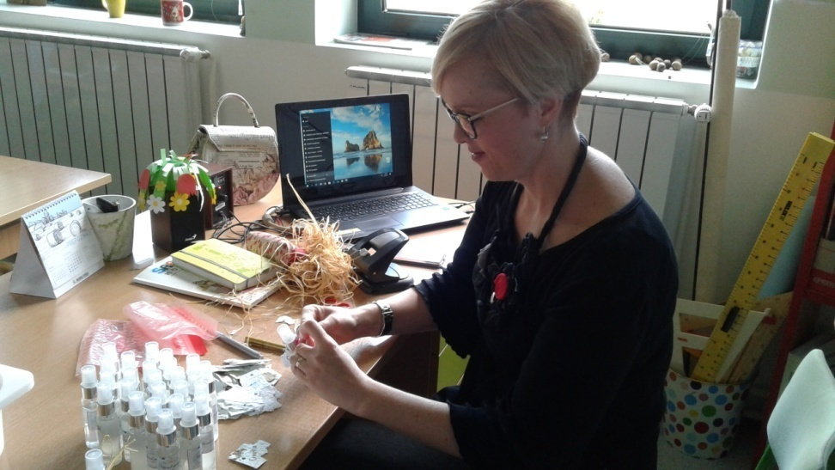
Decoration
Teacher primary school is decorating the bottles with the school logo and the logo of the project with her creative students.

Slide 7
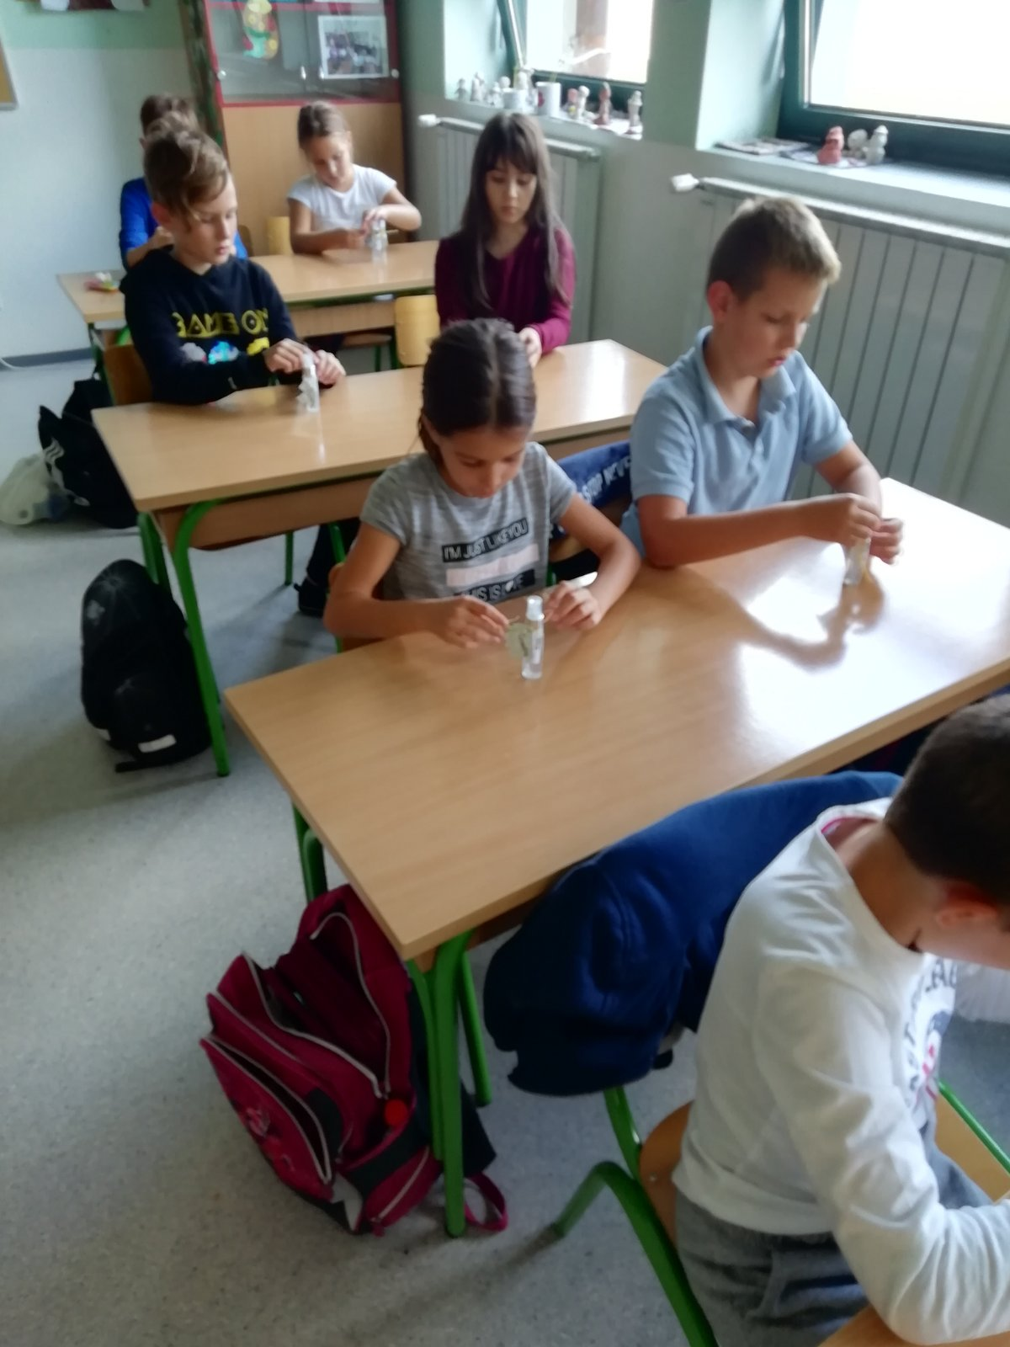

Slide 8
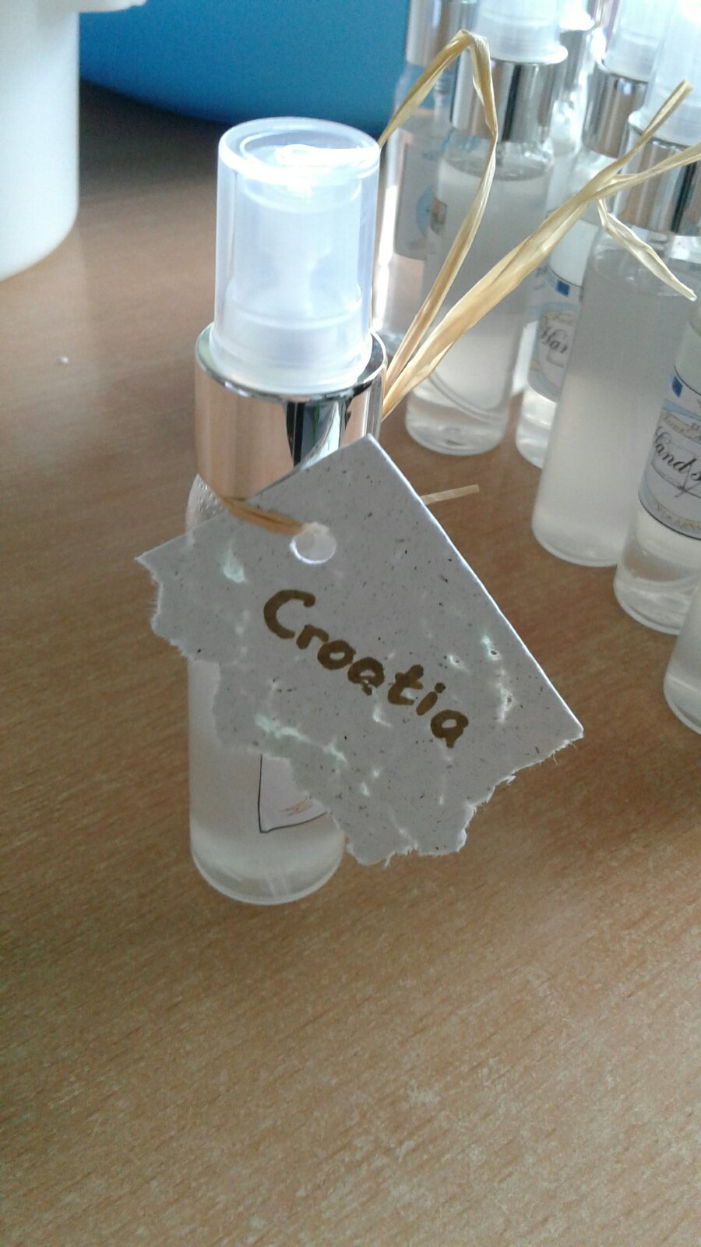

Slide 9
Mia Periškić i Roko Zrilić

