Slide 1
FINAL SCHOOLS –Eryaman Campus

Slide 2
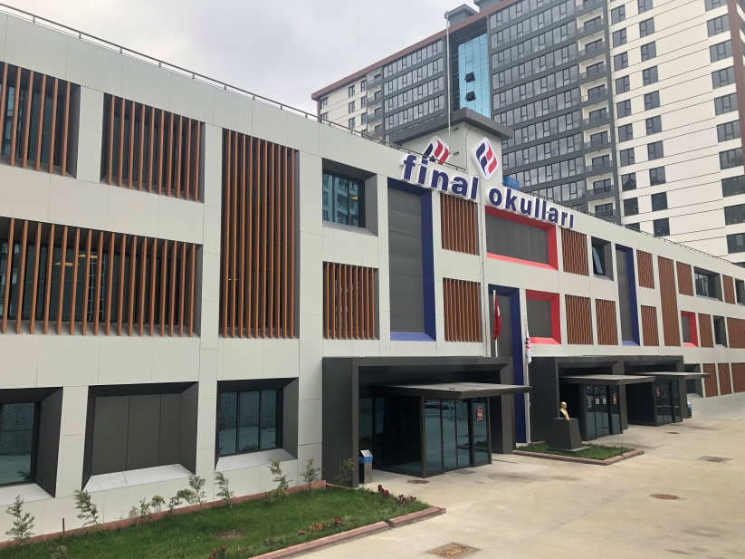
> Final Schools is one of Turkey’s most well-known private schools. > It has firstly founded in 1980. > It has 697 institutions all around Turkey and a university İn Northern Cyprus.

Slide 3
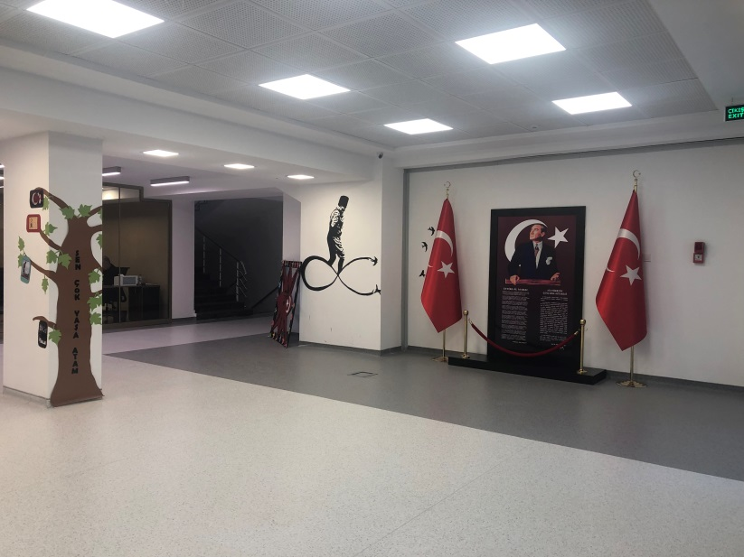
Our school has 4 main parts ,
Kindergarden
Primary School
Middle School
High School.
Since our school is new, everything is so clean.

Slide 4
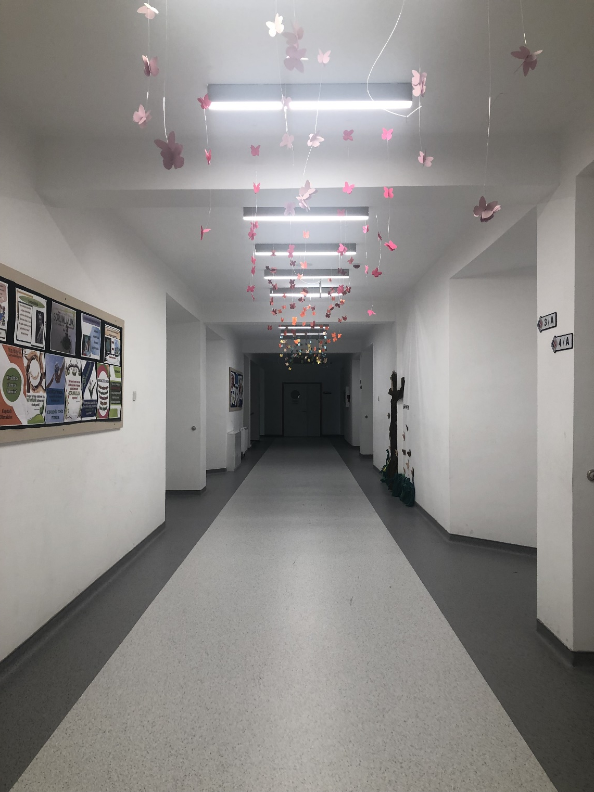

Slide 5
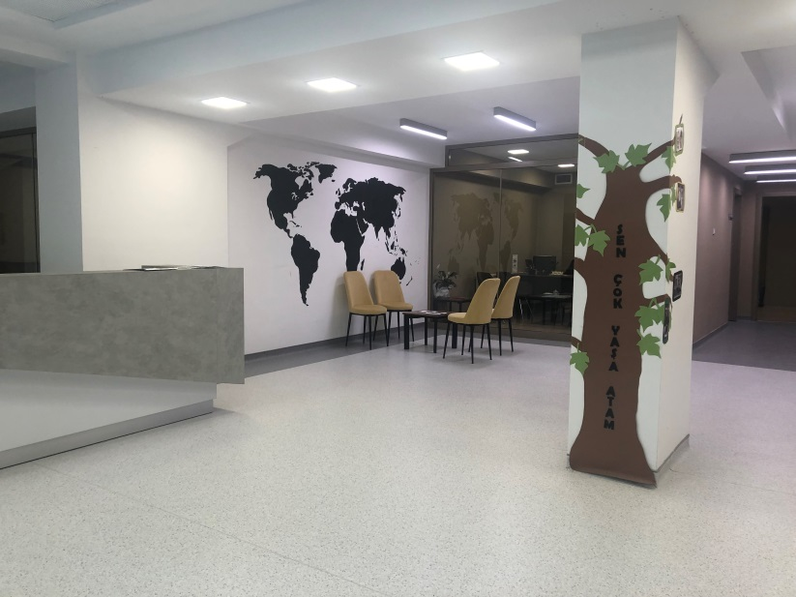
Our school has,
A drama room,
A music room,
An art room,
A sports hall,
3 libraries
A cafeteria,
A computer lab,
3 science lab,
And a small football field and a Basketball court outside.

Slide 6
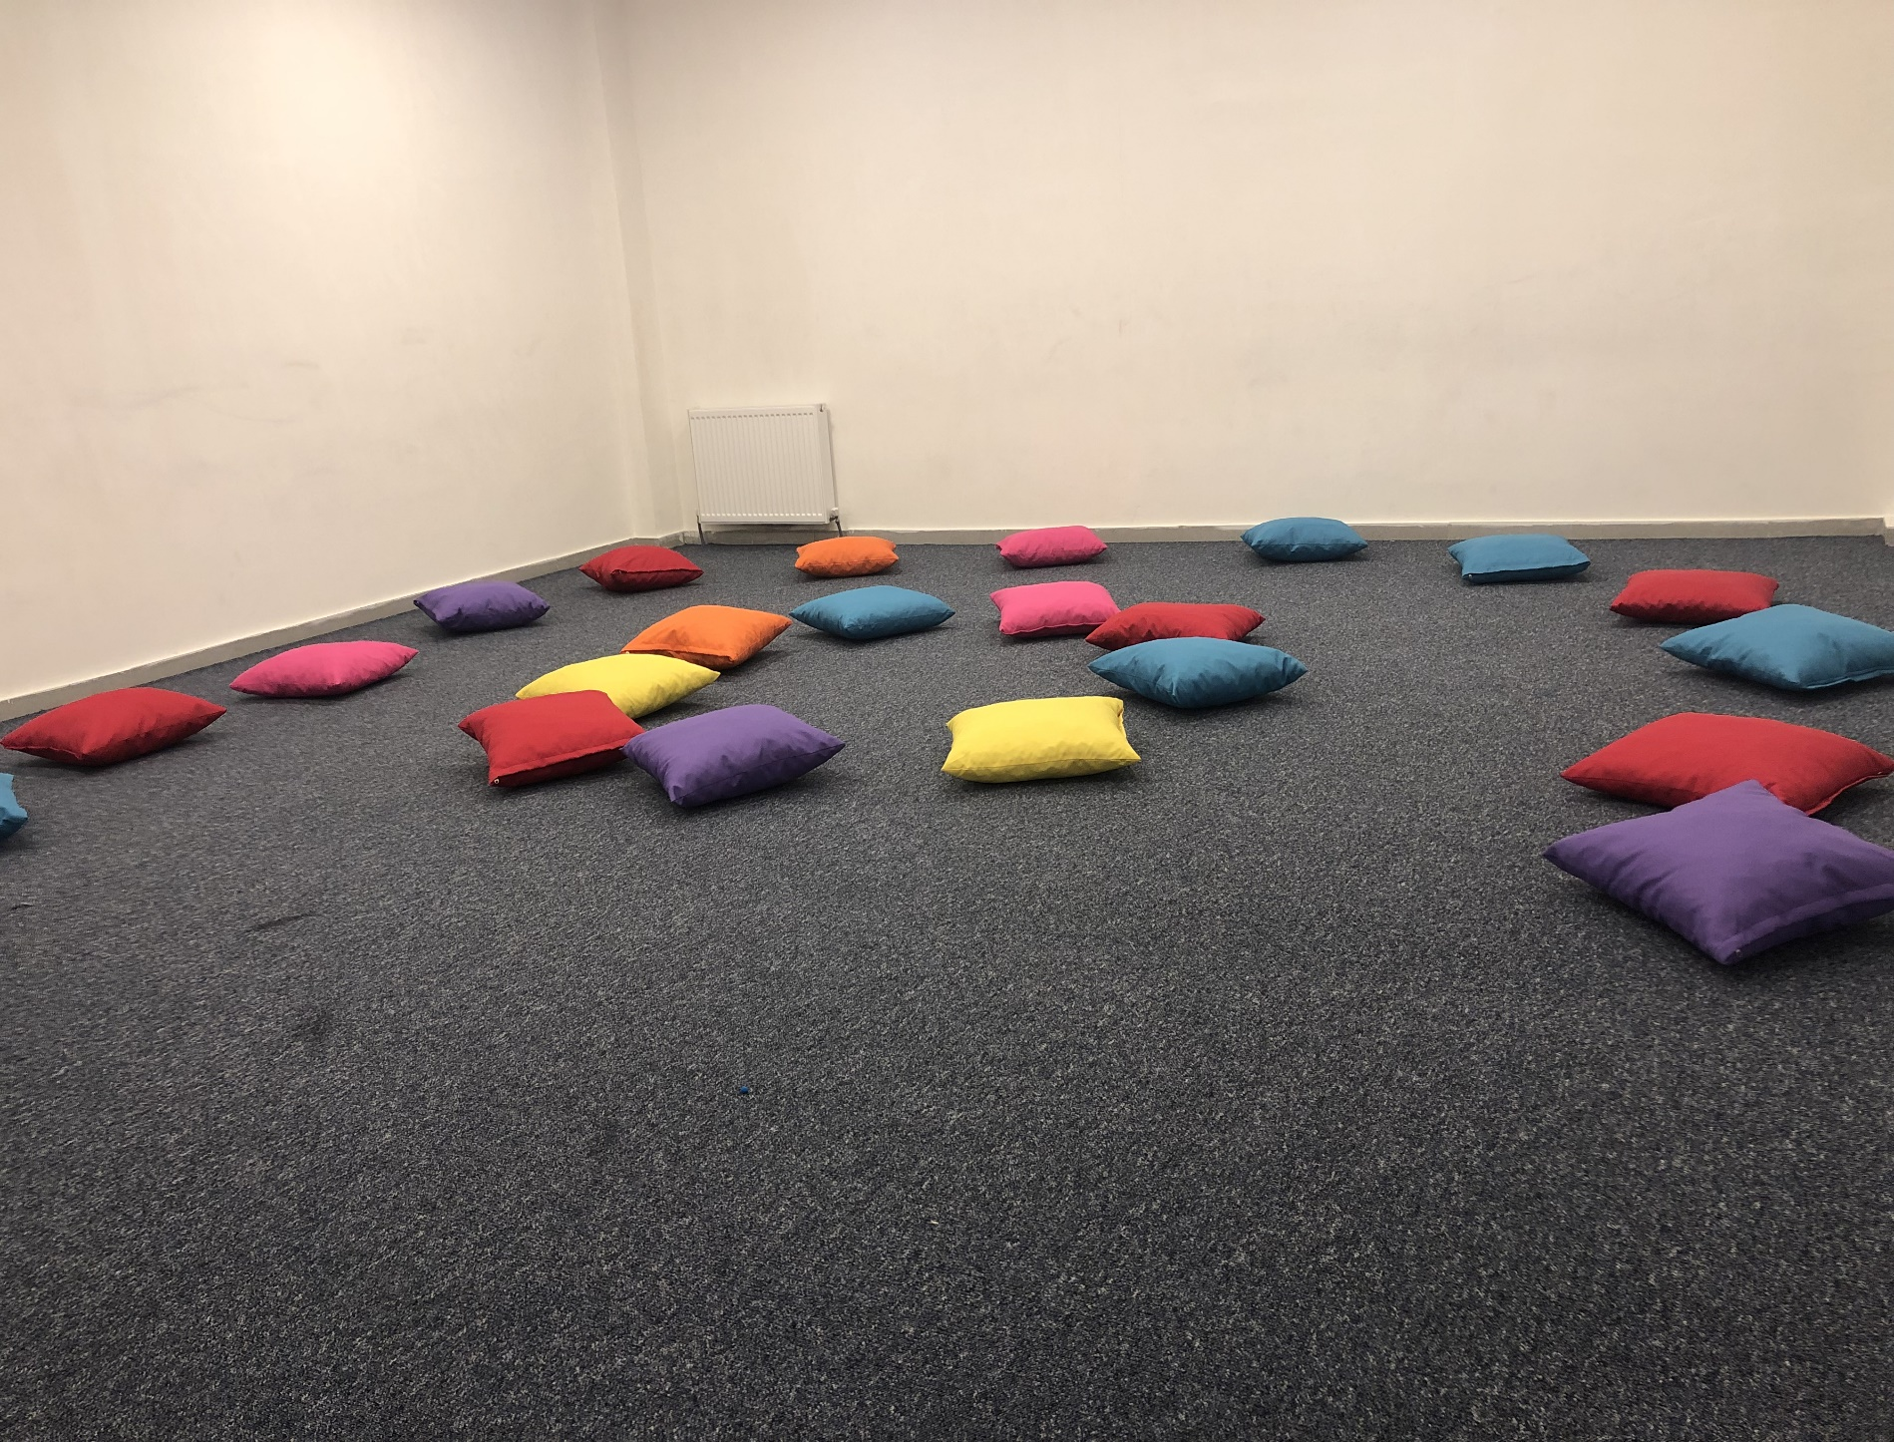
DRAMA ROOM
This is the place we go when we have a drama lesson.
This place is fun and relaxing.

Slide 7
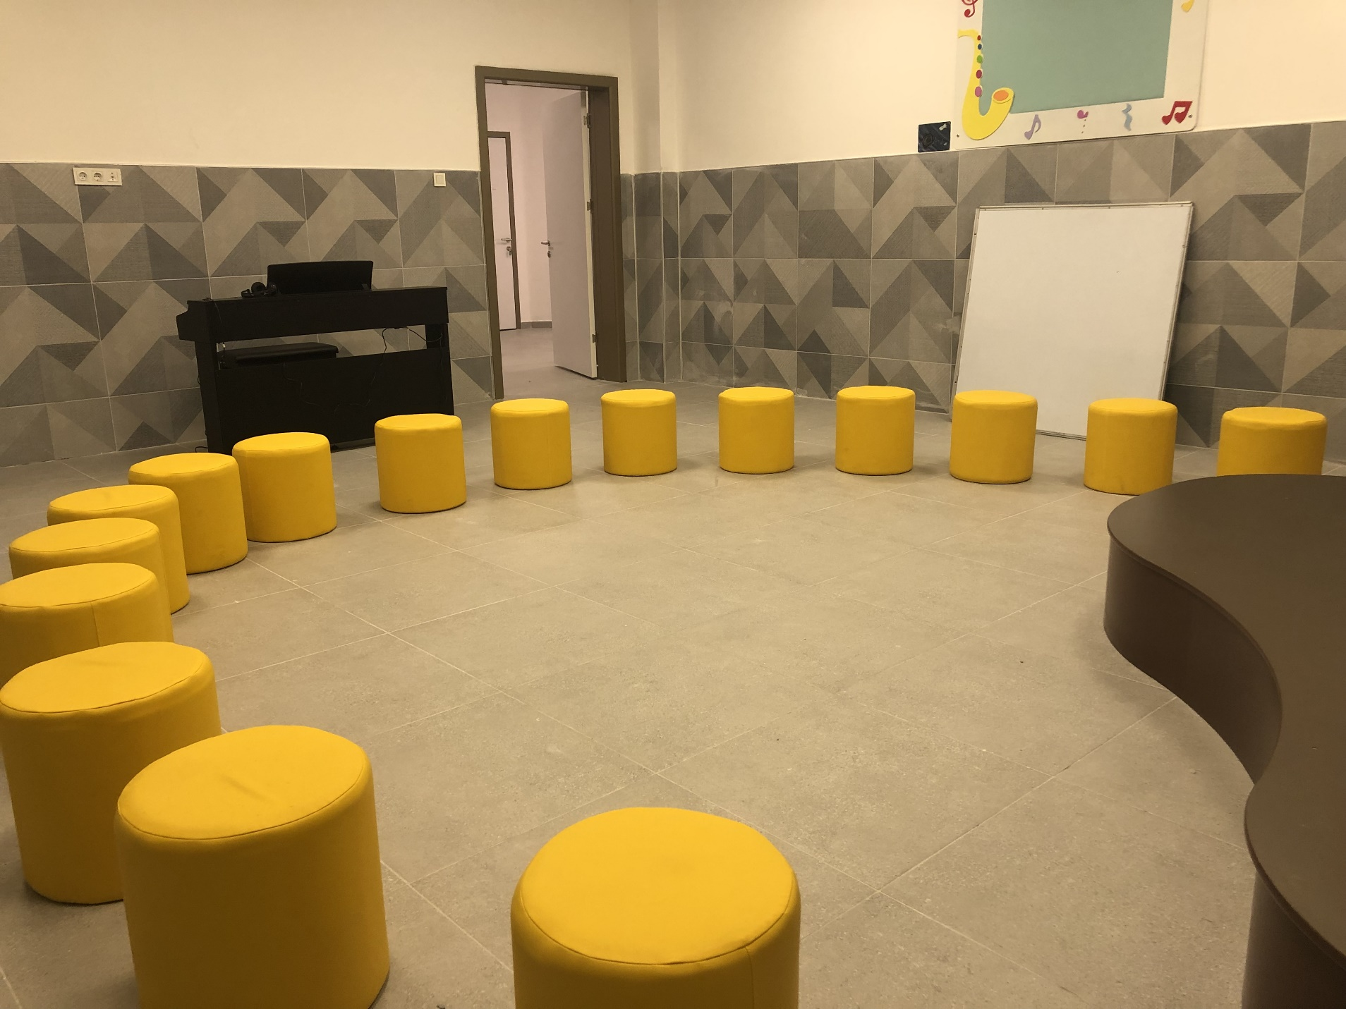
MUSIC ROOM
This is the place where we play instruments and practice if there is an upcoming show.
There is a piano and chairs to sit during the lesson.

Slide 8
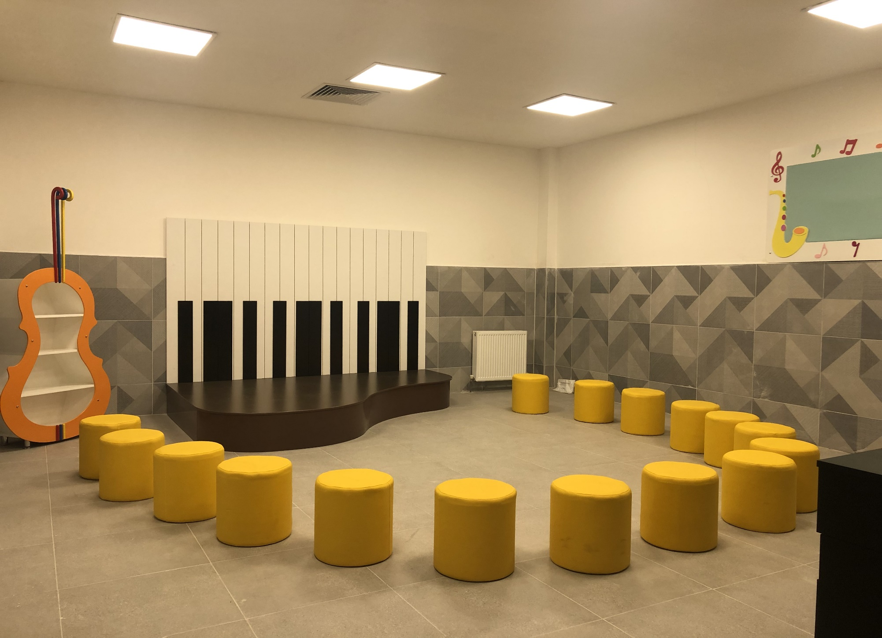

Slide 9
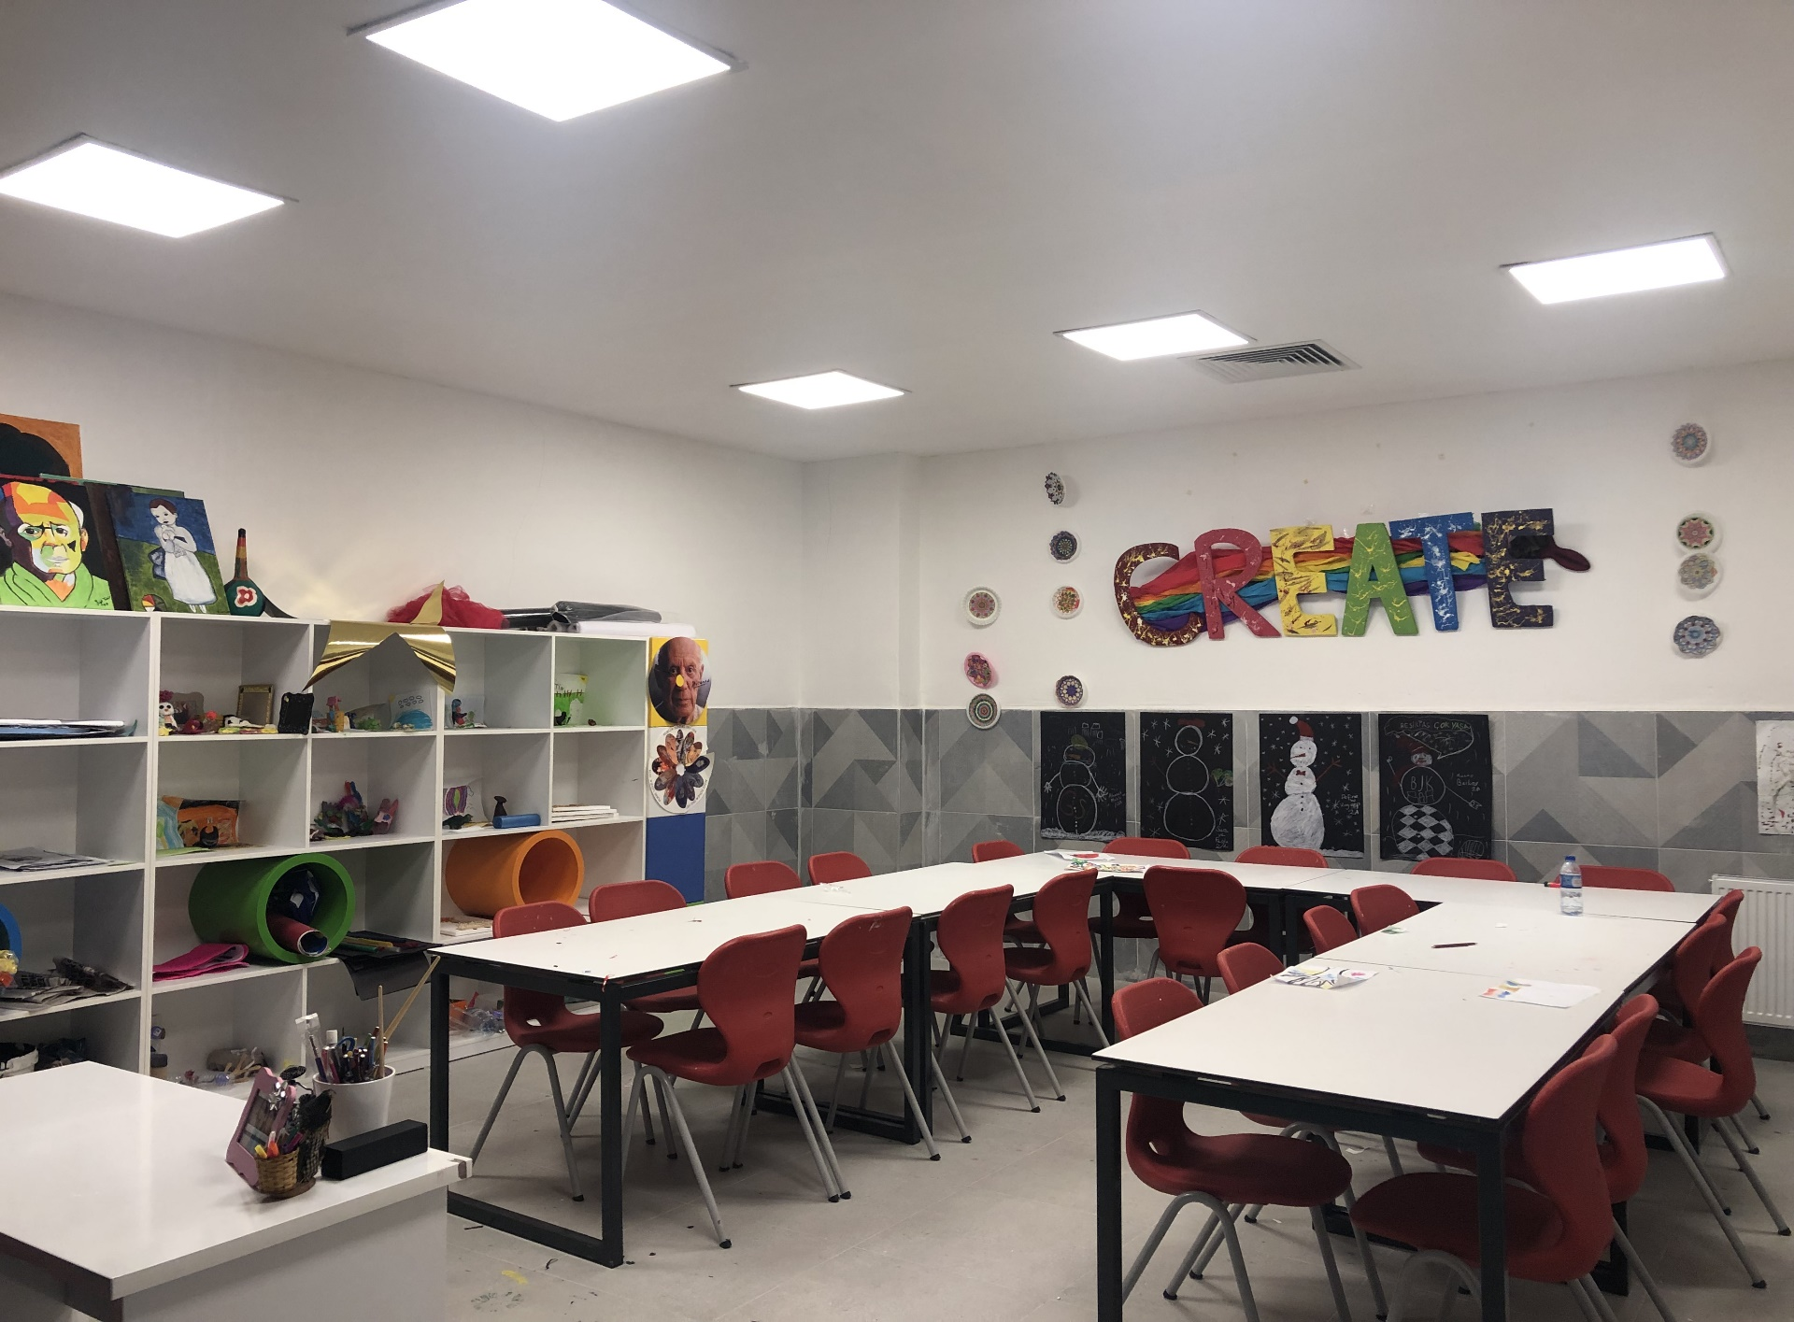
ART ROOM
This is the place where we draw and create things with different materials.
It’s one of my favourite lessons. It’s just fun to create something using our imagination.

Slide 11
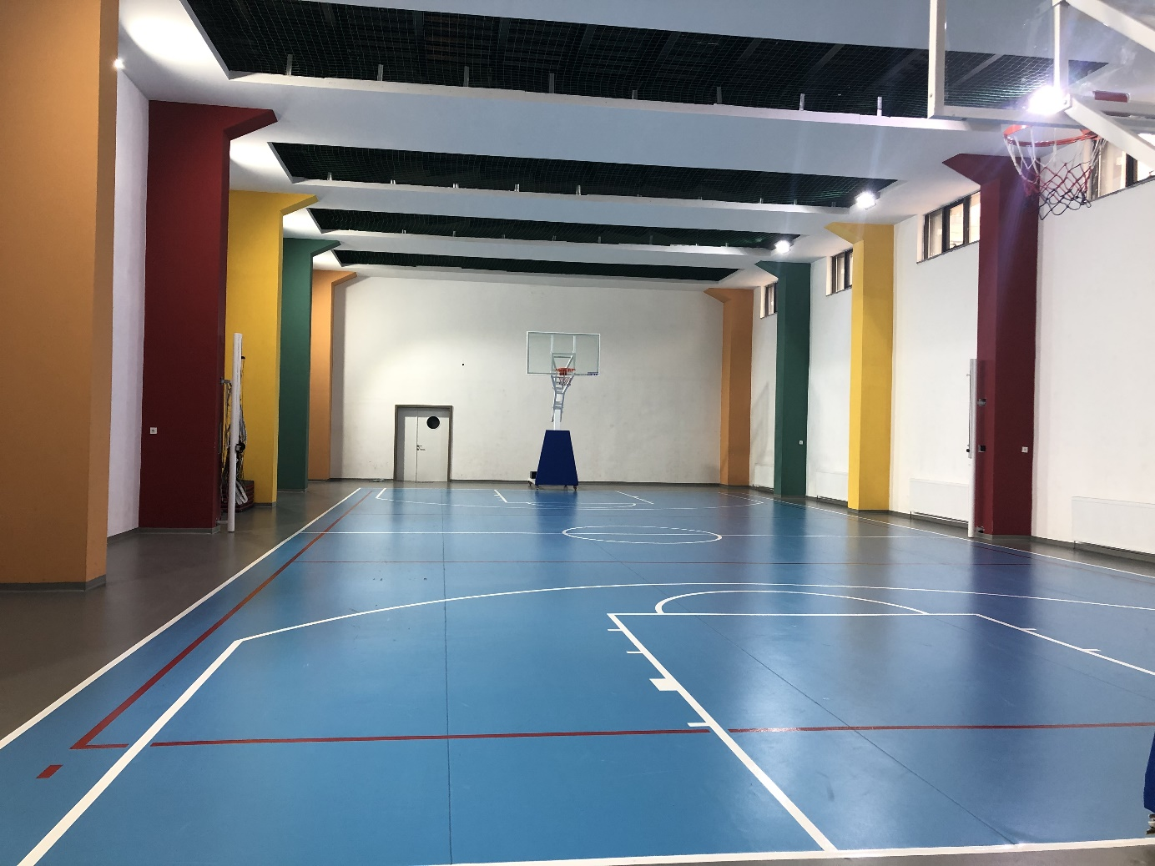
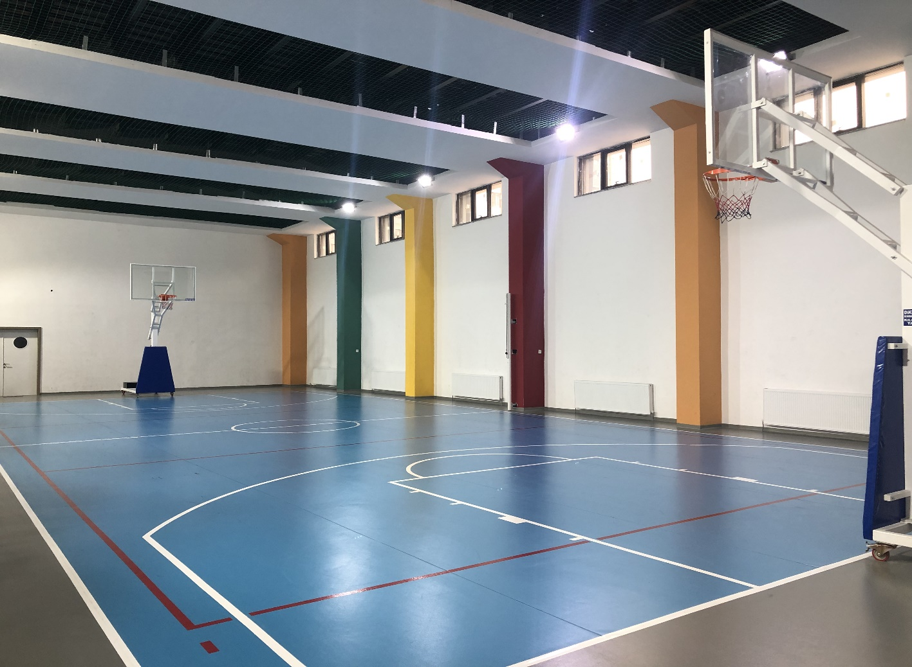
SPORTS HALL
Gym is the place where we play basketball, free run and exercise.
Liked by almost every student, P.E. is probably the most liked lesson in our school.

Slide 12
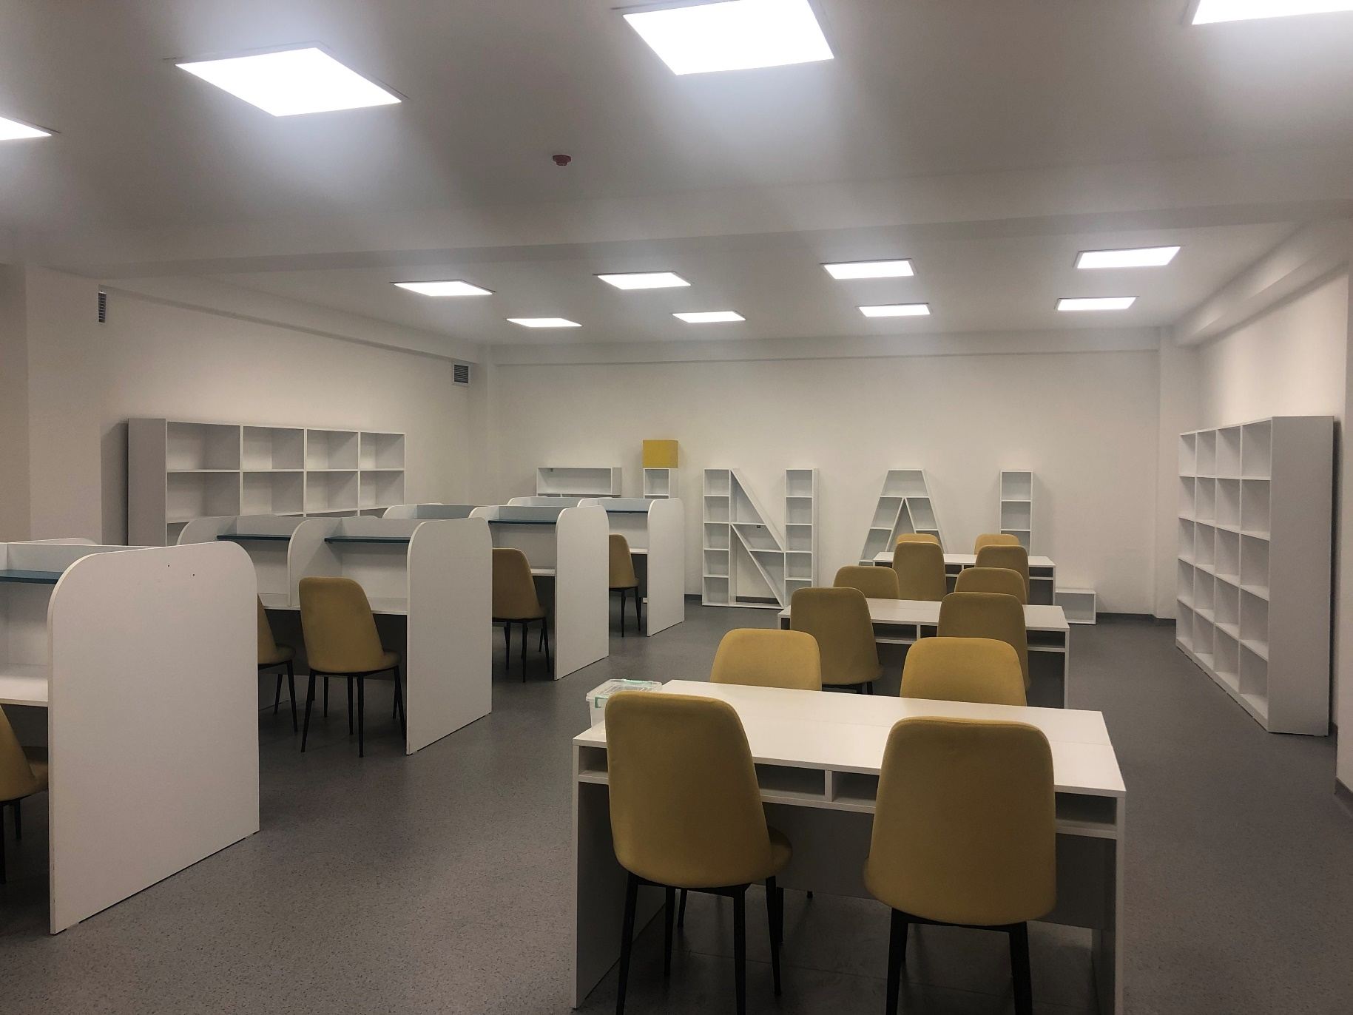
SCHOOL LIBRARY
We come here if we want to study in silence, or just read books simply.

Slide 13
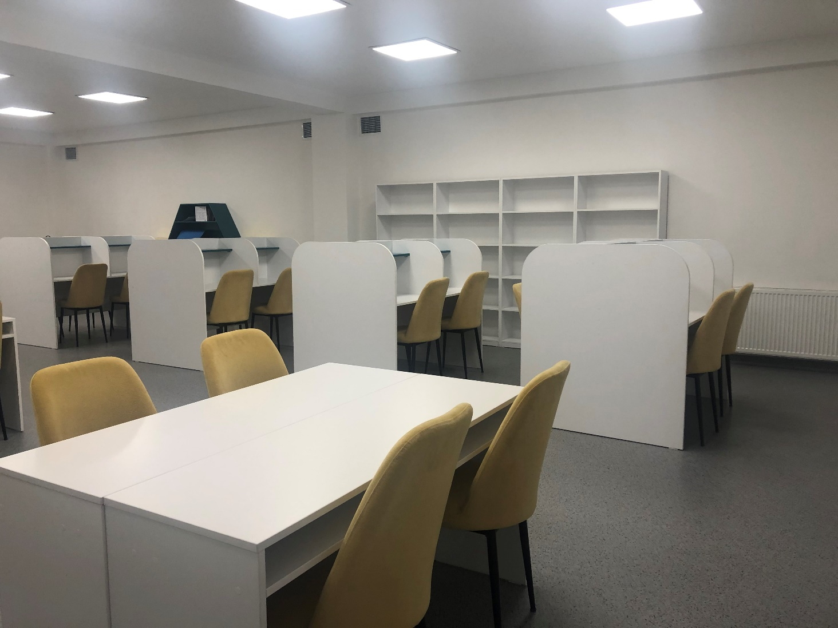
LIBRARY

Slide 14
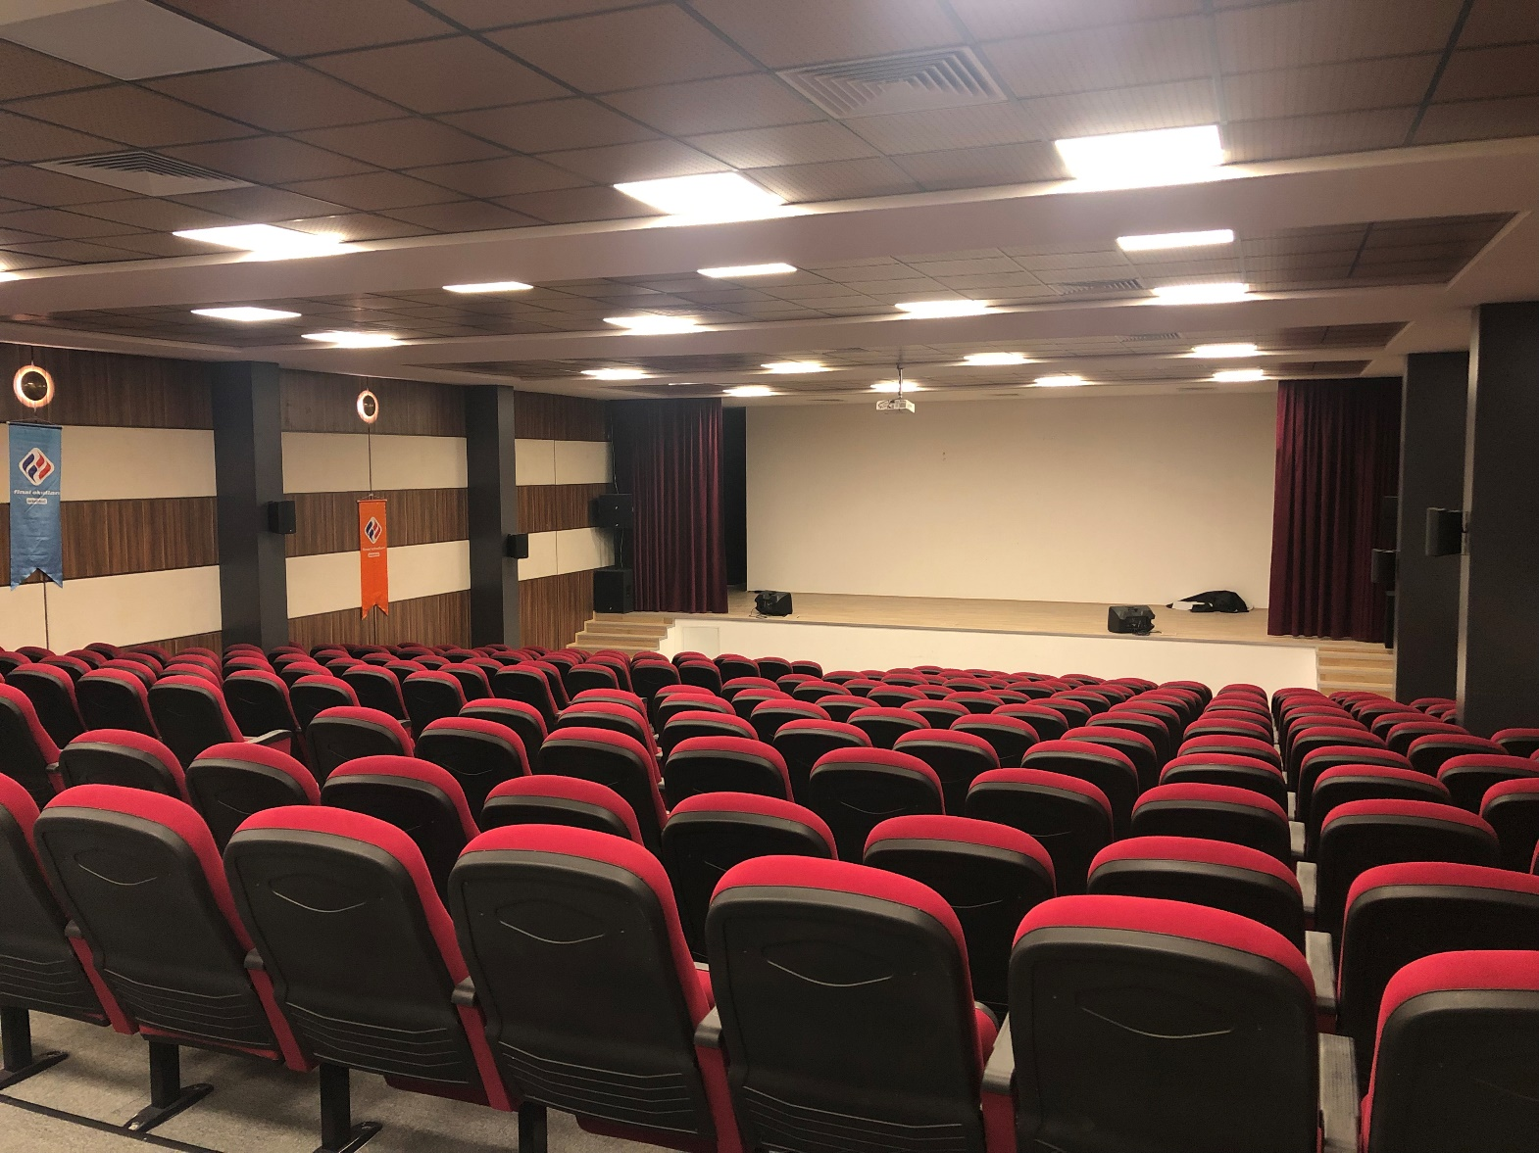
CONFERENCE HALL
We use this big hall for almost all ceremonies and seminars.

Slide 15
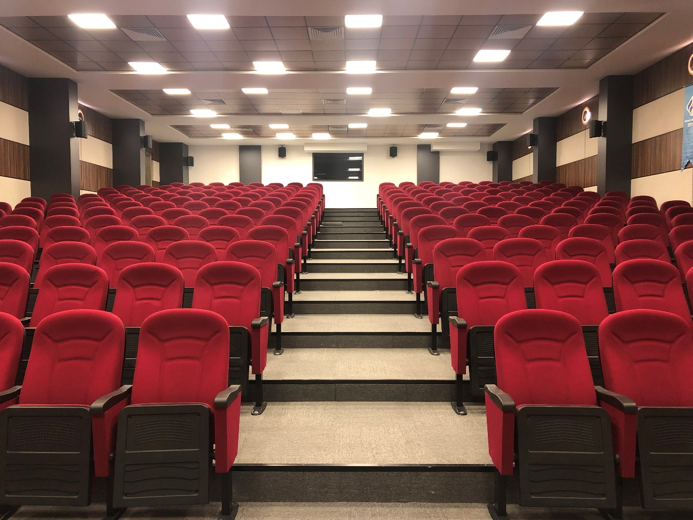

Slide 16
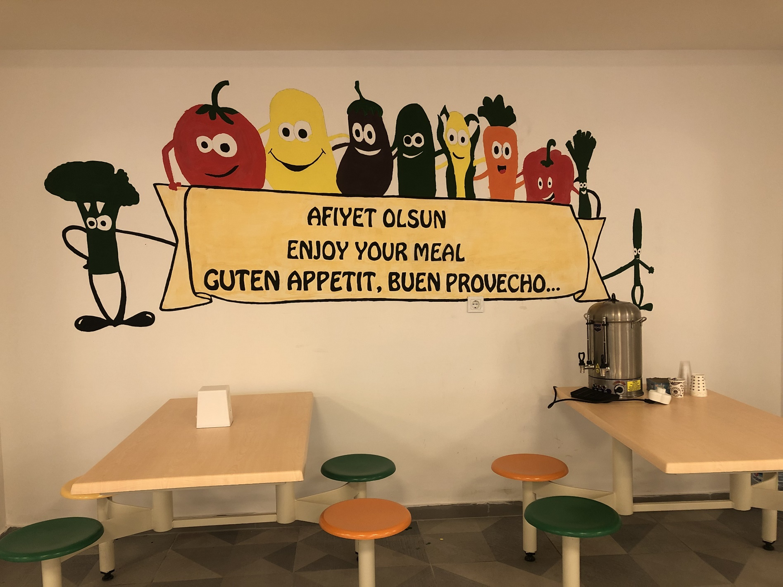
CAFETERIA
We eat lunch here.
Sometimes there is traditional Turkish dishes, and usually what is healthy for us.
We usually chat while we’re eating our lunch.

Slide 17
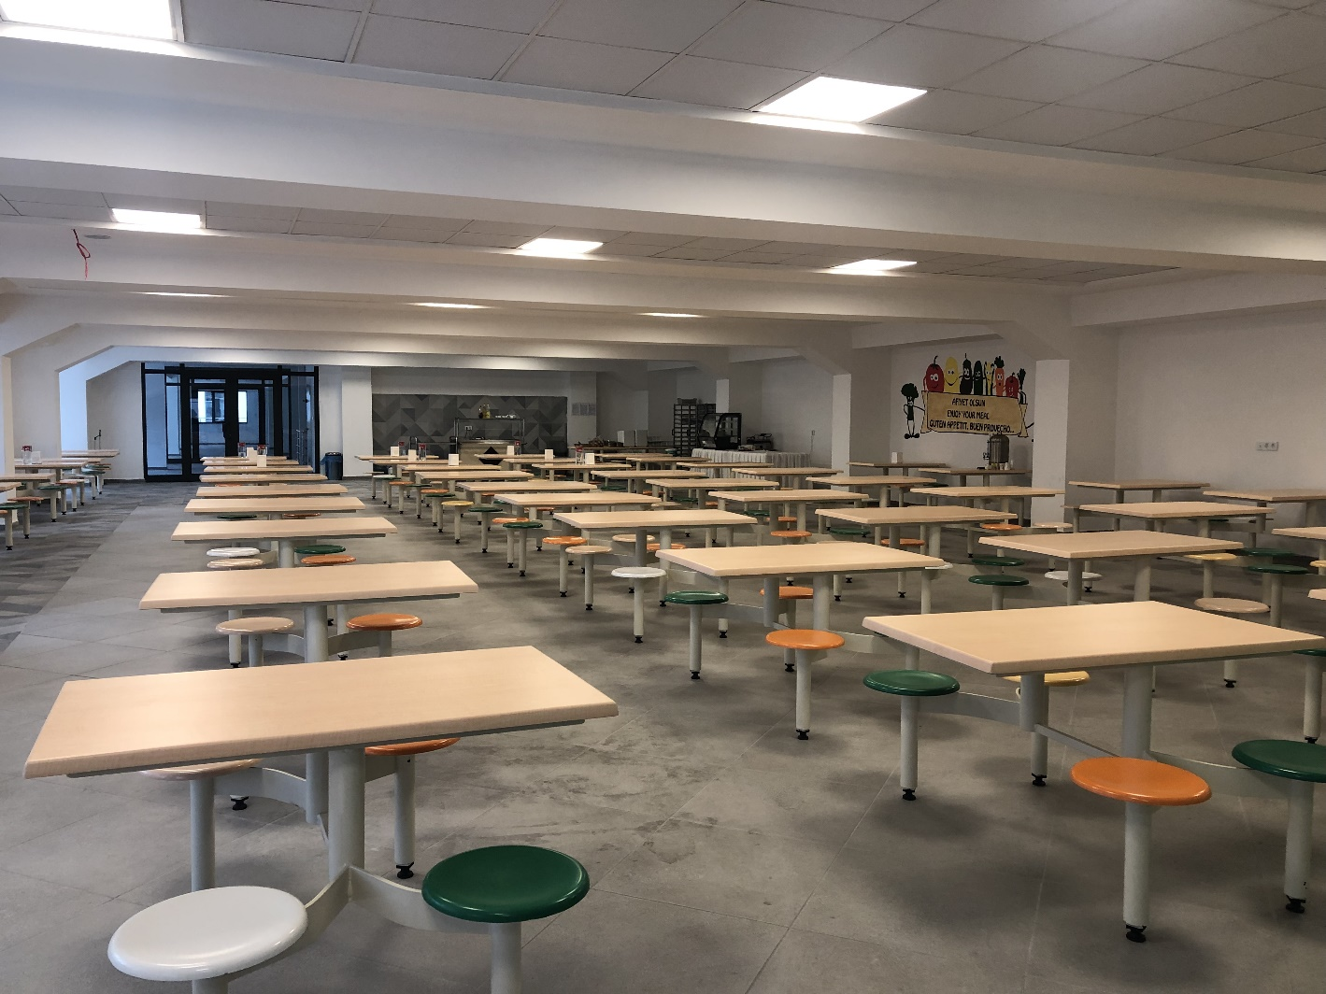

Slide 18
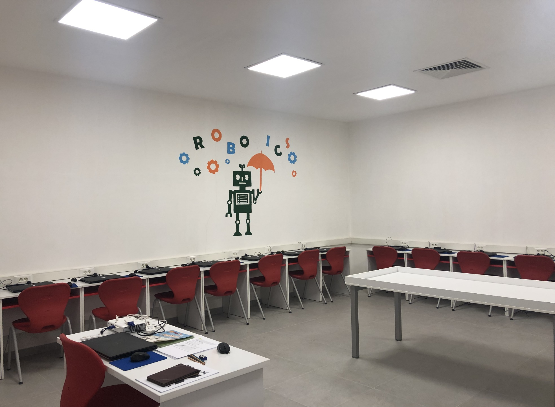
COMPUTER LAB.
This is the place where we learn about coding and robotics.
It’s very compatible with today’s standarts.

Slide 19
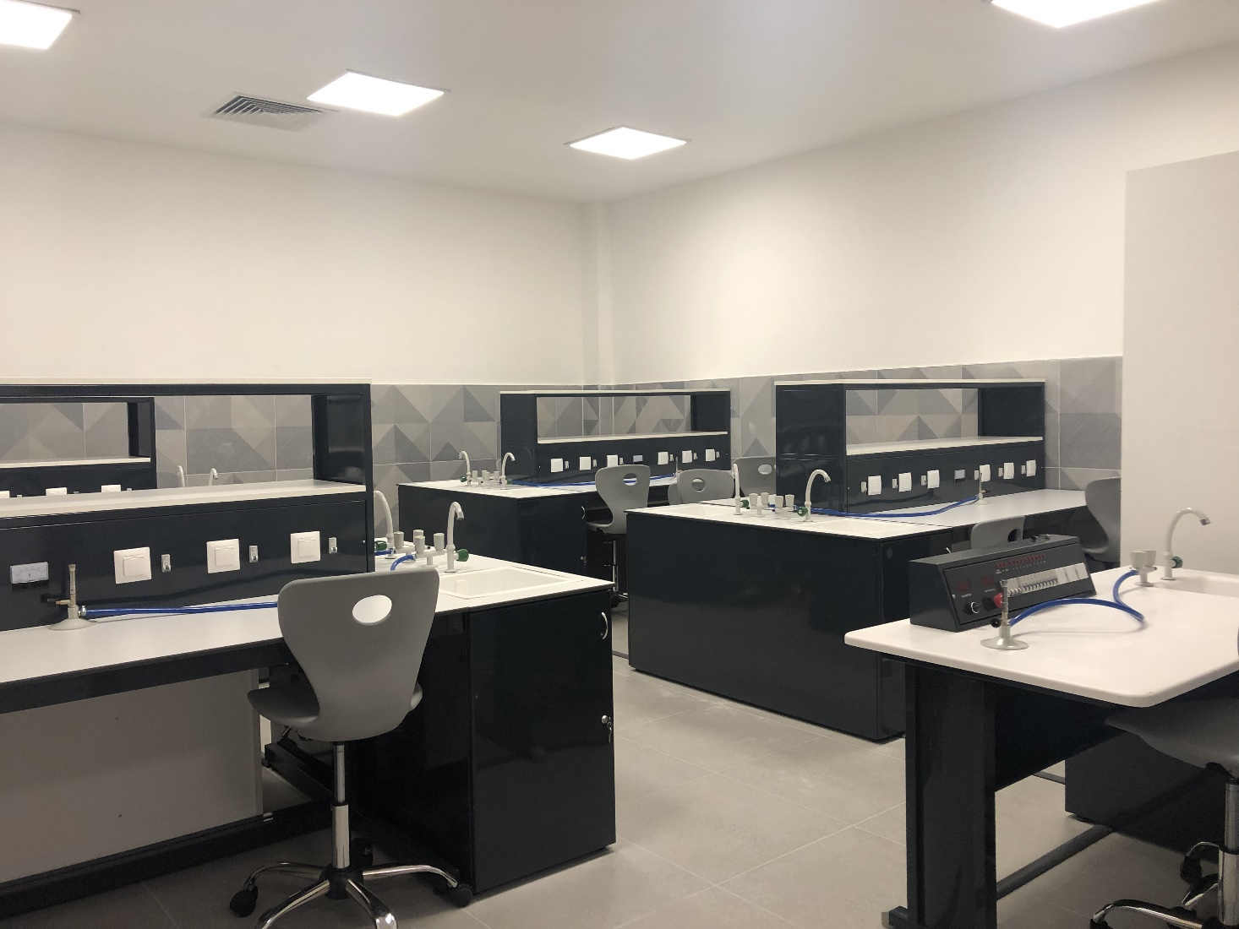
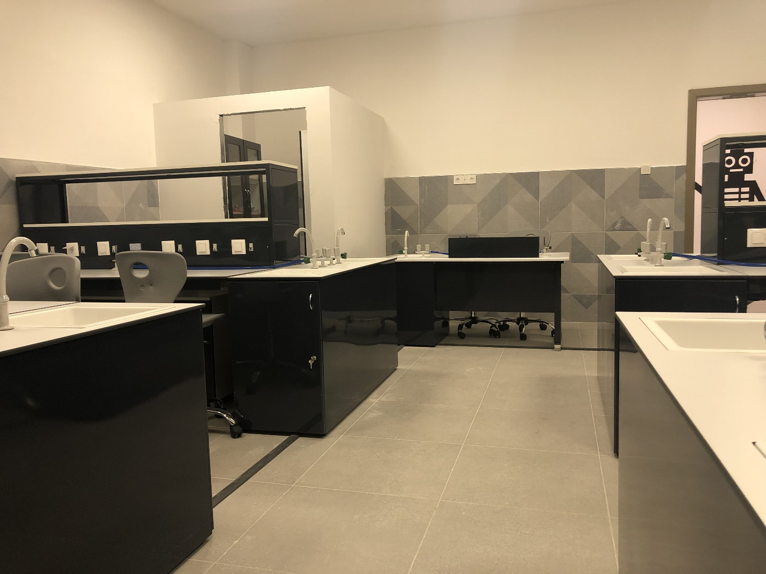
SCIENCE LAB.
The place where we do experiments.
With our teachers assistance, we do interesing experiments.

Slide 20
CHESS ROOM –MIND TEASER

Slide 21
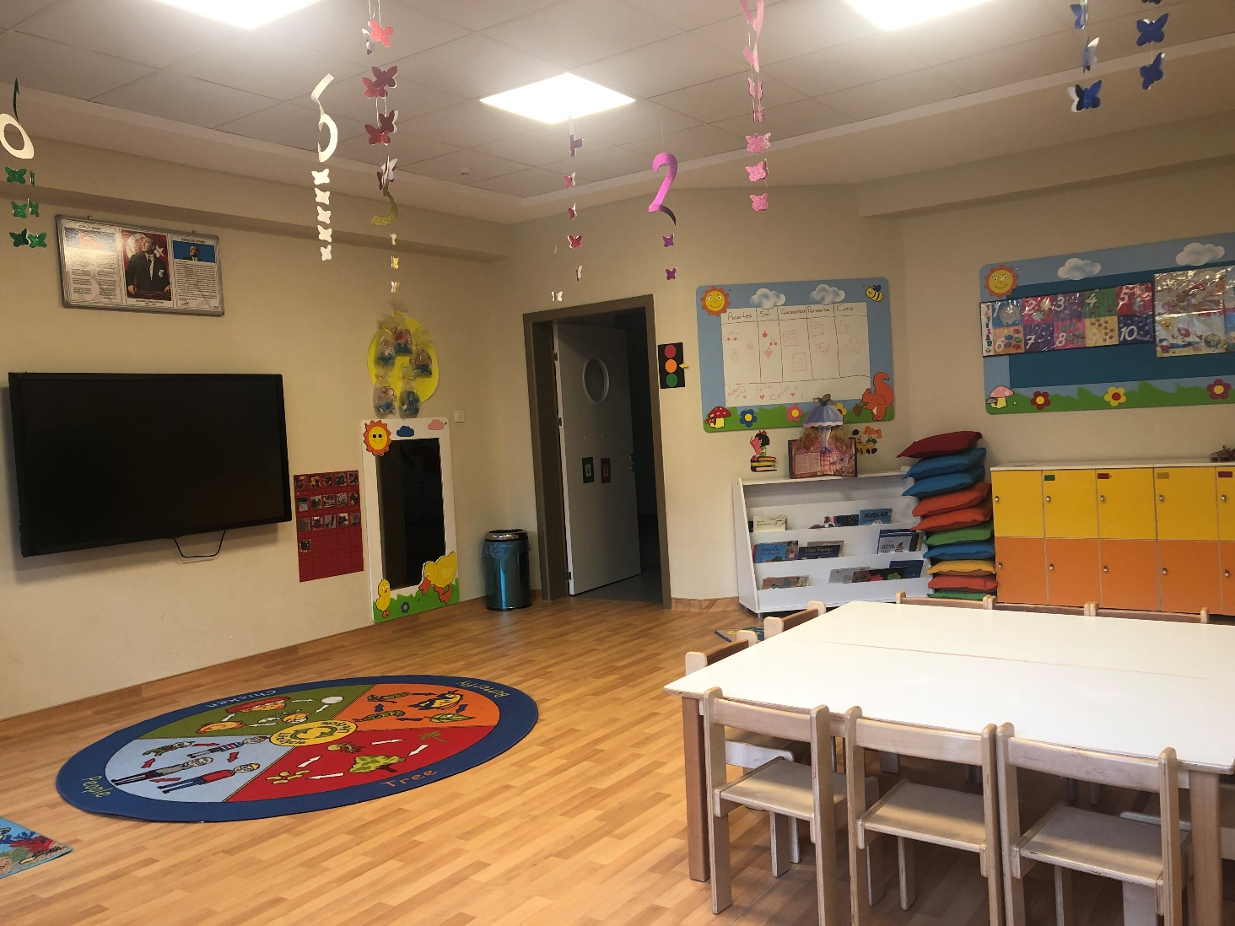
KINDERGARDEN

Slide 22
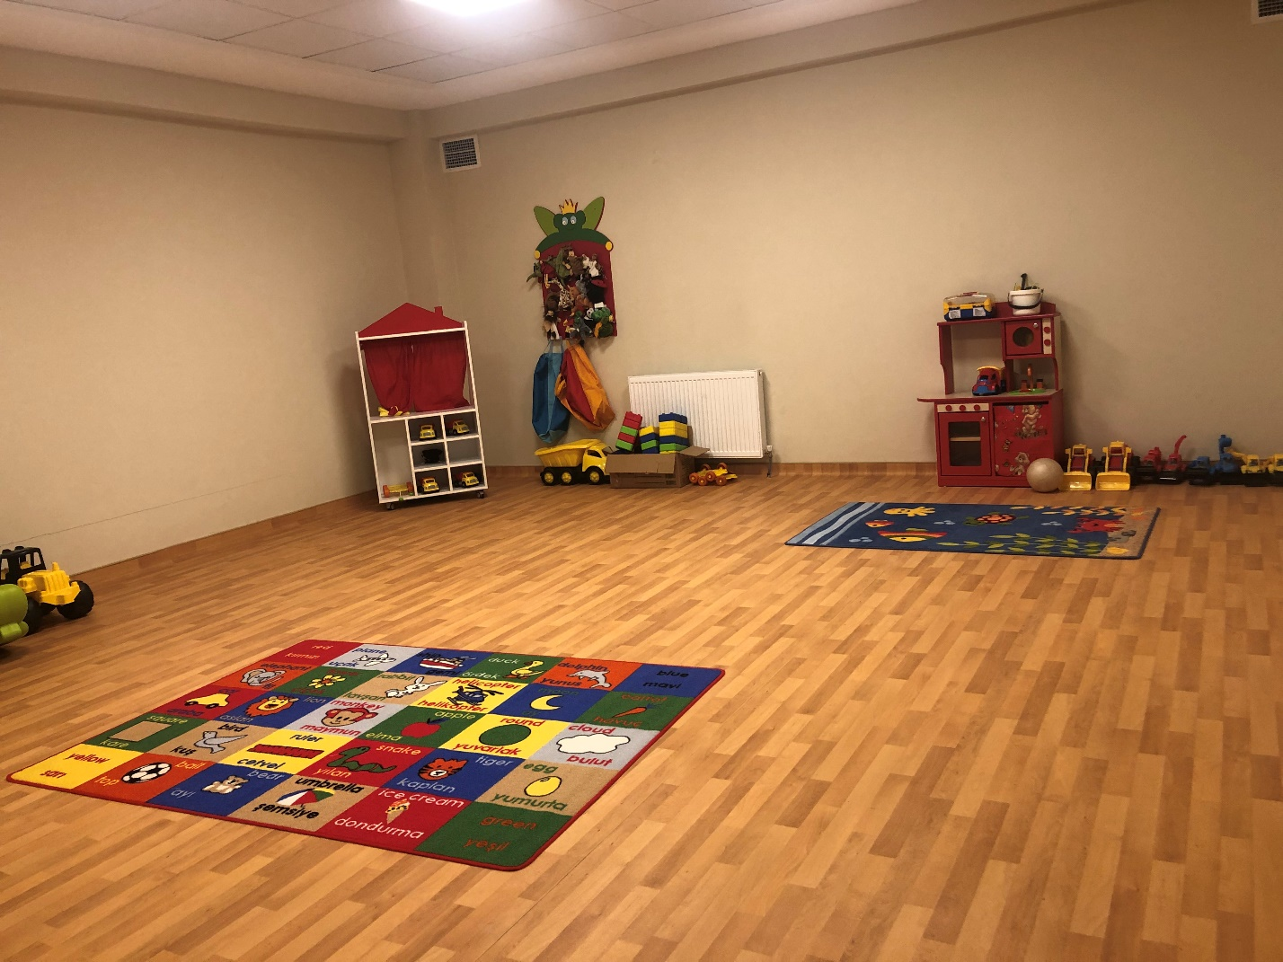
DRAMA ROOM –PLAY ROOM

Slide 23
CLASSROOMS ( Primary School )

Slide 24
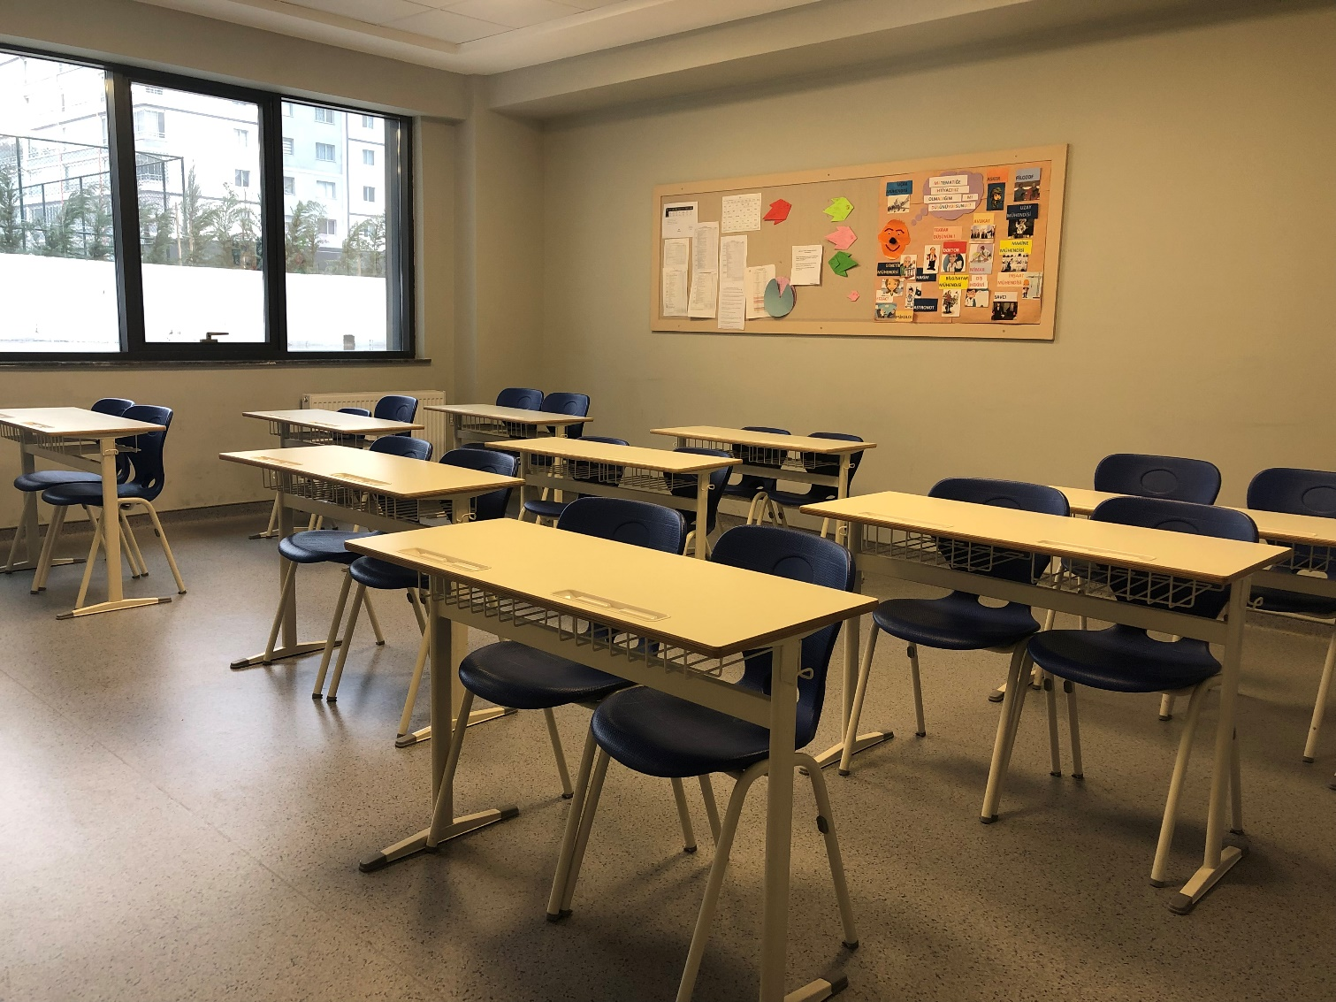
CLASSROOMS (Secondary School)

Slide 25
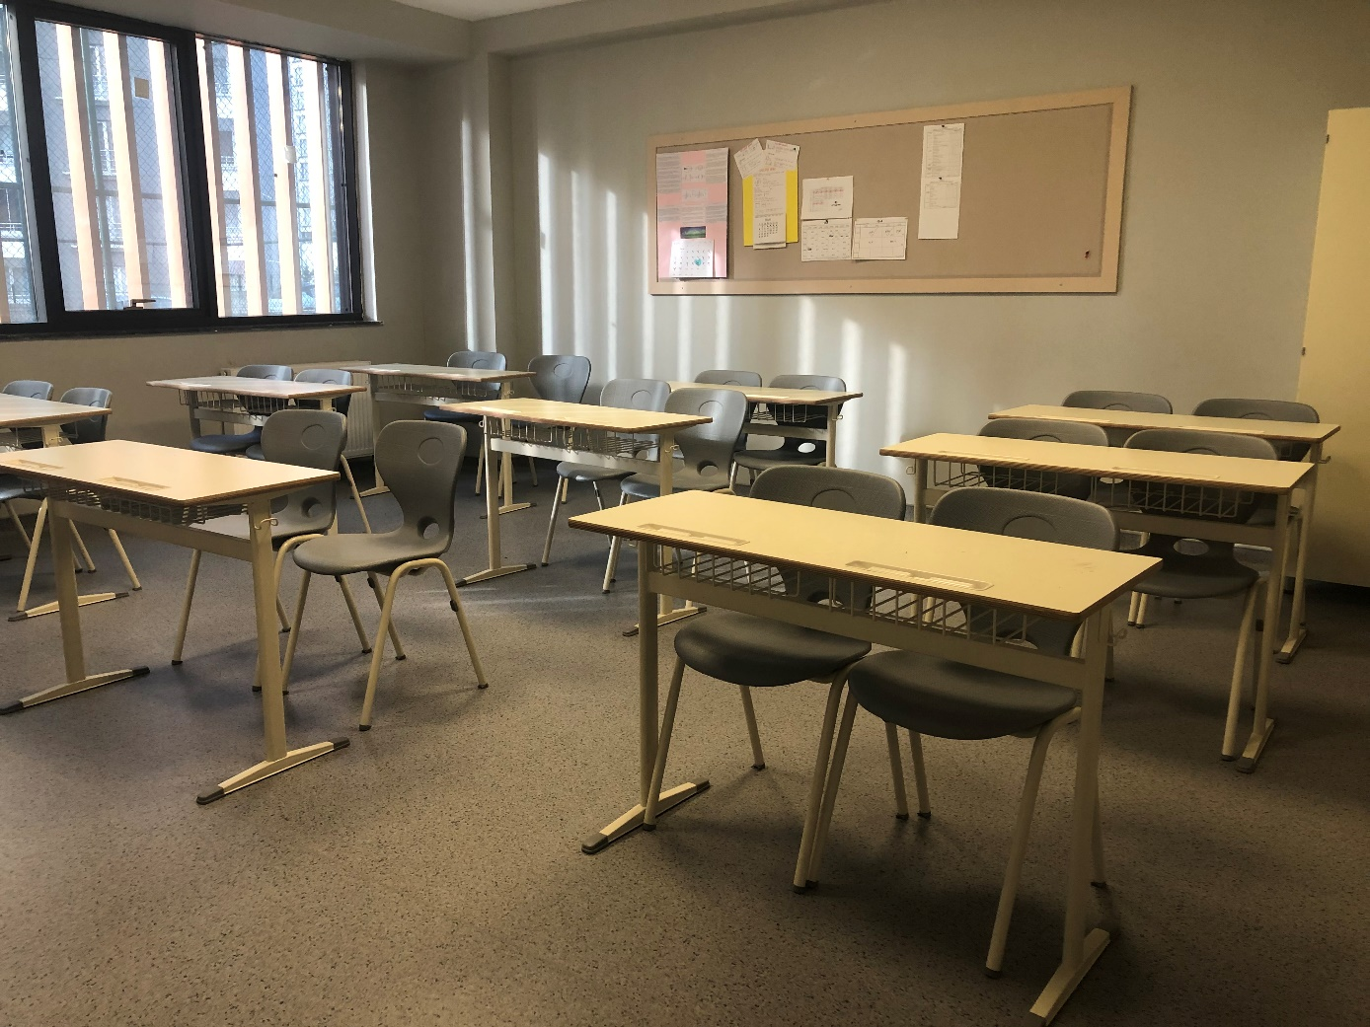
CLASSROOMS (High School )

Slide 26
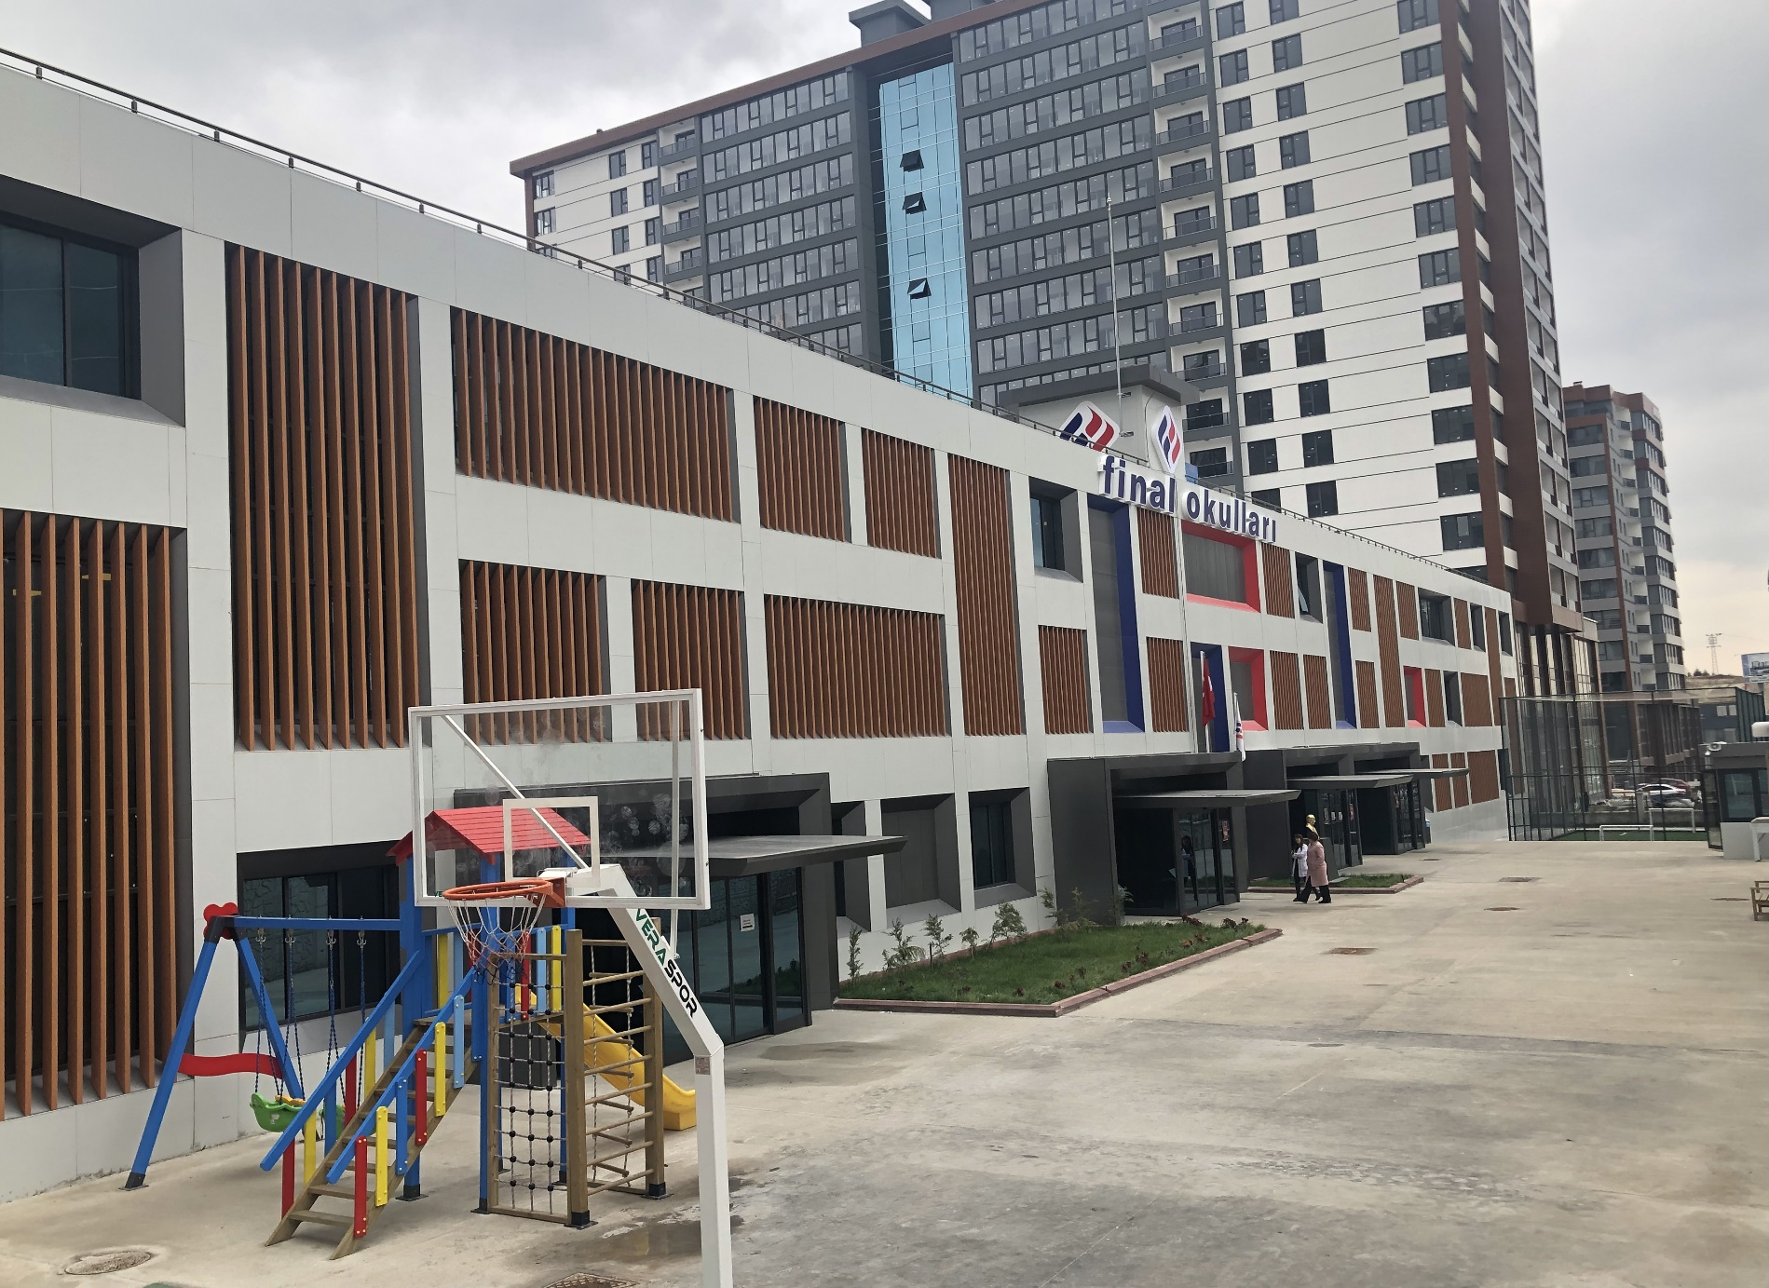
SCHOOL GARDEN
Here we have a basketball court and a small football pitch.
This is where most of us go at break-times.

Slide 27
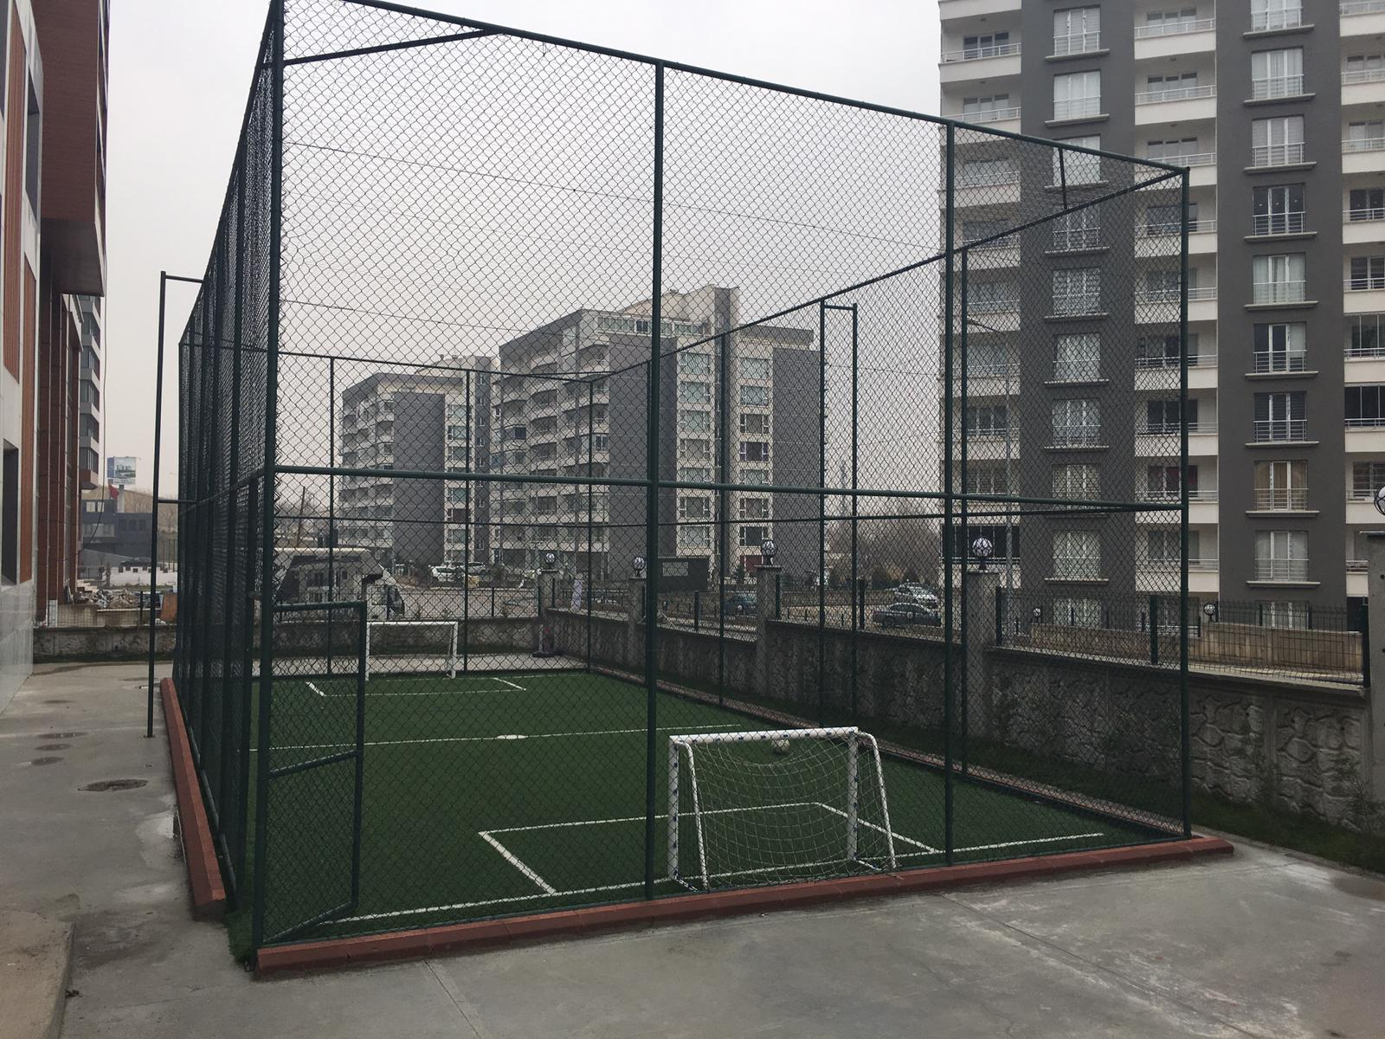

Slide 28
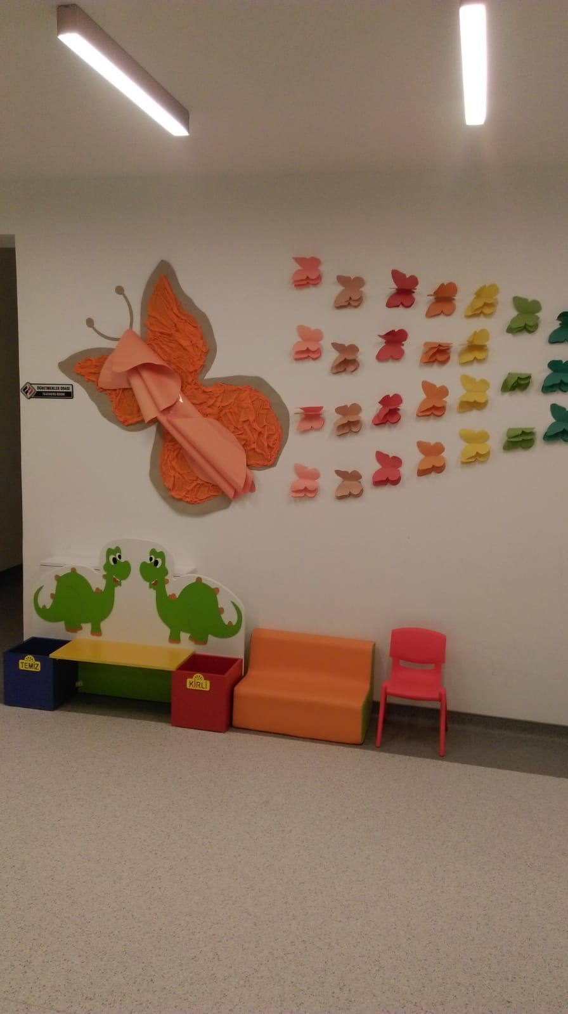

Slide 29
THANKS !
By Ibrahim Efe Yakar

