Slide 1
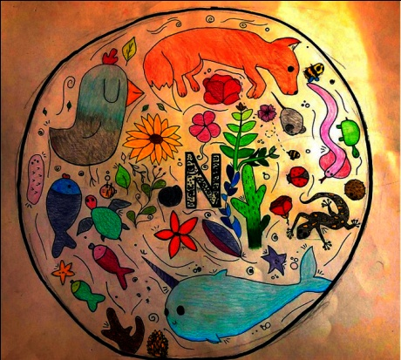
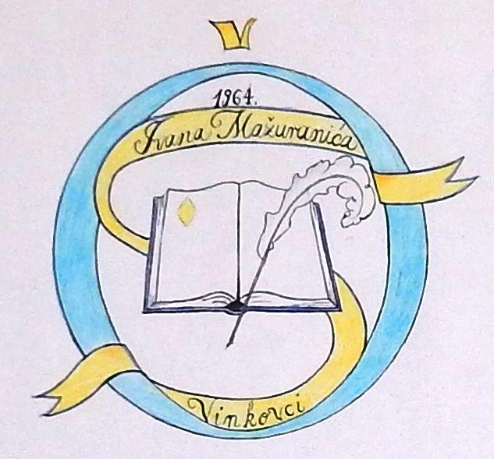
Traditional wisdome
OŠ Ivana Mažuranića
Vinkovci
Croatia

Slide 2
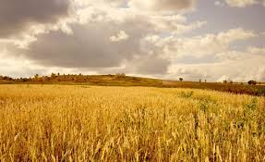
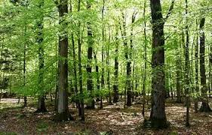
Proverbs
Riječi su kao pčele – i med i žalac.
Kakvo zvono, takav glas; kakvo žito, takav klas.
Drvo se na drvo naslanja, a čovjek na čovjeka.
Kakvo drvo, takav klin; kakav otac,takav sin.
Nisam ja tikva bez korijena.
Kud vojska prolazi, ni trava ne raste.
Tko s đavolom tikve sadi, o glavu mu se razbijaju.
Words are like bees – honey and spike.
Like bell, like sound; like wheat,like ear.
A tree leans on a tree and man leans on man.
Like tree, like wedge; like father, like son.
I’m not a gourd with no roots.
Where army goes, not even grass grows.
If plants gourds with the devil, they will smash you on the head.

Slide 3
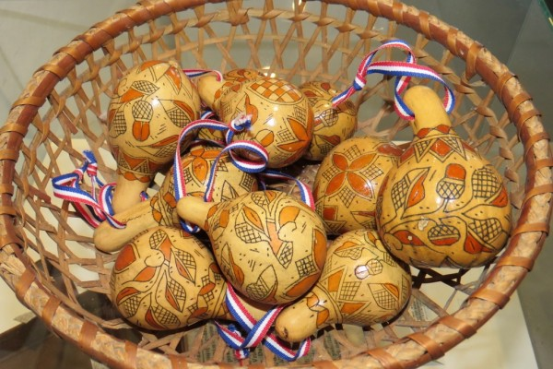
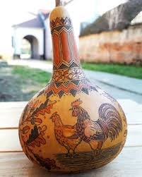
TIKVA – GOURD traditional art form

Slide 4
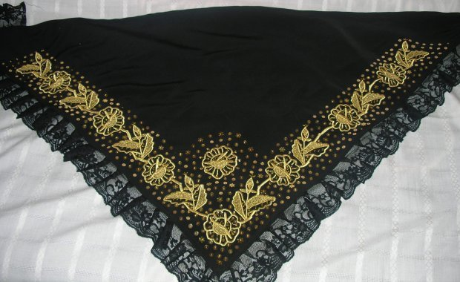
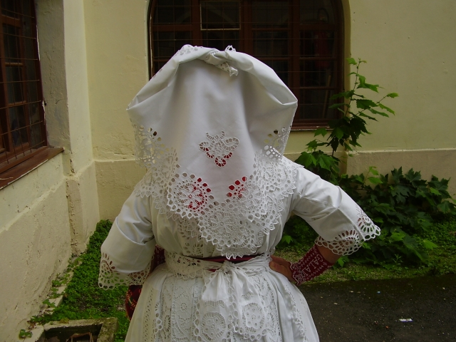
NATURE IN TRADITIONAL OUTFIT

Slide 5
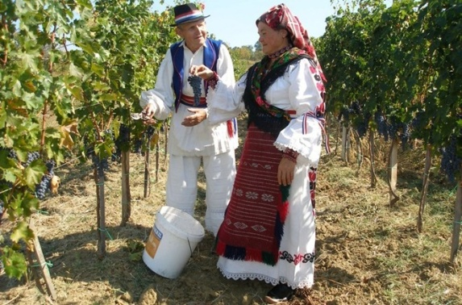
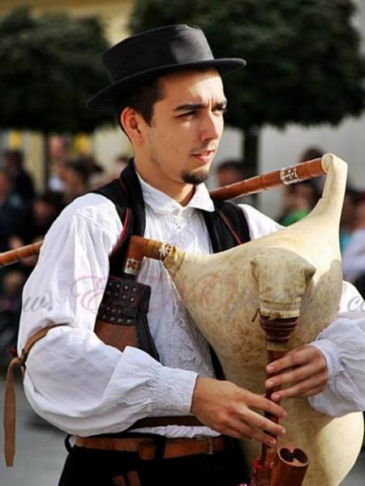
SONGS
Motives of nature are common in Croatian traditional songs, especially in slavonian bećarac and svatovac. Most frequent ones are: dawn, various animals (lamb, dove), corn, apple, hyacinth, pine tree, rose, walnut...
https://www.youtube.com/watch?v=ESGUxeGjLEQ “Zorja je zorja” (Dawn is dawning)
https://www.youtube.com/watch?v=vBhksAlrRJA “Ivo sadi bora zelenoga” (Ivo is planting green pine tree, Kries)

Slide 6
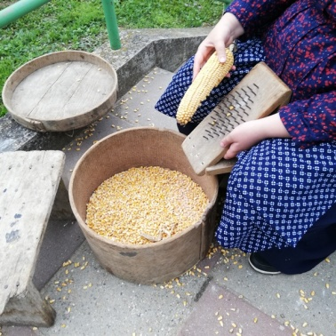
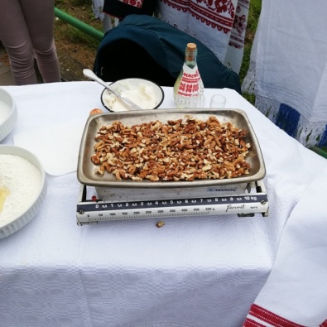
Dances
https://www.youtube.com/watch?v=3OnG7k1REwE “Tri sam dana kukuruze brala” (For three days I was picking corn)
https://www.youtube.com/watch?v=ZDAdSlJZQRg in this video we can find: janje (lamb, in the meaning of the beloved one), riba (fish), hrast, rastić (oak tree), kupus (cabbage), ditelina (clover)

Slide 7
Customs
https://www.youtube.com/watch?v=L2Xl-RVl07U In this link many motives of nature are present: smilje (immortelle), žito (wheat), klas (ear), raž (rye), žir (acorn), paun (peacock). This video shows a spring custom – young girls would go from house to house wishing everyone well with their song and dancing. Hosts would give them gifts like apples, eggs, some money...

Slide 8
Symbolism
Lamb, dove – beloved one
Apple – given to the one you like and if accepted it means you are liked too, if refused – better try your love luck elsewhere
Various flowers – usually represent the beauty of a girtl or a boy
Animals (peackock, roe) – represent how ellegant beloved one is

