Slide 1
San Viator school
http://www.san-viator.eus/es/

Slide 2
Our school:
Our school is located in the northwest of the Basque Country, exactly in a town called Sopuerta.
All courses, preschool, elementary, middle and high school, make different trips during the year through Europe and around Sopuerta. It depends on the course.
It has 3 differents buildings:

Slide 3
MAIN building
On the first floor there‘s the kindergarten, the first grade of elementary school, the staff room and support classes for children with disabilities.
On the second floor there is the second, third and fourth grade of elementary school, the computer room and the laboratory.
On the third floor there is the fifth and sixth grade of elementary school, middle school, high school and the staff room.
In the outside of the building there is also an emergency elevator.

Slide 4
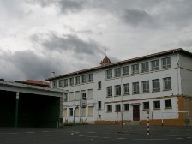
main building

Slide 5
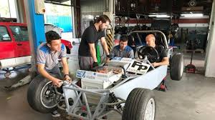
Second building
On this building there are basic vocational training, middle-level
training program and high-level training program.

Slide 6
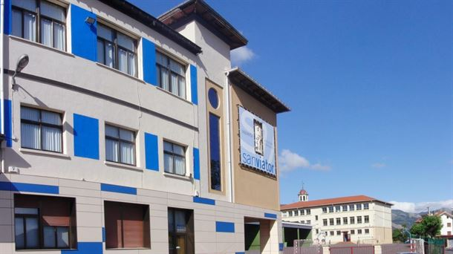
second building

Slide 7
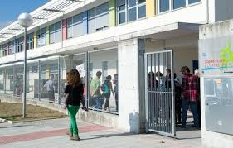
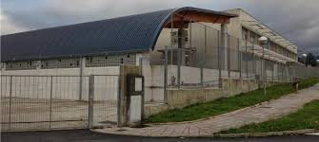
Third building
This third building is composed of kids from two to five years, then, once they finish preschool, they all go to the main building to do elementary school.

Slide 8
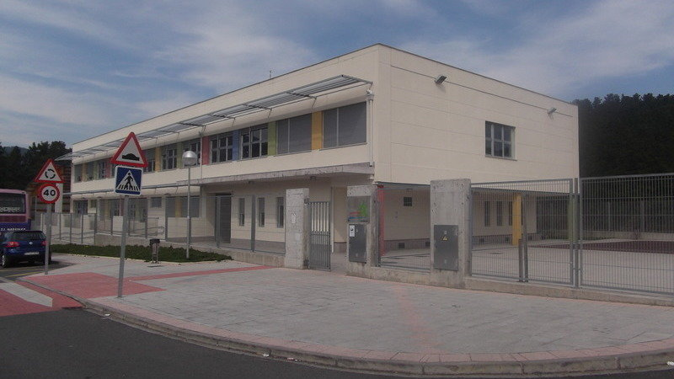
Third building

Slide 9
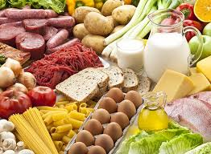
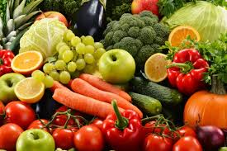
Green corner
It’s a group of middle school students who do activities to
promote healthy living and environmentalism.

Slide 10
Purple corner
Is a group created by high school students. We have a section
of the school in which they expose their different ideas and
opinions to reduce gender violence.

Slide 11
PAINTING

