Slide 1
NUTRITIONAL VALUES

Slide 2
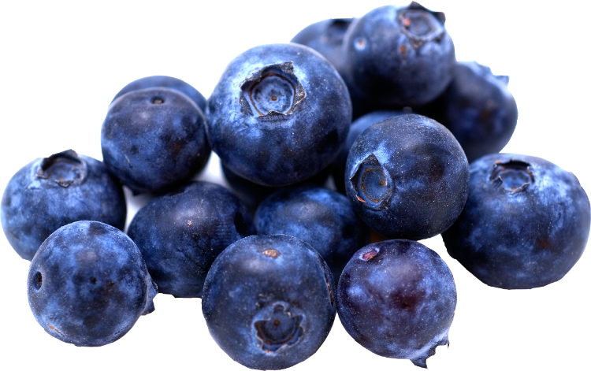
BLUEBERRIES:
Calories: 40 kcal
Energy: 169 kJ
Protein: 0,52 g
Carbohydrates: 9 g
Fat: 0,46 g
Fiber: 4 g
Blueberries – an amazing fruit good for your eyes and immunity. It is full of vitamin A, E, C, B1, B2 and B6. It also contains magnezium.

Slide 3
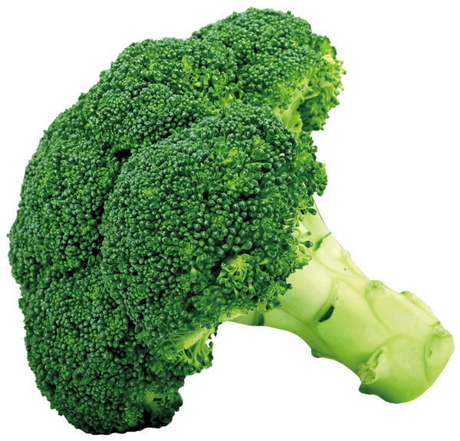
BROCCOLI:
Calories: 26 kcal
Energy: 109 kJ
Protein: 3 g
Carbohydrates: 2 g
Fat: 0 g
Fiber: 3 g
Broccoli is one of the worlds healthiest vegetables. It contains lot of vitamin C, B and E. Eating broccoli may help prevent cancer.

Slide 4
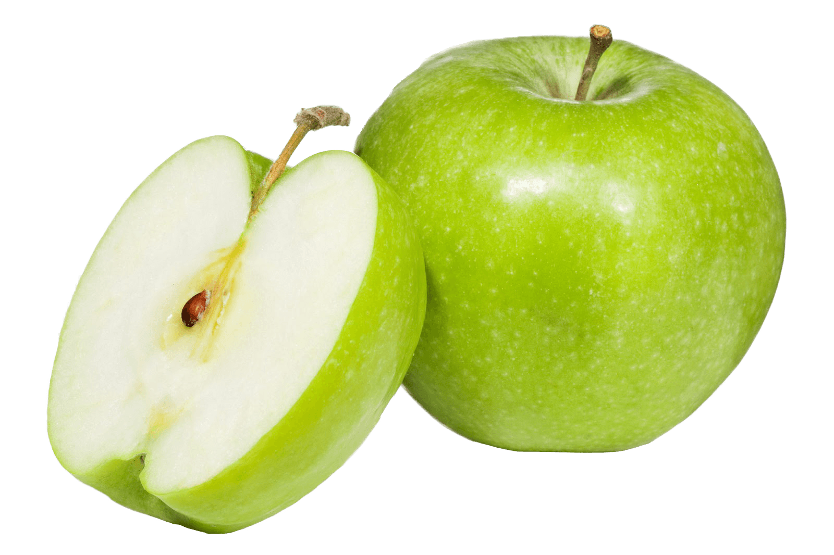
APPLE:
Calories: 57 kcal
Energy: 238 kJ
Protein: 0,37 g
Carbohydrates: 13 g
Fat: 0,4 g
Fiber: 3 g
Apples are extremely rich in antioxidants and dietary fiber. They reduce the risk of cancer, diabetes and heart diseases

Slide 5
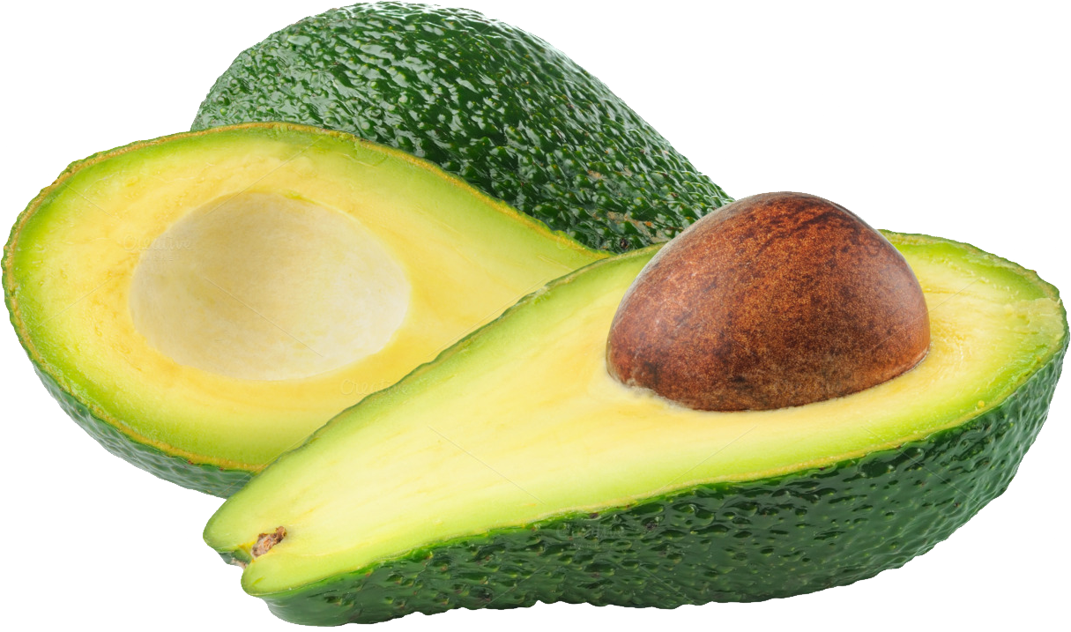
AVOCADO:
Calories: 122 kcal
Energy: 509 kJ
Protein: 1 g
Carbohydrates: 3 g
Fat: 12 g
Fiber: 2 g
Avocado is the ideal vegetable for healthy weight loss. It cintains 20 types of vitamins for example K, C, B and E. It also protects eyes and vision.

Slide 6
BANANA:
Calories: 85 kcal
Energy: 354 kJ
Protein: 1 g
Carbohydrates: 20 g
Fat: 0,22 g
Fiber: 2 g
We can find vitamins B, C, E and K in bananas. They help with heart deseases and diarrhea. Bananas also make mosquito bites less itchy.

Slide 7
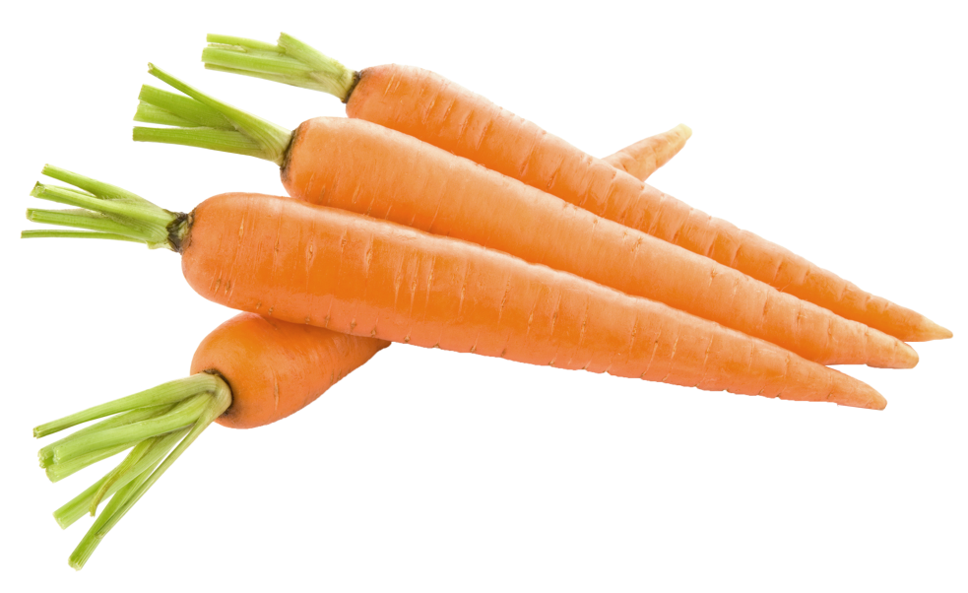
CARROT:
Calories: 35 kcal
Energy: 148 kJ
Protein: 1 g
Carbohydrates: 7 g
Fat: 0,22 g
Fiber: 4 g
Carrot, as well as blueberries can make your sight better. It is tasty and rich in vitamin A, C and D. It is also good for tooth and joint pain.

Slide 8
ORANGE:
Calories: 75 kcal
Energy: 312 kJ
Protein: 1 g
Carbohydrates: 17 g
Fat: 0,5 g
Fiber: 5 g
Contains more vitamin C than any other fruit, which means it is really good for you. It prevents you from getting cold and fever and it can have calming effect.

Slide 9
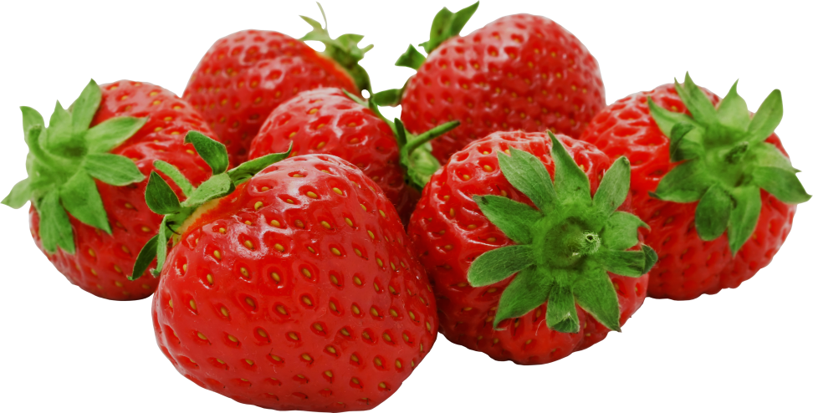
STRAWBERRIES:
Calories: 17 kcal
Energy: 73 kJ
Protein: 0,39 g
Carbohydrates: 3 g
Fat: 0,19 g
Fiber: 0,88 g
In this tasty fruit you can find vitamins C, A, B and E. They are commonly used in cosmetics, because they make your skin stronger and brighter.

Slide 10
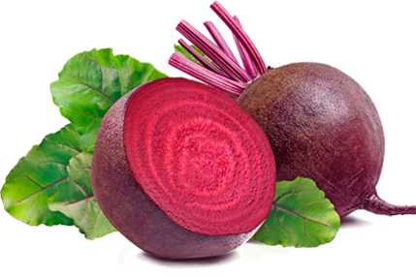
BEET:
Calories: 45 kcal
Energy: 189 kJ
Protein: 2 g
Carbohydrates: 10 g
Fat: 0,1 g
Fiber: 3 g
Beet makes you feel happier and optmistic. Plus it is healthy and helps your body produce red blood cells. It contains vitamins C and B.

Slide 11
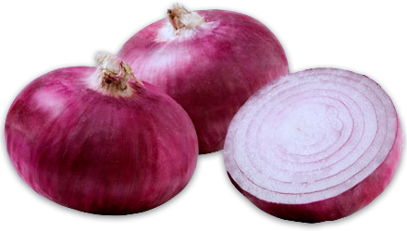
ONION:
Calories: 22 kcal
Energy: 91 kJ
Protein: 0,71 g
Carbohydrates: 4 g
Fat: 0,12 g
Fiber: 1 g
Is one of the best foods for your immunity and healthy body. Contains vitamins C, B and A and is good for bones of older people

Slide 12
AND WHAT DO THE KIDS FROM OUR SCHOOL LIKE?

Slide 13
FRUIT:

Slide 14
VEGETABLES:

Slide 15
THANK YOU FOR YOUR ATTENTION!
Erasmus+, Slovakia
By Emma and Katka

