Slide 1
Gifts Of Nature
Delicious and Easy Fresh Banana Almond Milk Recipe
SİBEL İREM SELVİ
TURKEY

Slide 2
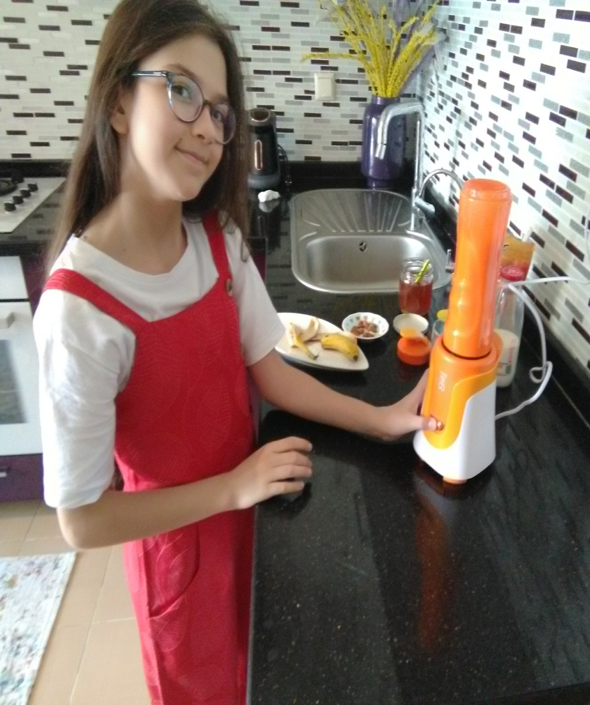
Delicious and Easy Fresh Banana Almond Milk Recipe
I’m here with a super drink recipe which I drink before going to school everyday.
The ingredients are:

Slide 3
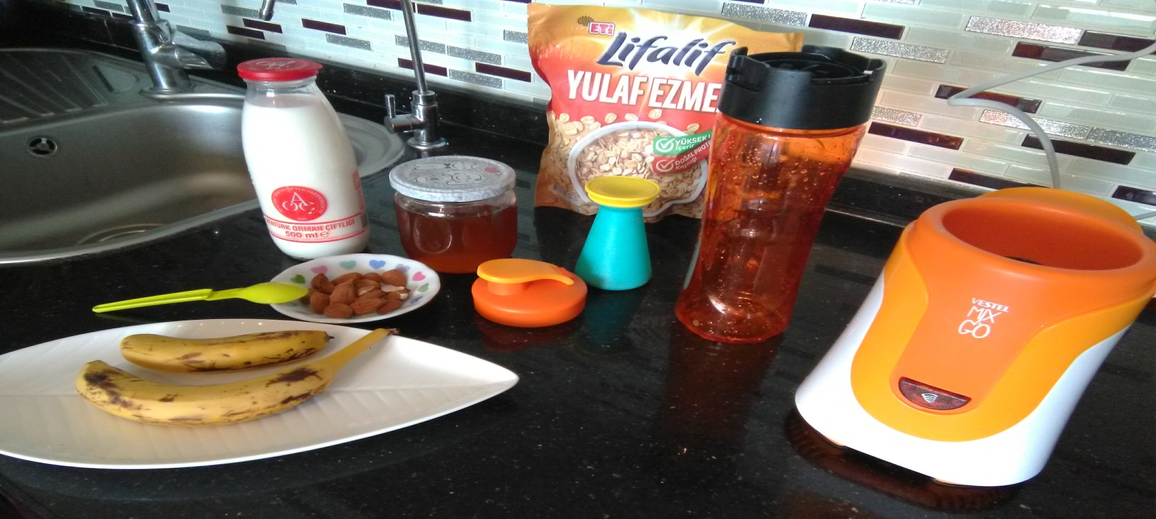
1 Anamur banana. (Anamur is a city in Turkey which is famous for bananas)
1 glass of milk
4 or 5 almonds
1 spoon of honey (organic one)
1 spoon of oat (organic one)
1 spoon of cinnamon

Slide 4
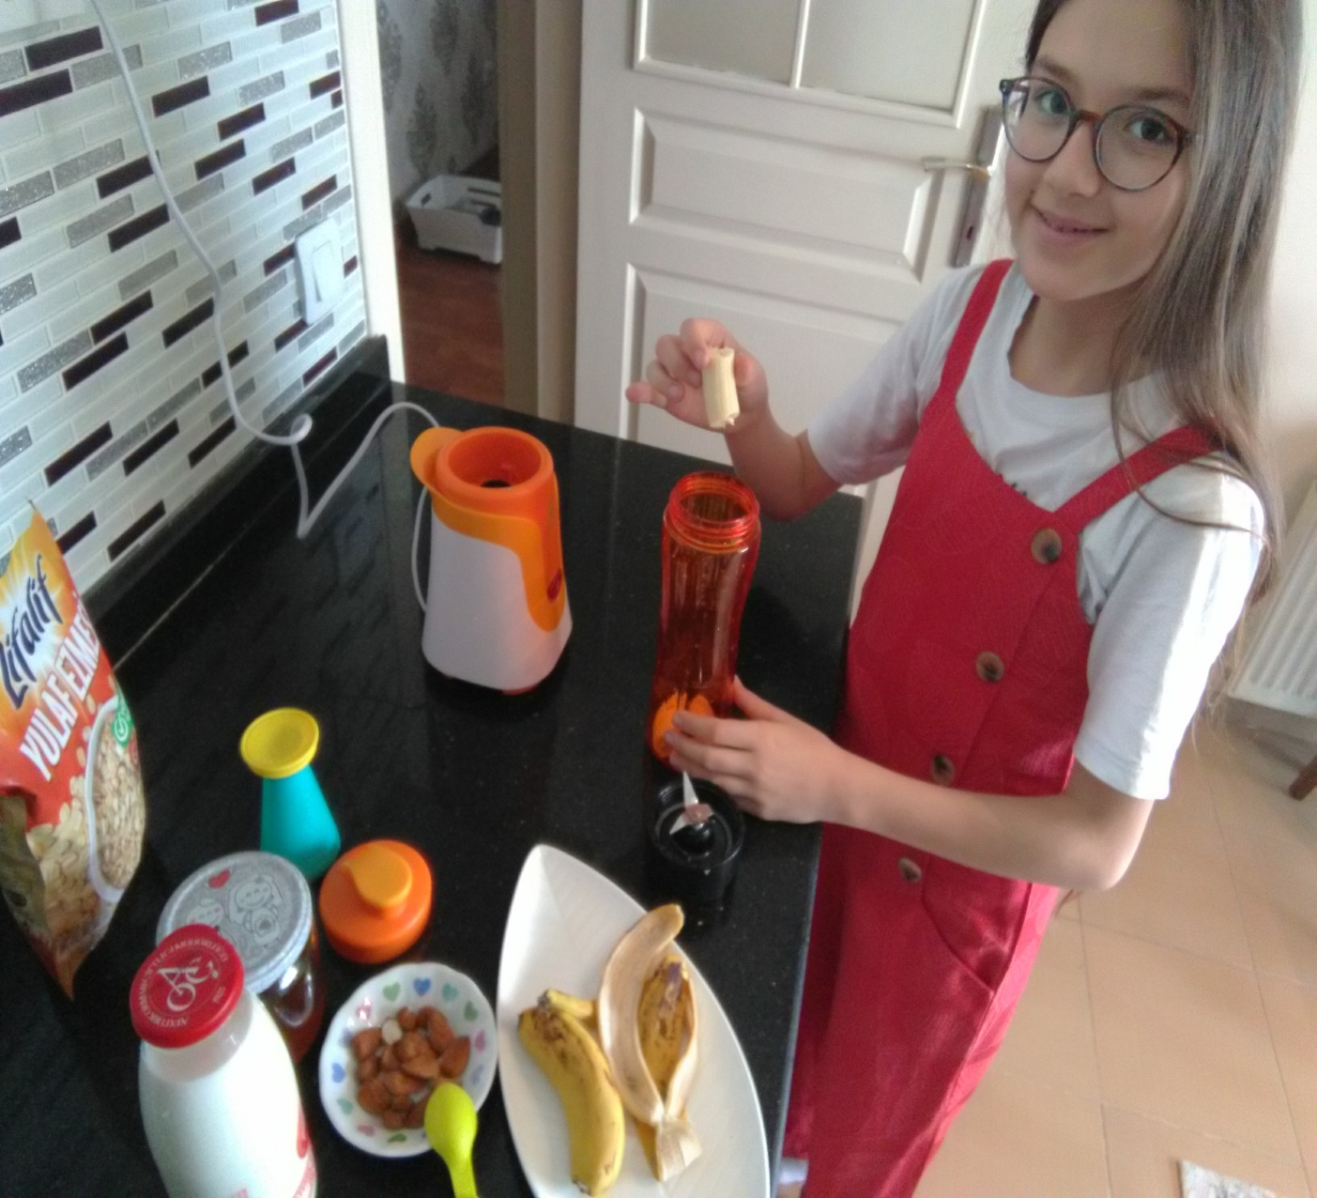
How to Make
I’m cutting up my banana into small slices.

Slide 5
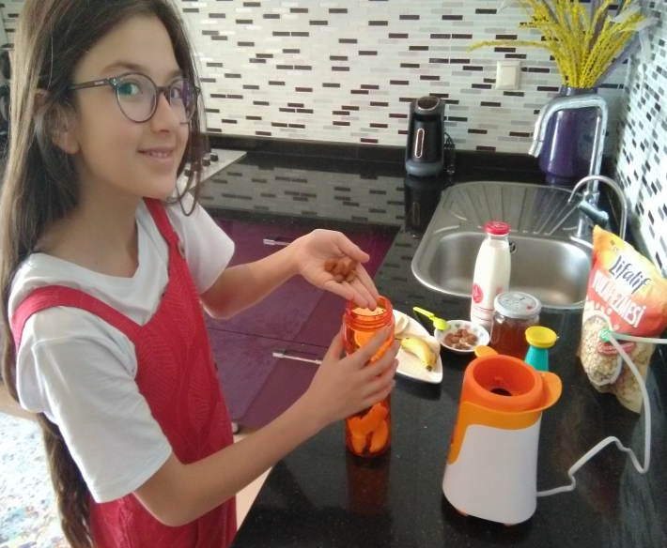
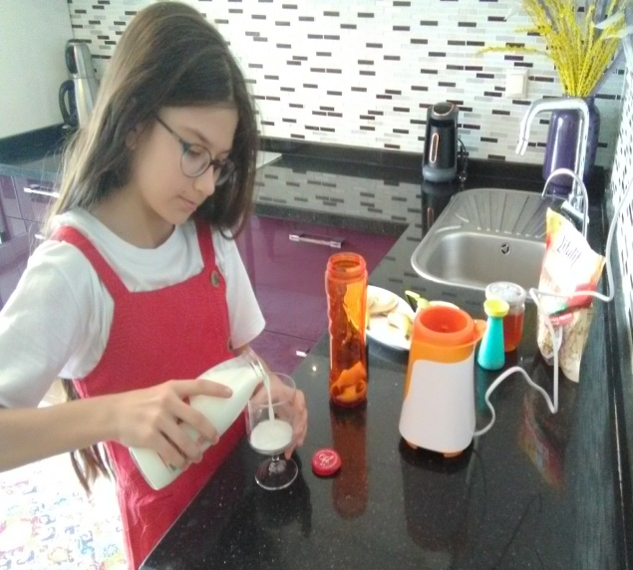
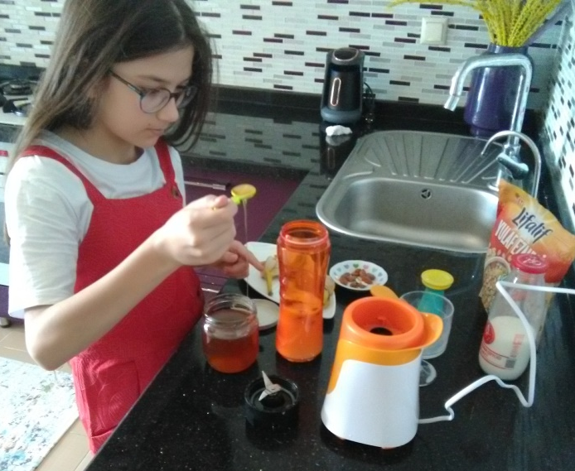
How to Make
Then, I’m combining all ingredients; milk, banana, almonds, cinnamon and oat in a blender.

Slide 6
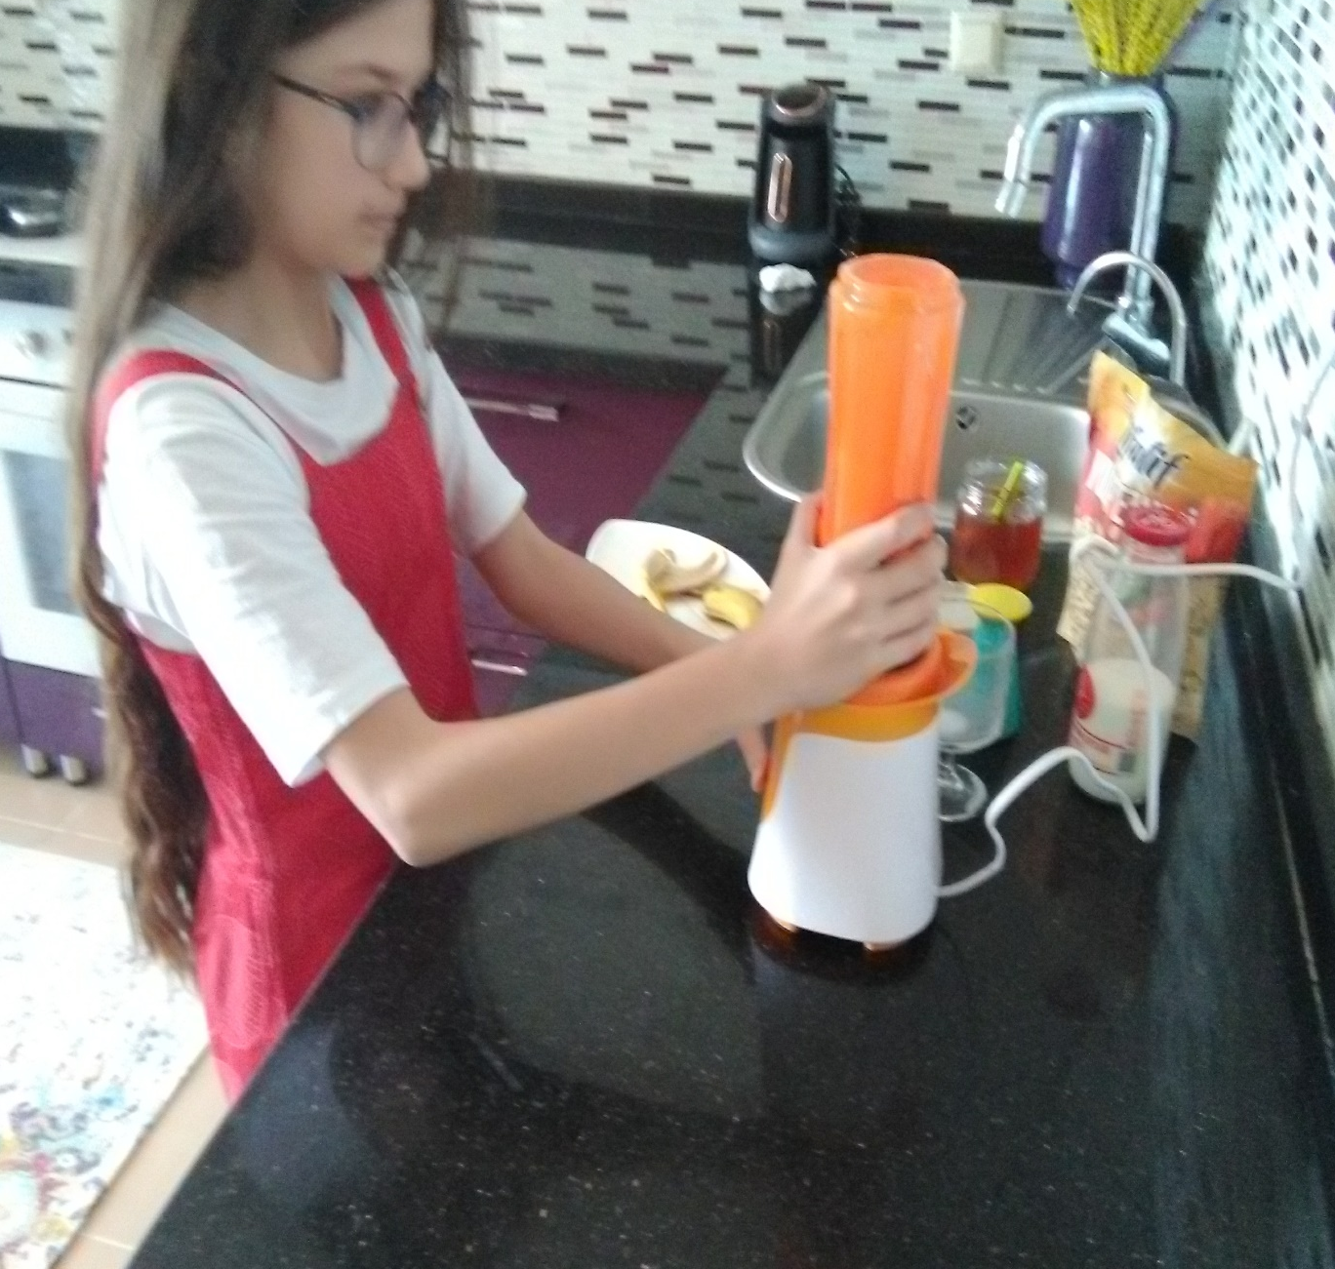
How to Make
After that, I’m blending then for just 20 seconds and our delicious drink is ready.

Slide 7
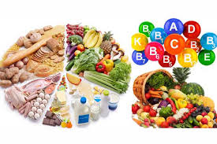
This drink is made up with very healthy things and will make us energetic.

Slide 8
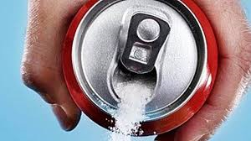
And you’ll see that whole day its effect continues by contrast with fizzy drinks because fizzy drinks don’t have natural vitamins and even they have refined sugar.

Slide 9
İn this point, I want to take your attention to one of my ingredients: honey! Is there a more natural sugar in the nature? And this sugar thing is not best thing about my drink.

Slide 10
Yes, be ready! You know, fizzy drinks not only have refined sugar but also they have additive agents and they can make us obese or ill.

Slide 11
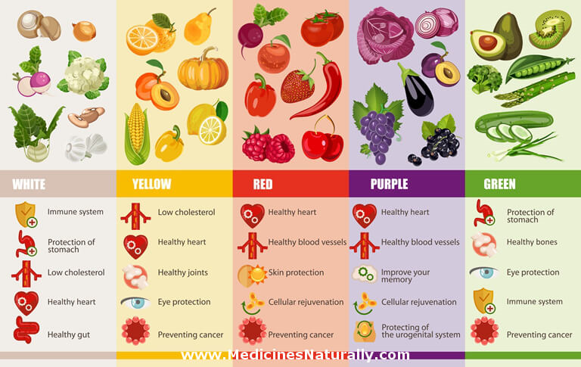
However, our drink has A, B, C, K vitamins and calcium, phosphor, iron, and potassium and all of them are natural.

Slide 12
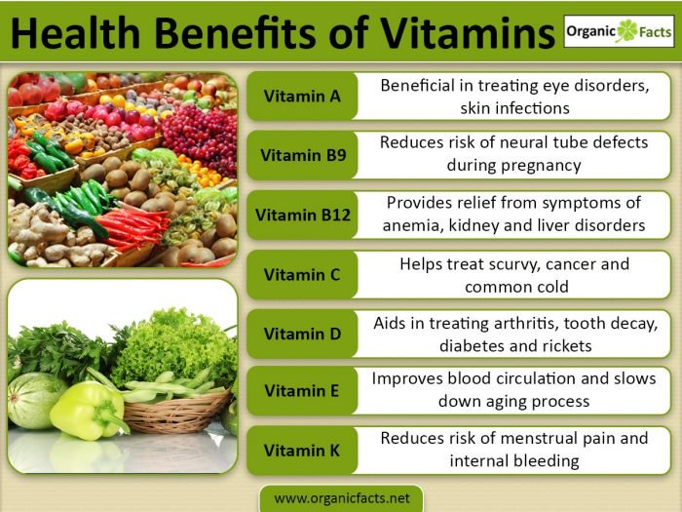
So, thanks to its mineral and vitamins.
It meets with our daily energy need,
It protects us from illness,
It is very good for our brain,
It makes our muscles improve

Slide 13
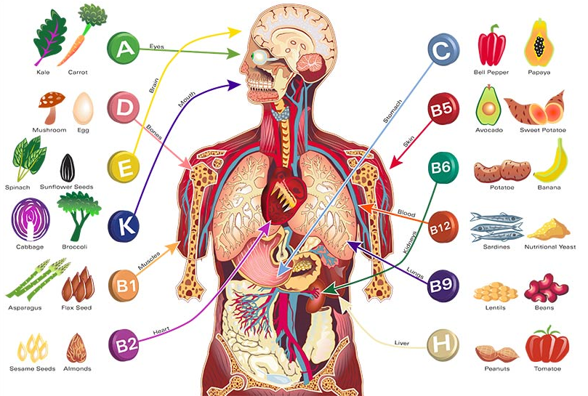
Finally, I want to ask you?
Do you prefer a drink with full of vitamins or a calorie bomb drink?
Make your choice!

Slide 14
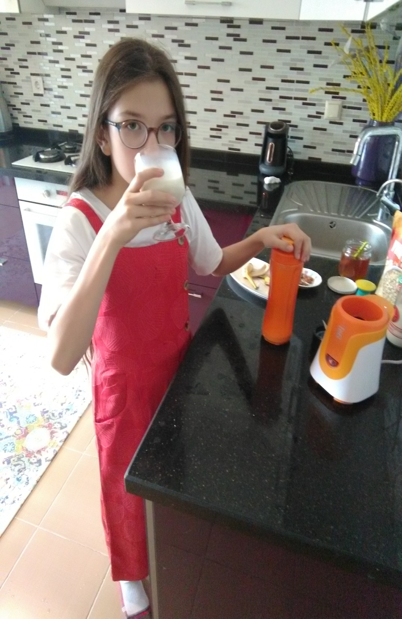
Thank you for listening to me.
Enjoy your drink!

