Slide 1
WELCOME TO QUIZ FROM
SLOVAK GIRLS

Slide 3
What is the name of the park we went to?
What is the capital city of Romania?
What is the name of the city we stayed in?
Where were we on last day of our trip?
Where did we eat our frist lunch?
Project is called Gifts of ............
What was the name of monument which we visited? Gate of ..........
Which country did five girls come from?
What was the name of the orchestra in the old town?
Which other city did we visit?
What was the name of the colum?

Slide 4
R | O | M | A | N | E | S | C | U
B | U | C | H | A | R | E | S | T
 |  |  | C | R | A | I | O | V | A
 |  |  |  |  | S | T | A | D | I | U | M
S | H | A | O | R | M | A
 |  | N | A | T | U | R | E
 |  |  | K | I | S | S
 |  |  |  | S | P | A | I | N
 |  | P | H | I | L | H | A | R | M | O | N | I | C
 | T | A | R | G | U |  | J | I | U
E | N | D | L | E | S | S

Slide 5
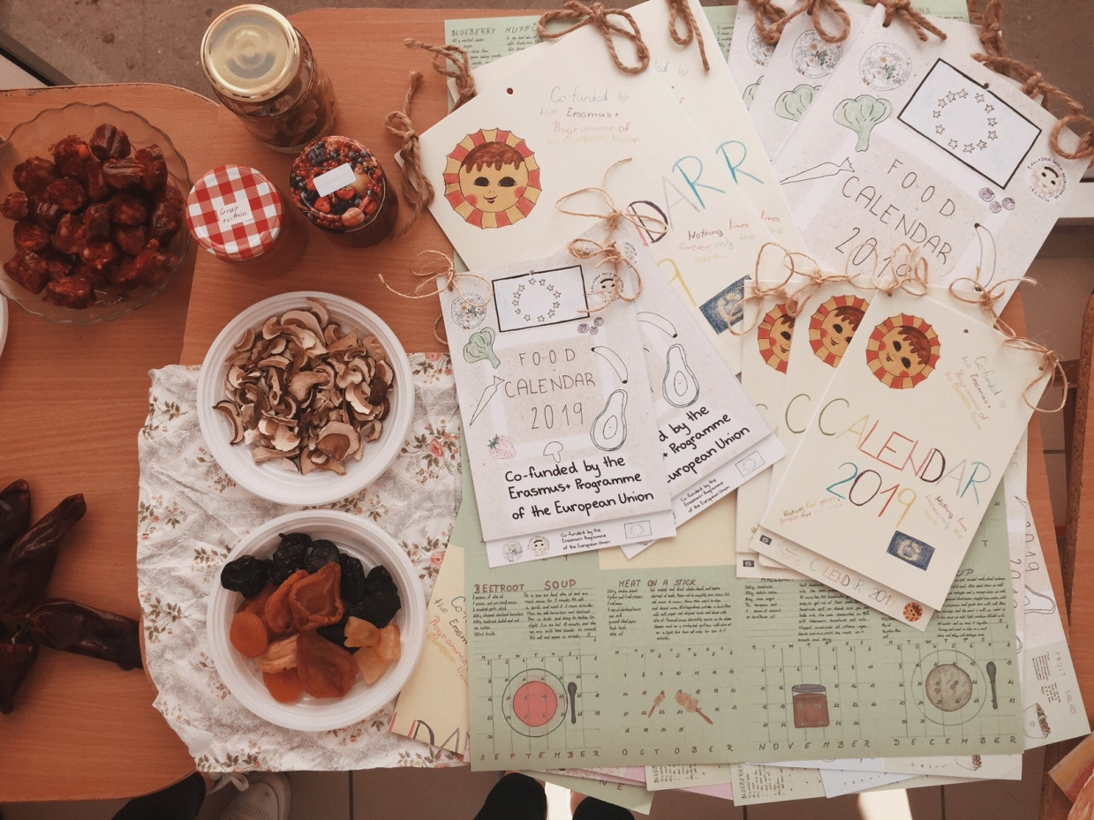
1. Which country made this?
Turkey
Slovakia
Romania

Slide 6
1. Which country made this?
Turkey
Slovakia
Romania

Slide 7
2. What is the traditional romanian food?
Mici
B) Sarmale
C) Cighiri

Slide 8
2. What is the traditional romanian food?
Mici
B) Sarmale
C) Cighiri

Slide 9
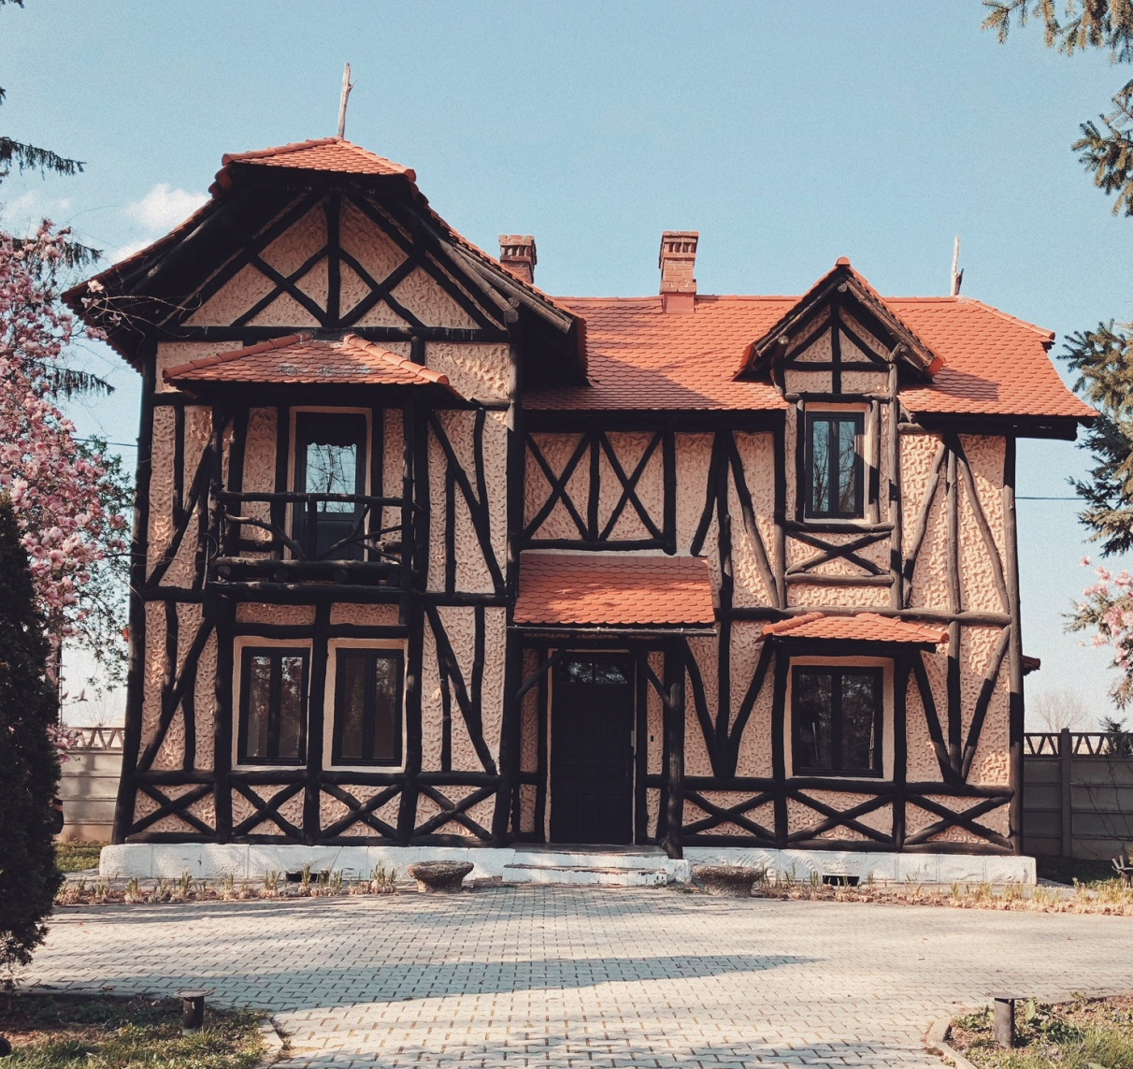
3. Which park was this cottage located in?
Nicolae Romanescu Park
Ceahlău National Park
Retezat National Park

Slide 10
3. Which park was this cottage located in?
Nicolae Romanescu Park
Ceahlău National Park
Retezat National Park

Slide 11
4. How do you say thank you in Romania?
vă rog
Mulțumesc
scuze

Slide 12
4. How do you say thank you in Romania?
vă rog
Mulțumesc
scuze

Slide 13
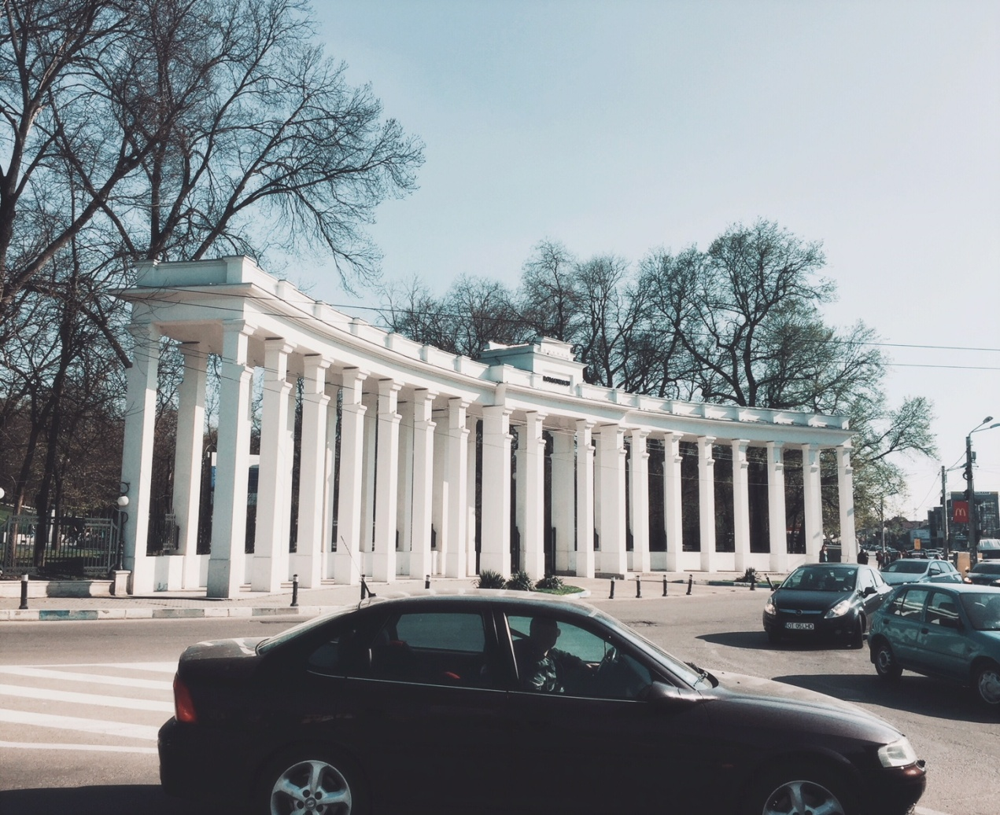
5. What is this?
A school
A colloseum
The entrance to a park

Slide 14
5. What is this?
A school
A colloseum
The entrance to a park

Slide 15
6. What is the capital city of Romania?
A) Transylvania
B) Bucharest
C) Craiova

Slide 16
6. What is the capital city of Romania?
A) Transylvania
B) Bucharest
C) Craiova

Slide 17
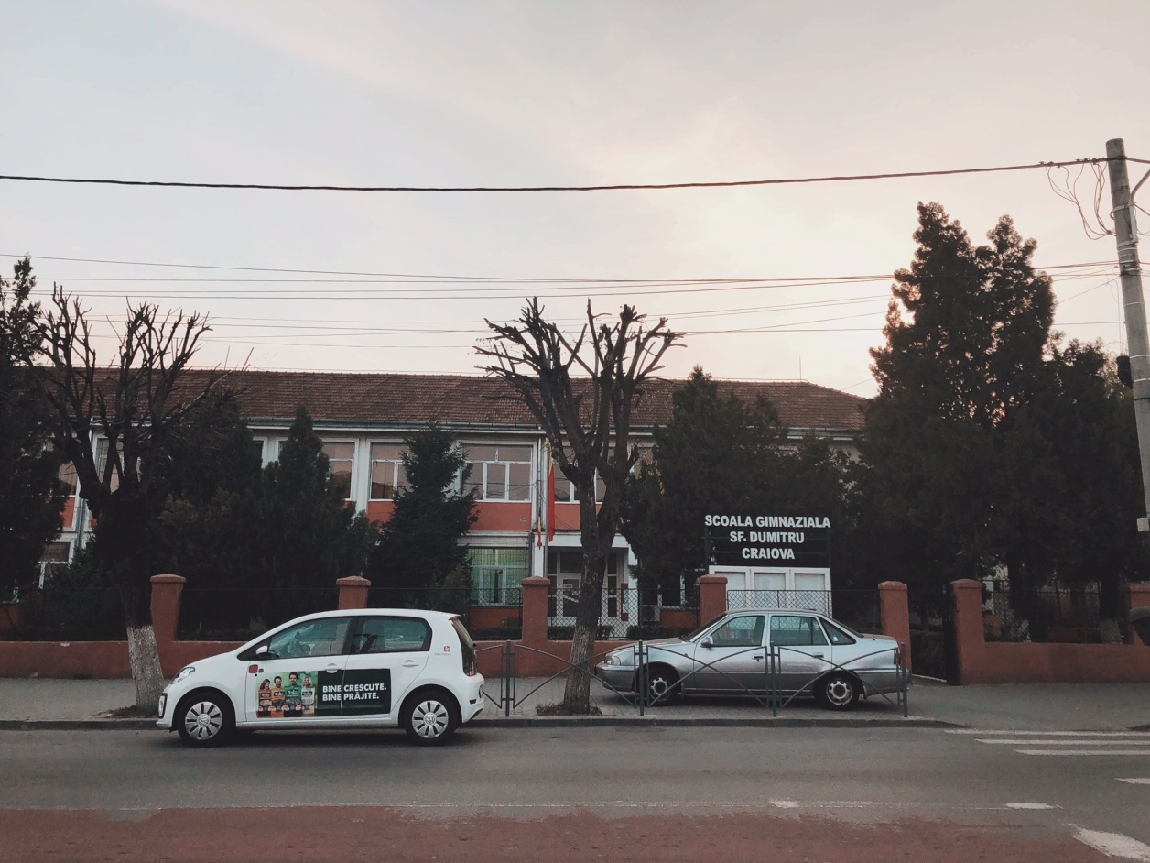
7. What is the name of this school?
SF. DEMETERU
ST. DUMITRU
SF. DUMITRU

Slide 18
7. What is the name of this school?
SF. DEMETERU
ST. DUMITRU
SF. DUMITRU

Slide 19
8. How do you say hello in Turkish?
Salem
Selam
Solange

Slide 20
8. How do you say hello in Turkish?
Salem
Selam
Solange

Slide 21
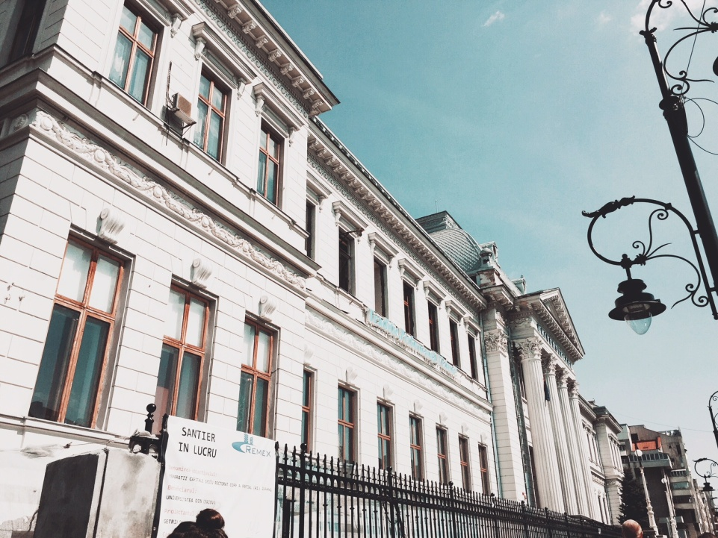
9. Where is this university located in?
Craiova
Targu Jiu
Bucharest

Slide 22
9. Where is this university located in?
Craiova
Targu Jiu
Bucharest

Slide 23
THANKS
FOR
YOUR
ATTENTION
d.e.k.

