Slide 1
PREPARING FOOD FOR WINTER

Slide 2
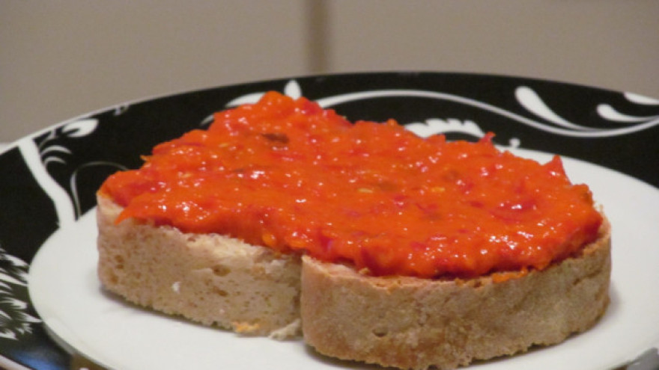
AJVAR
Ingredients:
10 kg red peppers
3 big eggplants
5 dcl of oil
salt
1 big spoon of sugar

Slide 3
PREPARATION:
Grill the peppers and place them in a bowl immediately after grilling and cover it with a kitchen cloth to soften the skin so it could be easy to peel them. After peeling each pepper clean them from the seeds and put them in a large bowl. Repeat the same process with the eggplants.
Put everything into a large pot and cook on a light fire.
During cooking, the mixture should be continuously mixed and add the oil by 1 dcl every 20 minutes, stir constantly so that the oil can not break the surface. The easiest way to make sure that the chutney is finished go trough the mixture with a wooden spoon scrape the bottom of the pot, if you can see the bottom of the pot the chutney is cooked.
Add salt and sugar at the end, in the last 20 minutes of cooking.
Meanwhile, while cooking the mixture, you need to prepare jars. Sterillize in the oven at 50 degrees . Put the mixture in the jars and place them in the box and cover it with a tablecloth and a blanket.
Leave them covered for 24 hours, then save them in a cold and dark place.

Slide 4
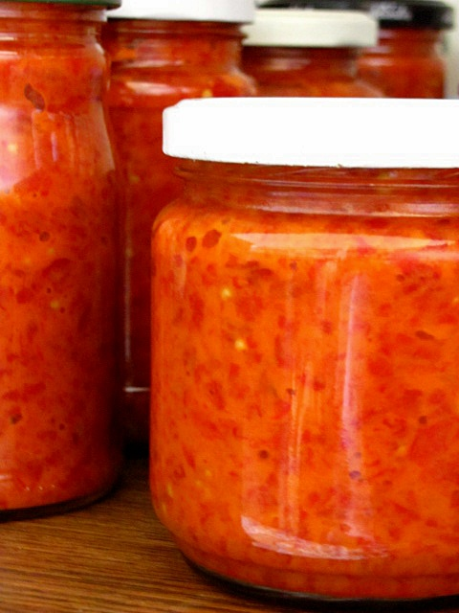
Why we prepared ajvar?
Ajvar is rich with vitamin C, because peppers contain a lot of that vitamin, it improves the immune system and the overall functionation of the organism. Ajvar is also rich with vitamin A. Eggplants contain required amount of vitamin B2 and folic acid. Ajvar also contains a useful amount of fibers which is good for our digestion.

Slide 5
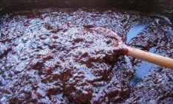
Plum jam
Ingredients:
5 kg cleaned plums,
1 kg sugar,
2 spoons of cinnamon
Preparation
The plums need to be well washed and have removed the skin.
Then mix the plums with half of the sugar in a large pot with a thicker bottom and cook on the light fire with occasional mixing with a wooden spoon. In the beginning it is necessary to mix more often so that the jam does not burn.
When the plums are completely disintegrated (approximately 4 hours of cooking), add the remaining sugar (specify the exact amount according to your taste) and continue cooking to evaporate the excess liquid. The jam is cooked when it is thick and has lost all the liquid.
At the end of the cooking, you can chop plums with the blender and optionally add some cinnamon.

Slide 6
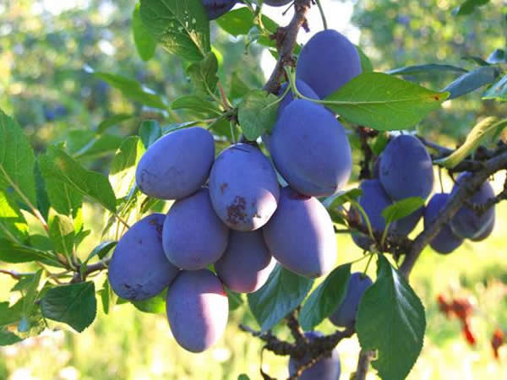
PLUM BENEFITS
Plums are excellent source of vitamin C, K, E, B6 and folic acid and niacin. The most prominent minerals in this fruit are copper, potassium, magnesium, iron, and pine. Plums are powerful antioxidant.
Beta cryptoxanthin contains in plum reduces the risk of developing lung cancer by more than 30% and arthritis by as much as 41%.
Plums contain citric acid, which eliminates fatigue, prevents spasms, and improves liver and improve digestive.
Plums abound with fibers that contribute to proper digestion and healthy metabolism.

Slide 7
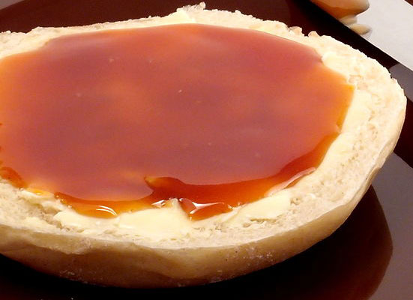
BRIAR JAM
Ingredients
8 kg of pure briar
5 kg of sugar
Tools and accessories
Press
strainer
gauze
gloves
Preparation
Remove the black parts from briar. Pour the sauce into a deep pot, then pour the water and boil it until it’s soft.
Mash them , then cook it again (make sure it does not burn), repeat the process once again and help with warm water again to rinse the dough from the rod.
This is the first stage of the process. Filter all the juice through the barn. Many go trough the gaze again, gently. Put on fire to cook. When the amount of liquid is halfed, put the sugar in and cook again and mix until it gets dark. Check the density frequently. Place a spoon on a plate and cool it. Heat a hot saucepan in warmed pots, put in a warm oven and leave it overnight to catch the basket. Put the lids on in the morning.

Slide 8
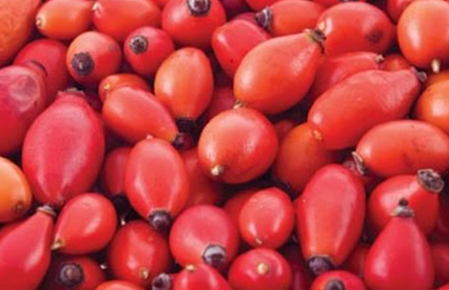
BRIAR BENEFITS
It contains plenty of vitamin C, and a higher amount of folic acid and vitamins A and E, and minerals have a special place for potassium. There are very powerful forms of antioxidants that protect the cells in the juice.

Slide 9
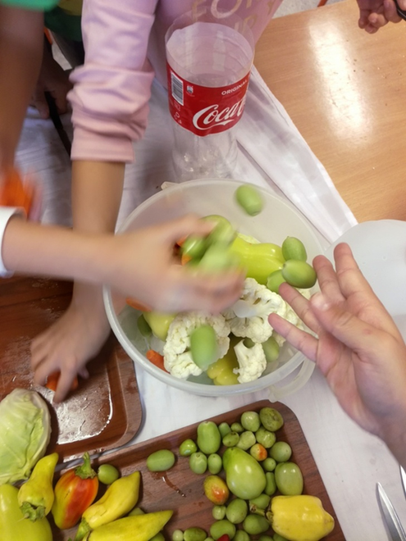
TURŠIJA
Ingredients:
2 kg peppers
2 kg green tomatos
2 kg cucumbers
2 kg cauliflower
1 kg carrots
As you wish onions, cabage
Liqiud for pouring
1 l boiled water
9 l cold vode
300 g salt
200 g sugar
2 L 9 % vinegar
1 bag of pepper in the grain
2 vinyl bags
2 bags of preservatives

Slide 10
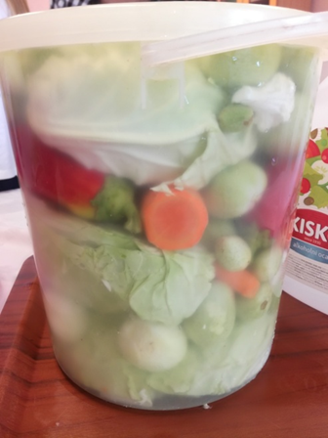
Preparation:
Vegetables should be washed well, peel the carrots and cut it into 4 pieces.
Poke peppers and tomatos a little to cook better. Break a part the cauliflower, clean the cabbage from the outer leaves and cut it to quarters. Wash the cucumbers. Boil 1L of water with sugar, salt and pepper. Put in warm liquid vinegar, vinobran, preservative and all this put together with cold water. Put the vegetables in the bowl, pour ,close and leave in a dark, cold place.

