Slide 1
BASQUE LANGUAGE

Slide 2
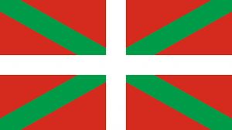
INDEX
“EUSKARA” THE BASQUE LANGUAGE
THE USE OF BASQUE
THE FIRST TEXTS IN BASQUE
DIALECTS OF THE BASQUE LANGUAGE
EUSKARALDIA
BASQUE IN THE WORLD
THINGS THAT YOU DON’T KNOW ABOUT BASQUE
DICTIONARY

Slide 3
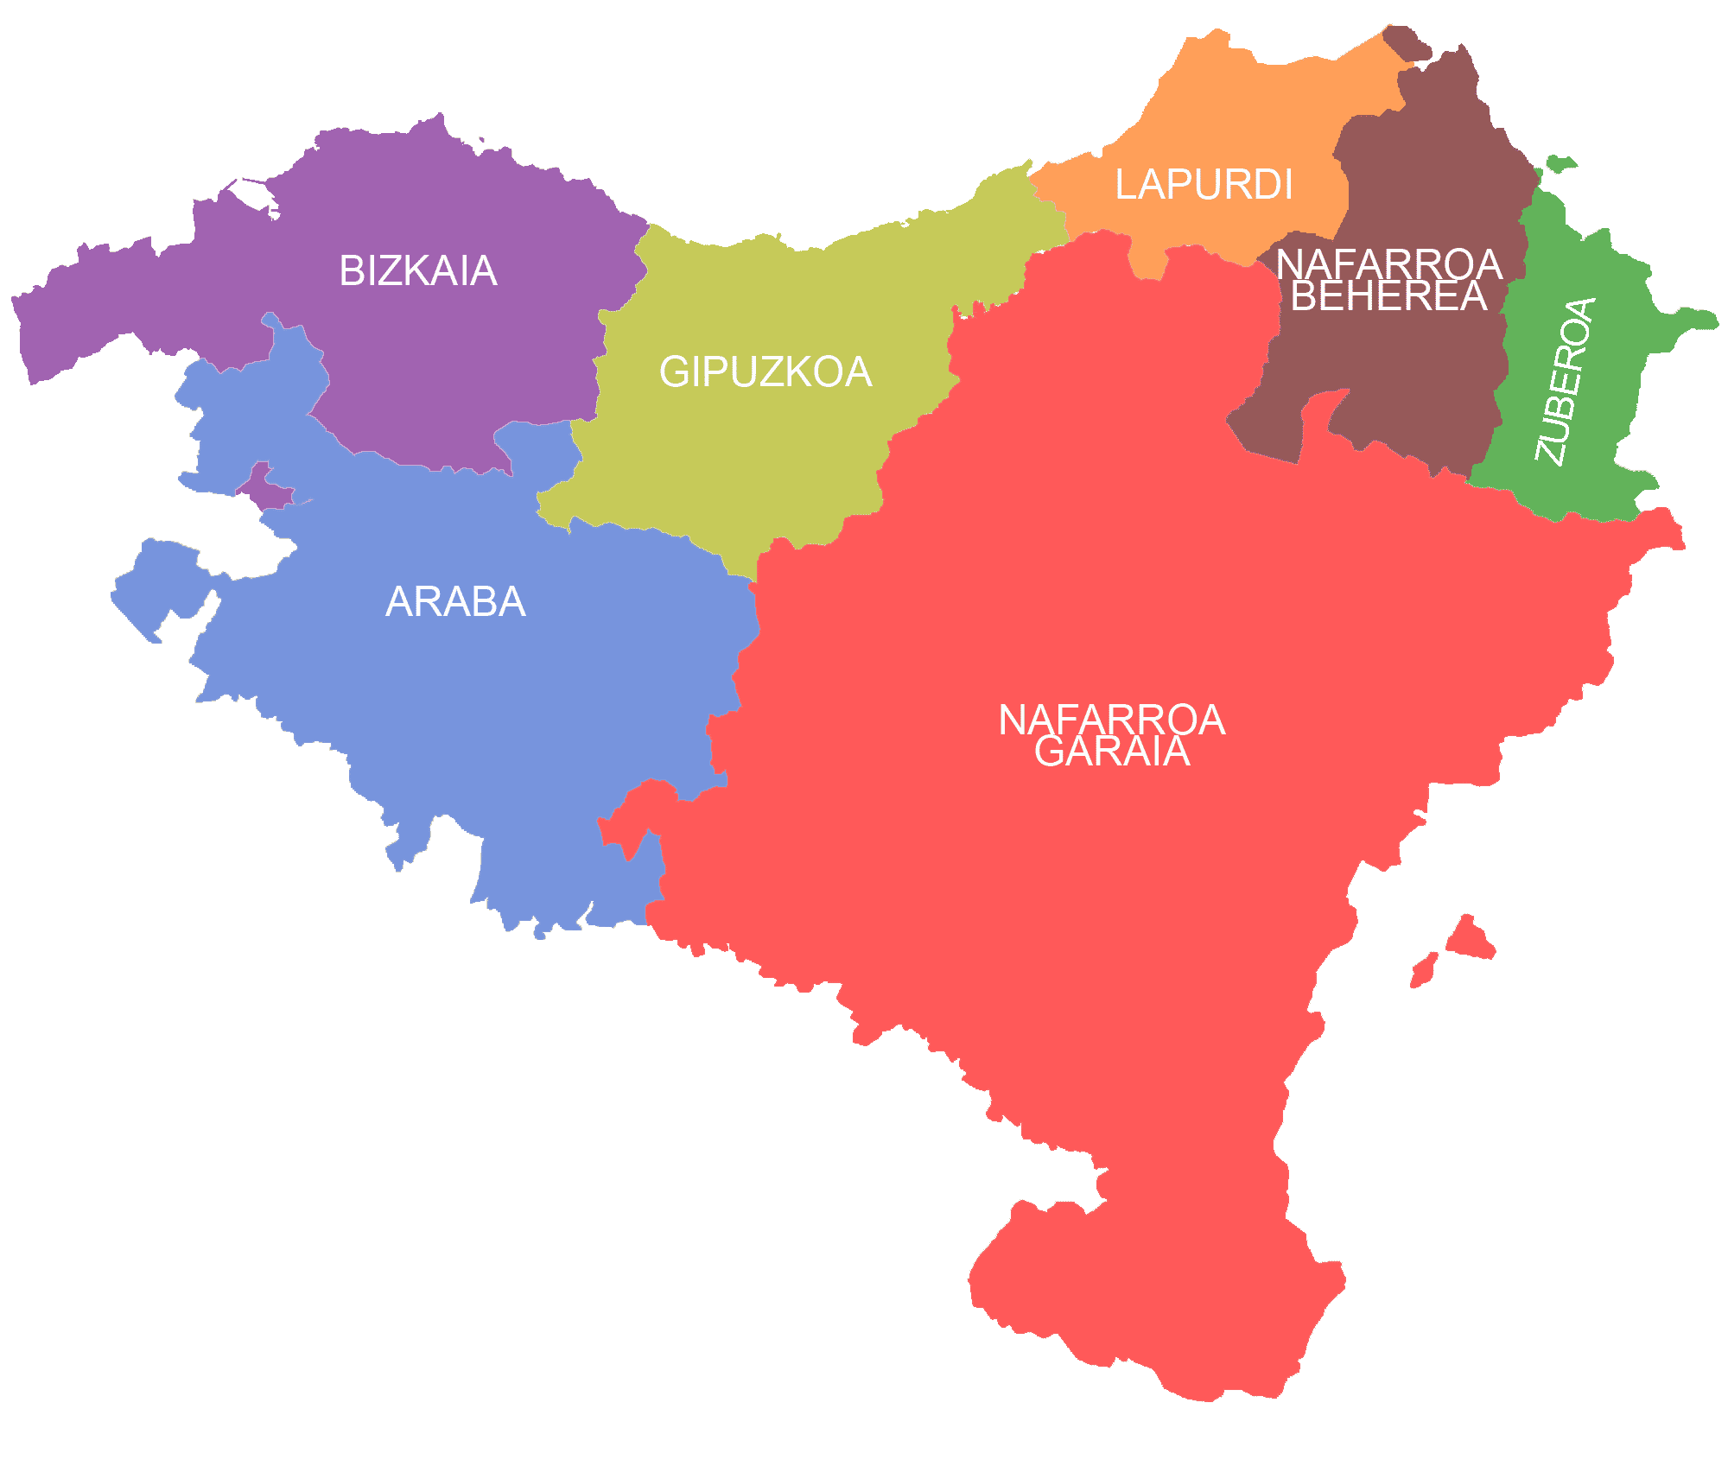
“EUSKARA” THE BASQUE LANGUAGE
Basque “euskara” is a language that is spoken in the Basque Country.
It is one of the oldest languages of Europe .
Basque is one of the few non-Indo-European languages in Europe.
It is the only isolated language in Europe, ( it does not have any relation with any other language).

Slide 4
THE USE OF BASQUE
17.5% of the inhabitants of the Basque Country have basque as a native language.
93.2% of the speakers of the Basque language live in Spain and 6.8% in France.
400,000 people understand the Basque language but they have problems to speak it.

Slide 5
THE FIRST TEXTS IN BASQUE
The first written texts in basque are from the 16th century, even though in the 10th century appears sings or words in texts of other languages.
The first book in basque is Linguae Vasconum Primitiae, written by Bernard Dechepare in 1545.

Slide 6
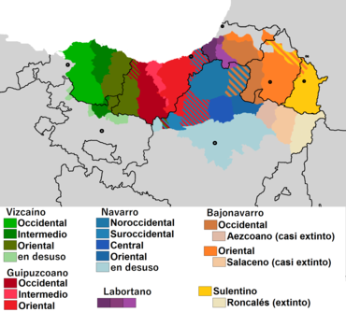
DIALECTS OF THE BASQUE LANGUAGE
“Euskera batua” is the most used dialect of the basque language. It is used in public administrations, mass media, education and literature.
There are more dialects but we used them only to speak.

Slide 7
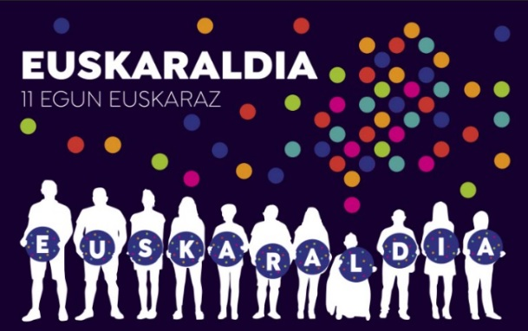
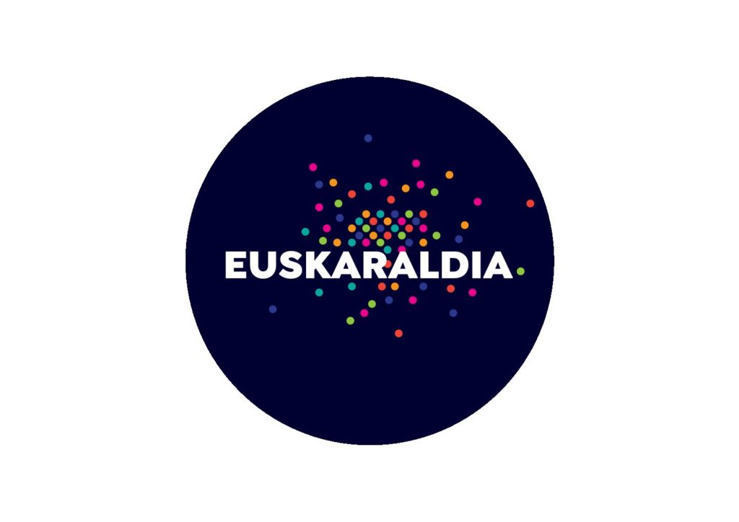
WHAT CAN WE DO TO IMPROVE THE BASQUE LANGUAGE?
EUSKARALDIA is a proyect to improve the use of basque. During 11 days, since 23rd of november till 3rd of december, 200.000 people, who loves basque, took part this year.
The objective is that the largest number of people use Basque in their daily life. If you take part in Euskaraldia you can choose between Ahobizi or Belarriprest
-If you are Ahobizi, it means that you are going to speak in Basque.
-If you are Belarriprest that means you can understand Basque so you want people talk to you in Basque.

Slide 8
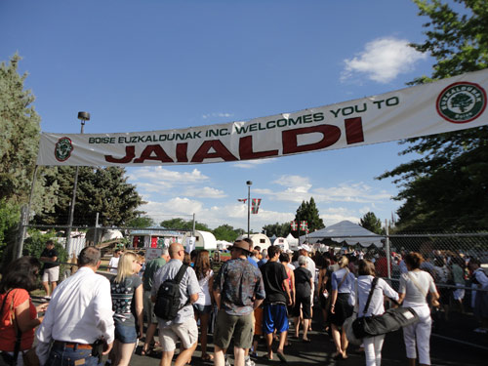
BASQUE IN THE WORLD
Over the years, many Basque people have left Basque Country in order to find a better life.
Most of them went to America but they still have a special feeling for their land. To remember their origins they created the Basque houses “euskal etxeak”.
Nowadays about 2000 people study Basque in 71 basque houses from 62 cities in 17 countries.
In Boise (Idaho) every five years is celebrated the biggest Basque festival outside Euskal Herria.

Slide 9
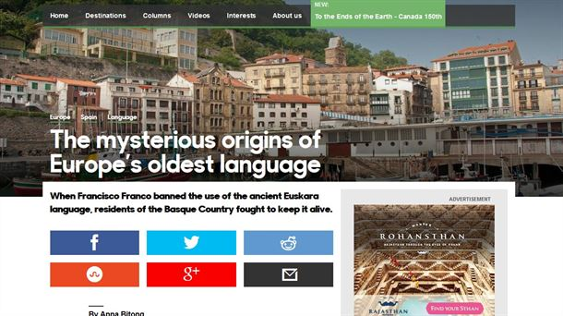
THINGS THAT YOU DON’T KNOW ABOUT BASQUE
You know that in Canada and Iceland they spoke the language “pidgin” and that it had Basque words by the influence of our “arrantzales” ?
In 1944 a group of parents clandestinely created the first “ikastola”.

Slide 10
DICTIONARY
Egun on !
Eskerrik asko
Mesedez
Gabon
Zorionak
Zelan zaude
Bihar arte
Kaixo
Good morning !
Thank you
Please
Good night
Happy birthday
How are you
See you tomorrow
Hello
BASQUE
ENGLISH

