Slide 1
RECIPES

Slide 2
GREEK SALAD

Slide 3
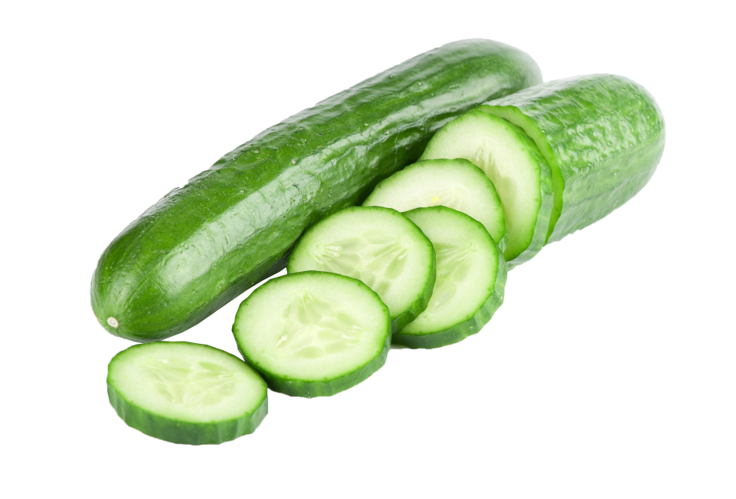
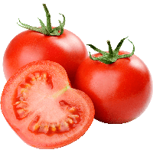
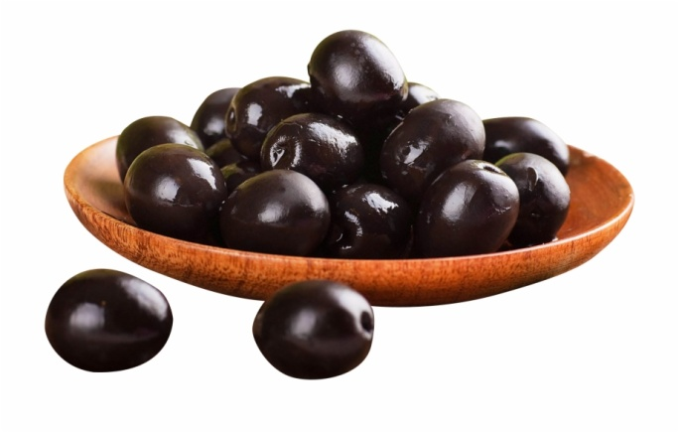
ingredients:
four large tomatoes
one cucumber
half a red onion
16 olives
one tsp dried oregano
85g feta cheese
4 tbsp greek extra virgin olive oil

Slide 4
How to make it:
put all the ingredients together
serve with crusty bread

Slide 5
peaceful pasta with cream sauce and meat

Slide 6
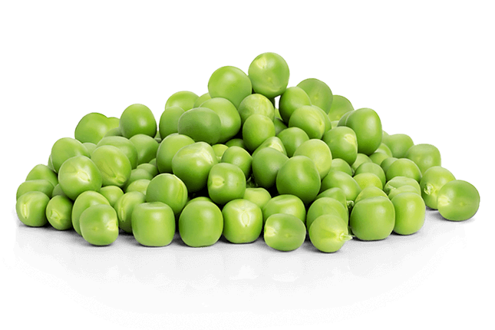
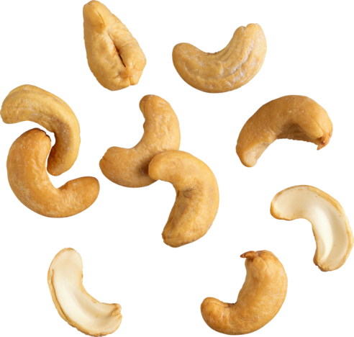
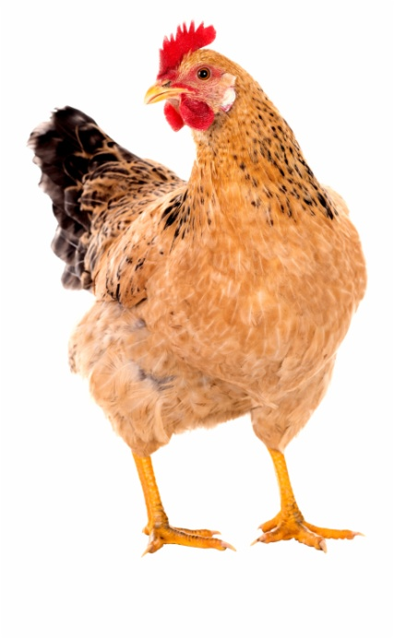
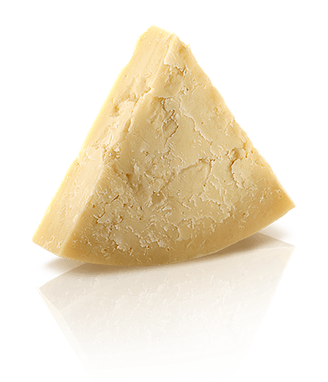
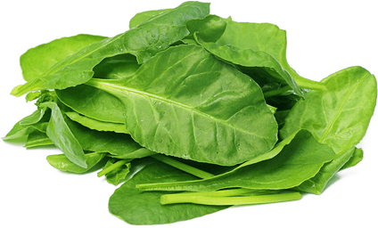
ingredients:
pasta (farfalle)
cream
baby spinach
peas/peace
chicken breasts
cashew nuts
parmigiano

Slide 7
How to make it:
prepare the pasta
sauce: pour the cream, spinach, peas, grated parmigiano and cook them all together (also with already prepared meat cut to small pieces)
rest the nuts on a pan and put them on served meal

Slide 8
Yogurt fruit cake

Slide 9
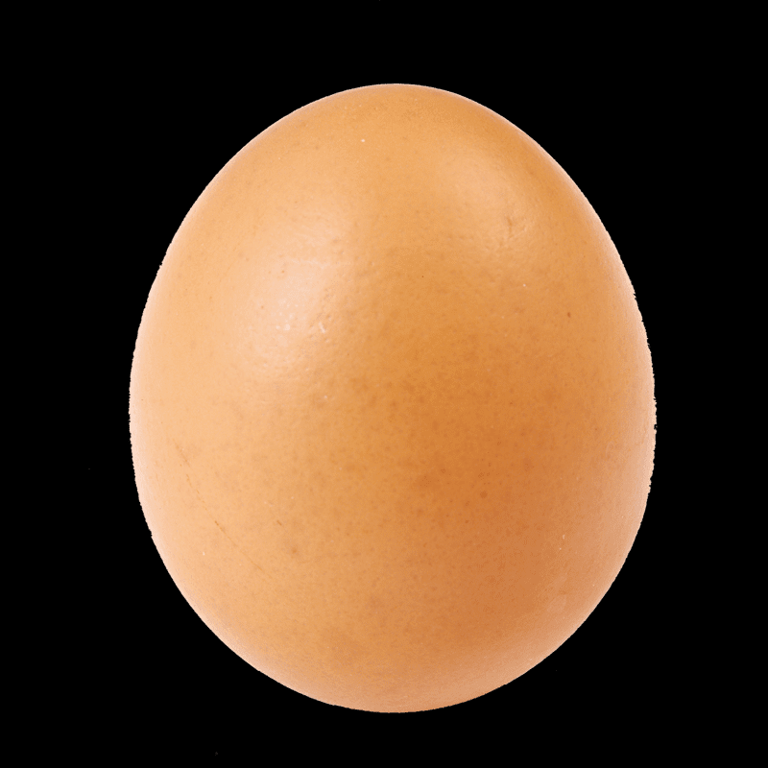
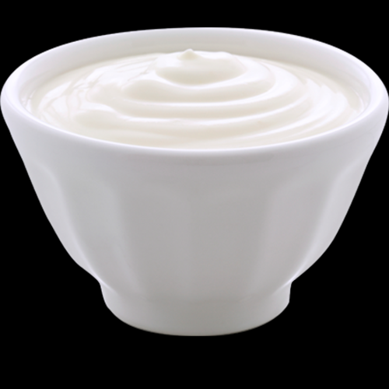
ingredients:
BATTER:
yogurt – 200ml
one egg
brown sugar – 80g
flour – 120g
one vanilla sugar
baking powder – 2tsp
a pinch of salt
fruit – 400-500g
STREUSEL:
butter – 2tbsp
flour – 2tbsp
oatmeal – 2tbsp
brown sugar – 2tbsp
ground cinnamon – ½ tsp (or more)

Slide 10
How to make it:
preheat the oven at 180 degrees,
prepare the streusel: put the flour, oatmeal, sugar and cinnamon on a dry pan and mix them together. It will take about 10 minutes. Let it cool down for a bit and then add the butter you prepared earlier
mix yogurt, egg and both kinds of sugar. Slowly add flour mixed with baking powder and salt. Bake for 40-45 minutes at 170 degrees

